Slide 1
Refugees: The Ins and Outs
Jeroen Doomernik
University of Amsterdam

Slide 2
Legal labels
Refugees
Migrants
  Workers
    Highly skilled
    Seasonal
  Students
  Family members

Slide 3
Fundamental causes
Demographics
Economics
Incomplete nation building
=> Emigration pressure

Slide 4
Fundamental causes
Demographics
Economics (nature of labour market)
Promise of safety and perspective
=> Opportunities at possible destination

Slide 5
Fundamental causes
Both sides brought together by intermediary structures
Colonial links
Economic connections
Networks
  Personal ones (family, friends, acquaintances)
  Impersonal (e.g. human smugglers)

Slide 6
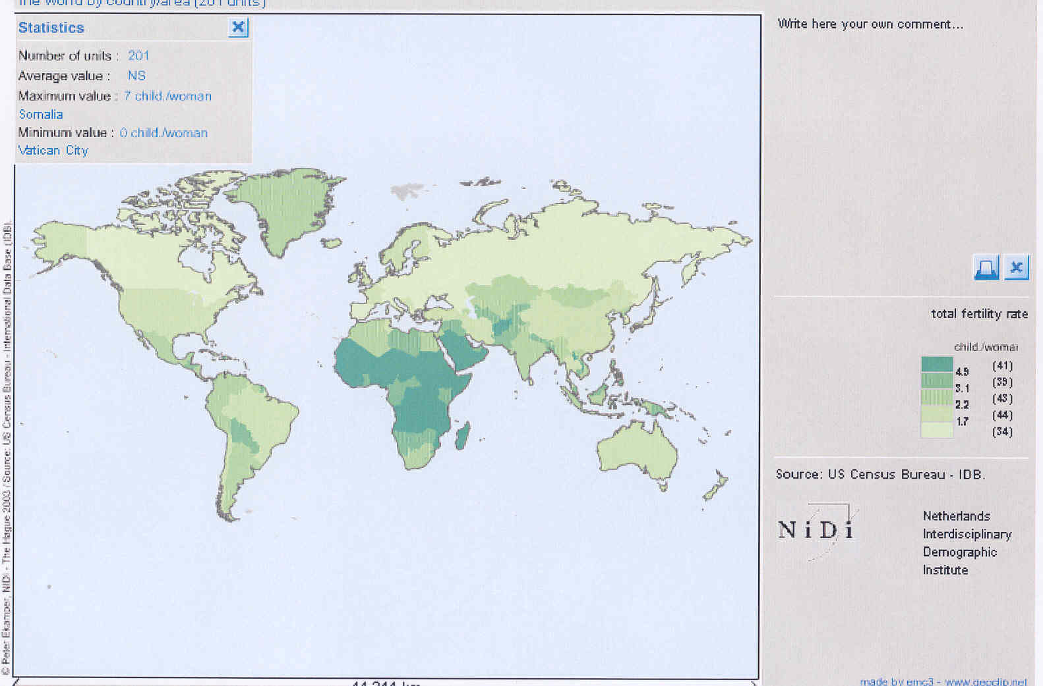

Slide 8
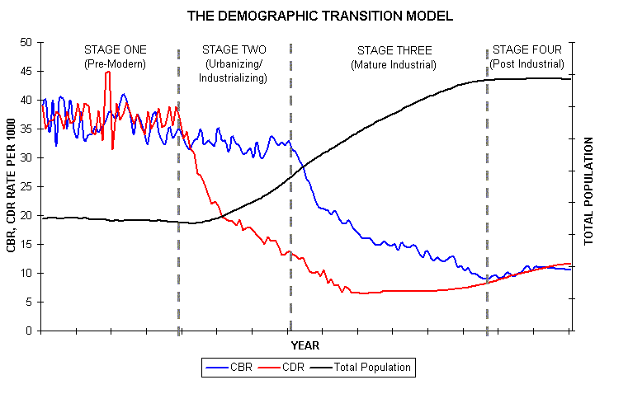

Slide 9
Economy
Continuing (growing?) global disparities

Slide 10
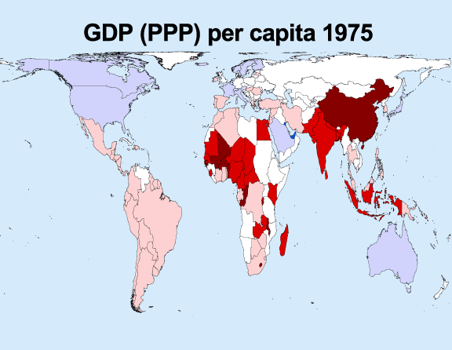

Slide 11
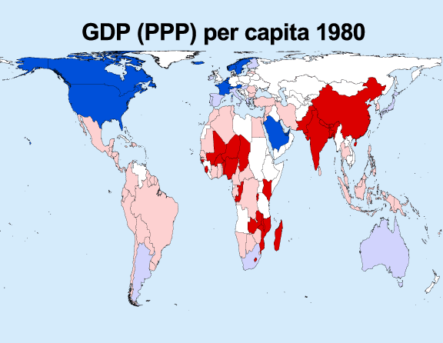

Slide 12
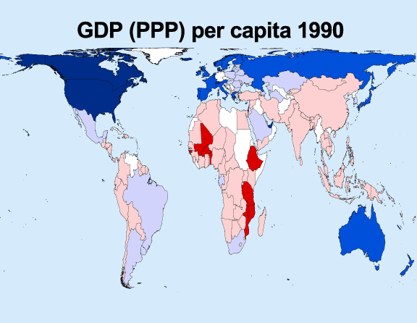

Slide 13
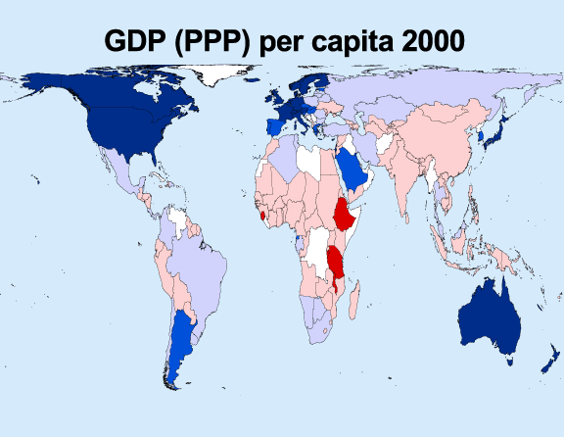

Slide 14
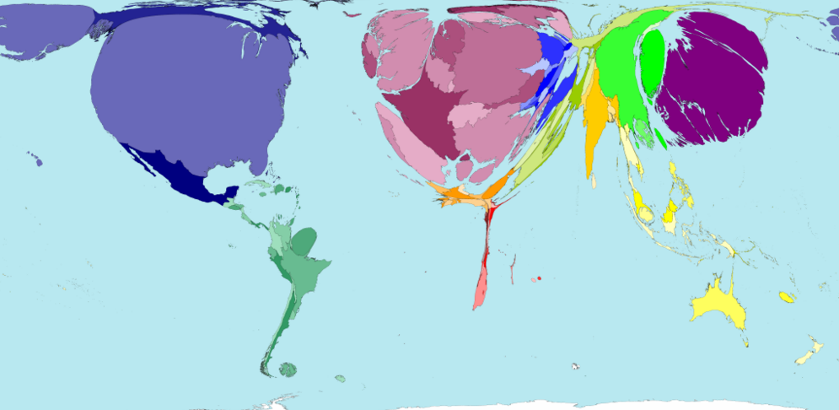

Slide 15
Post-colonial nations
Competition (incomplete nation building) in combination with:
Ethnic strife
Poor or failing governance/governments
Invasions in other/neighboring states

Slide 16
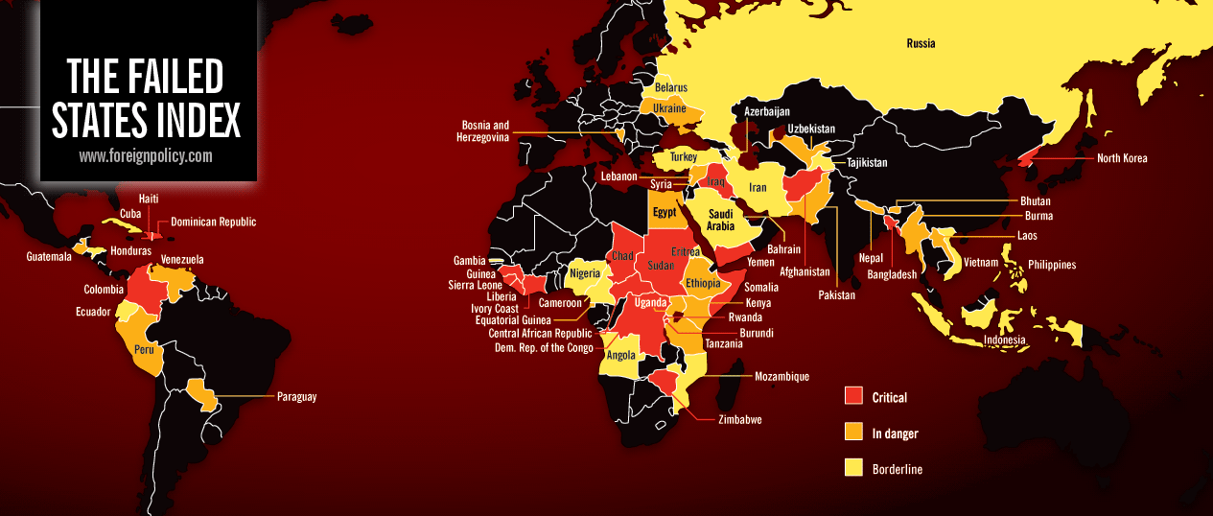

Slide 17
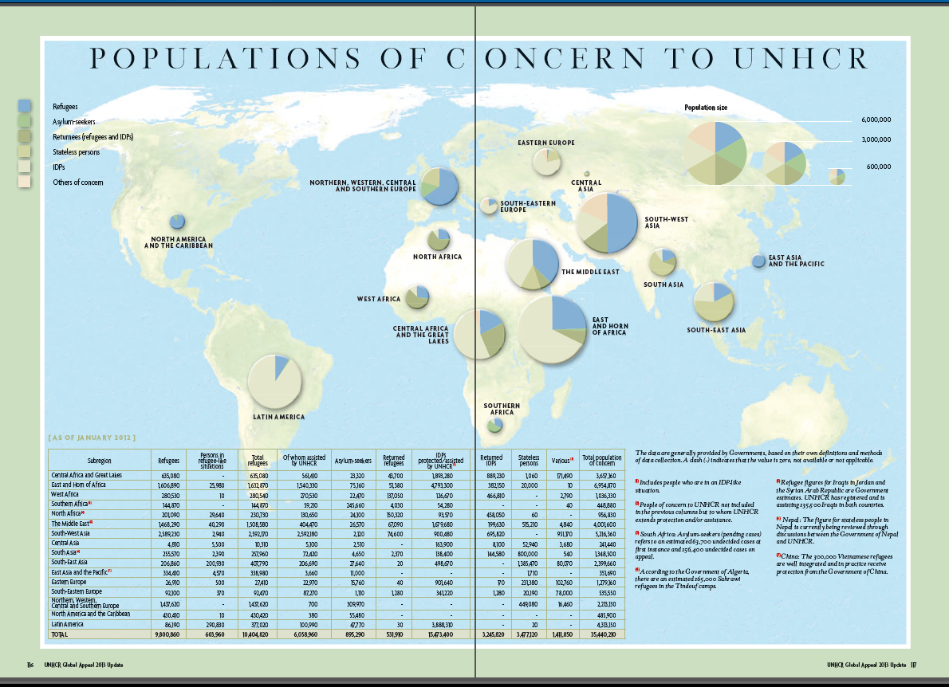

Slide 18
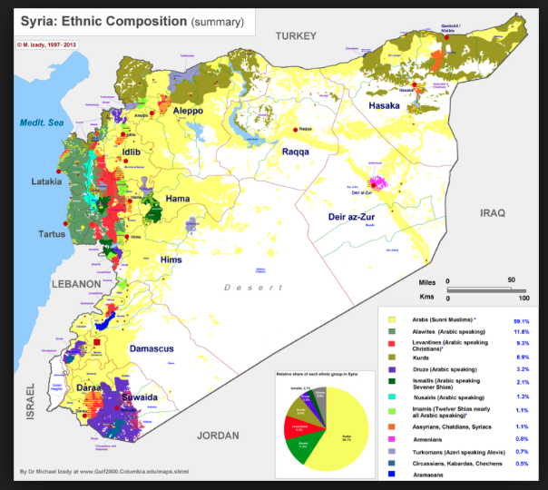

Slide 19
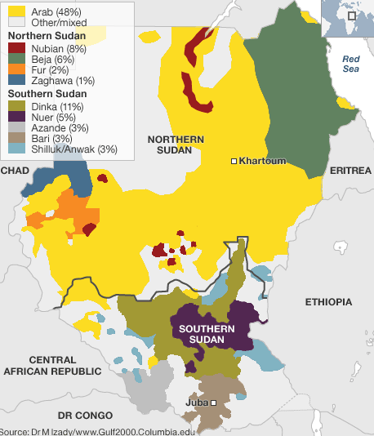

Slide 20
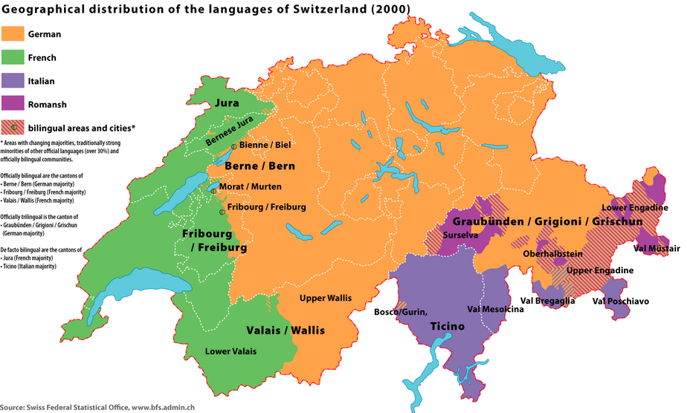

Slide 21
In sum: Motives for leaving
Security and freedom
Economic improvement
  Individual
  Household

Slide 22
Why the household matters
Relative deprivation
Remittances
Networks
=> Expectations and responsibilities

Slide 23
The Demand Side: the dual labour market
Stimulate
Versus
Limit

Slide 24
Welcome migrants
Scarce professions (usually highly skilled)
Students
Seasonal workers (in some countries)
Refugees

Slide 25
Informal demand for
Flexible
Undemanding
Low pay
Dangerous (and uninsured)

Slide 26
Typical informal sectors
Personal/household services (cleaning, child-care, granny-care)
Odd-jobs (plumbing, painting)
Prostitution
Catering services
Construction
Agriculture and horticulture

Slide 28
State Logic: Restrict and Control
Real world needs (economy, labour market, welfare, public health, crime)

Slide 29
Restrict and Control
Real world needs (economy, labour market, welfare, public health, crime)
Pragmatic answers are effective answers

Slide 30
Restrict and Control
Real world needs (economy, labour market, welfare, public health, crime)
Pragmatic answers are effective answers
Yet, pragmatism being replaced by “security” rhetoric: attrition, criminalization, detention and deportation

Slide 31
Restrict and Control
Real world needs (economy, labour market, welfare, public health, crime)
Why:
  in NW Europe: impatience with policy imperfection => path dependency?
  In the Mediterranean countries: pressures of EU integration

Slide 32
Restrict and Control
Real world needs (economy, labour market, welfare, public health, crime)
Why: impatience with policy imperfection => path dependency?
And controls and borders need “performance”

Slide 33
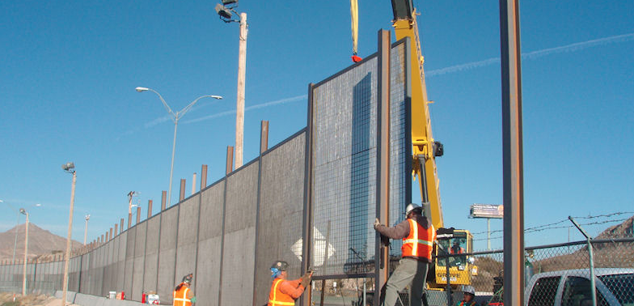
Mexico/US

Slide 34
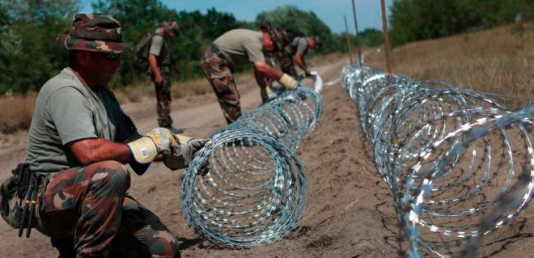
Hungary

Slide 35
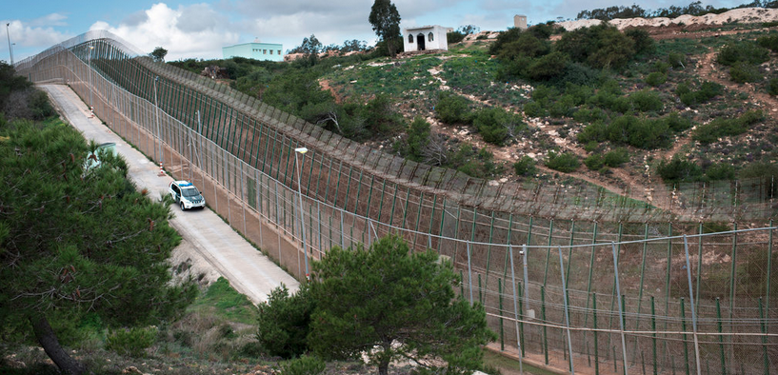
Melilla

Slide 36
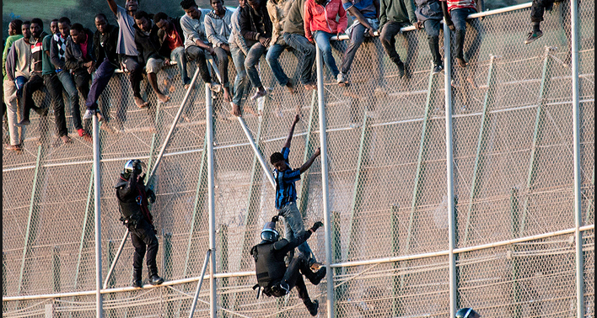
Melilla

Slide 37
The business that results
Smuggling
Exploitation (trafficking)

Slide 38
Which subsequently
Makes return socially and economically impossible
While states do their best to keep them from staying

Slide 39
Constraints
International law:
  Refugee Convention
  ECHR
    (art. 3 ‘inhuman treatment’)
    (art. 8 ‘right to family life’)
  1990 Migrants’ Rights Convention

Slide 40
Refugees
"owing to well-founded fear of being persecuted for reasons of race, religion, nationality, membership of a particular social group or political opinion, is outside the country of his nationality and is unable or, owing to such fear, is unwilling to avail himself of the protection of that country; or who, not having a nationality and being outside the country of his former habitual residence as a result of such events, is unable or, owing to such fear, is unwilling to return to it.” Art.1 1951 (1967) Geneva Convention

Slide 41
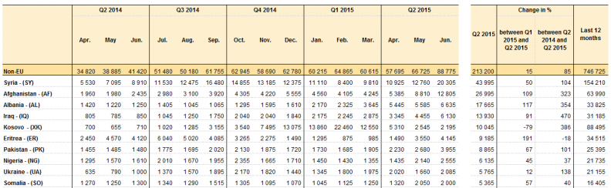
Eurostat

Slide 42
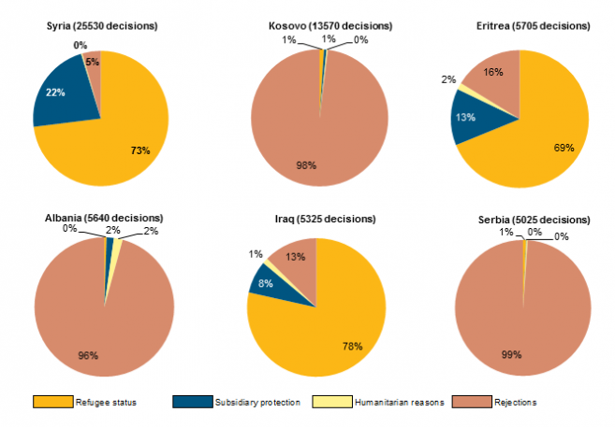
Eurostat

Slide 43
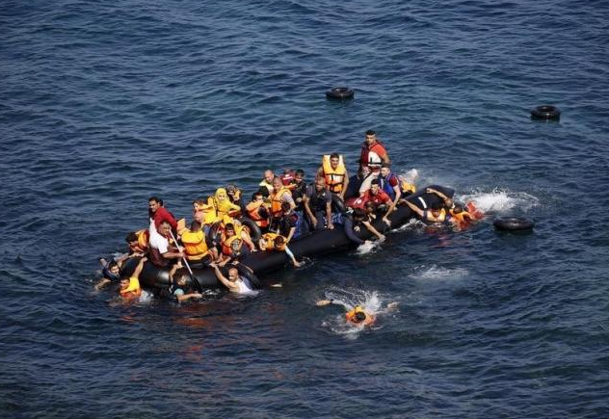
The riddle

Slide 44
Urgent issues
Common European policy and practice
On migration
  Improved management
  More legal access
  Reducing the market for smugglers
On asylum
  Burden sharing
  Fair distribution (e.g. through quota)
  Unequivocal goals (i.e. protection)

Slide 45
Urgent issues
And (ultimately) ensuring people’s right to stay

