Slide 1
TTIP lecture: Clash of Regulatory Cultures?
Prof. Anne Meuwese (anne.meuwese@uvt.nl)
Notes:
Writing the ‘rules of the game’ for TTIP is an historic undertaking. In the TTIP negotiations, fundamental clashes between the legal systems and regulatory cultures of Europe and the United States need to be accommodated. What are the main sticking points what do these tell us about broader legal, political and cultural differences on either side of the Atlantic? Prof. Anne Meuwese (Tilburg University) will share her insights into what has been dubbed ‘the most dangerous aspect’ of the world’s most far reaching trade deal: regulatory cooperation. Find out what norms and values within institutional law, constitutional law and legal frameworks protecting consumers have to do with the institutions and instruments being devised. Join Studium Generale to explore how trade law can become a vehicle for geo-politics.

Slide 2
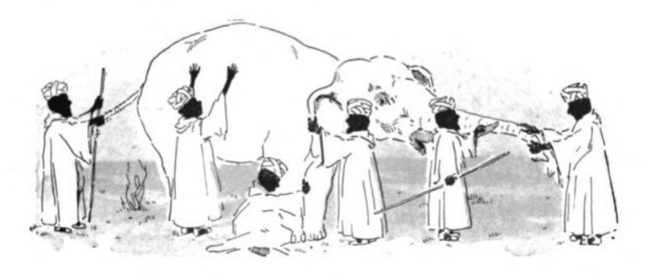
TTIP: analysing components or the entire beast?
The Blind Men and the Elephant John Godfrey Saxe (1816-1887)
“It was six men of Indostan
To learning much inclined,
Who went to see the Elephant
(Though all of them were blind),
That each by observation
Might satisfy his mind.”
Notes:
American poet John Godfrey Saxe (1816-1887) based this poem on a fable that was told in India many years ago. It is a good warning about how our sensory perceptions can lead to some serious misinterpretations; especially, when the investigations of the component parts of a whole, and their relations in making up the whole, are inadequate and lack co-ordination.

Slide 3
It isn’t about trade?
TTIP as “an economic NATO”?

Slide 4
Does Trump like TTIP?

Slide 5
From a conservative news website
“TTIP is a European Raid on America’s Economy”
“Only a Democrat would sign off on such a secretive, anti-free market initiative like TTIP”
“We’re talking about the introduction (read: standardisation) of European regulatory standards across the United States. Again, there will be some people cheering about this. More regulation, “safer” produce, etc etc. But it spells disaster for U.S. agriculture, for instance, which has become accustomed to a certain way of working”
“So America, please pay attention. The European Union is about to raid your economy. Actually, it’s going to ****e you into mediocrity. Because where the EU fails (seriously, because most Europeans are lazy), they won’t try to aspire to be like you, but rather bring you down to their level”
Raheem Kassam, 30 July 2015 on Breitbart.com

Slide 6
Transparency around TTIP
A long-standing complaint of NGOs and politicians
On 9 October 2014 the Council finally published the secret negotiating mandate for TTIP
The 12th round of TTIP negotiations took place in Brussels from 22 to 26 February 2016
The European Commission has published negotiating texts; the US has not

Slide 7
New negotiation texts available

Slide 8
My particular elephant: regulatory cooperation
You are a gold mine…
TTIP

Slide 9
‘Regulatory cooperation’ in the words of the European Commission
“Our second goal for the talks is to make sure that regulators coordinate better in the future when they design regulation for new products or update regulation of existing products. This is because it’s easier to iron out our differences at the beginning than to change things around once we have already set up complex regulatory systems. The result should be that our regulations gradually become more compatible. Both sides have procedures to analyse the consequences of new regulations – impact assessments in the EU and cost-benefit analysis in the US. By considering the effects on EU-US trade and investment in our respective procedures we could help make sure that when we make political choices on both sides of the Atlantic we are better informed about the potential consequences of regulatory decisions for transatlantic trade and investment flows.”

Slide 10
Clash 1
Both sides are protectionist, but they differ as to the focus of this
Feta cheese vs. “Buy American”
A matter of negotiation…?

Slide 11
Clash 2
Differences as to the extent to which and the way in which regulation should be “precautionary”
“fear of chemicals” vs. “fear of bacteria”
A matter of culture?

Slide 12
Clash 3
Differences as to how to make the necessary “trade-offs” in regulation
“Institutionalize” vs “Juridify”
> Closely related to how to deal with interest groups
A deep-rooted matter of constitutional systems and legal traditions!

Slide 13
Even if ISDS is off the table…

Slide 14
…there are plenty of democratic and constitutional values at stake

Slide 15
TTIP: a race to the bottom, the top, or some place else?

Slide 16
Discussion statements
TTIP protests should focus more on what should be in the agreement
Data protection…?
Joint standards for financial services…?
Sustainability…?
TTIP is possibly our best shot at “taming globalization”
The End

