Slide 1
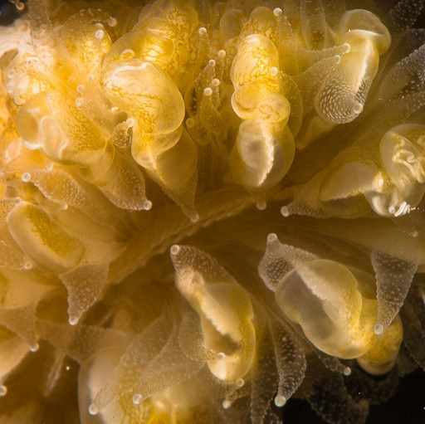
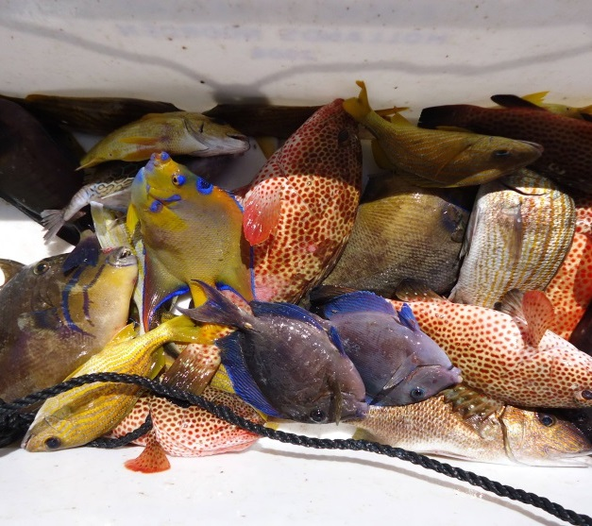
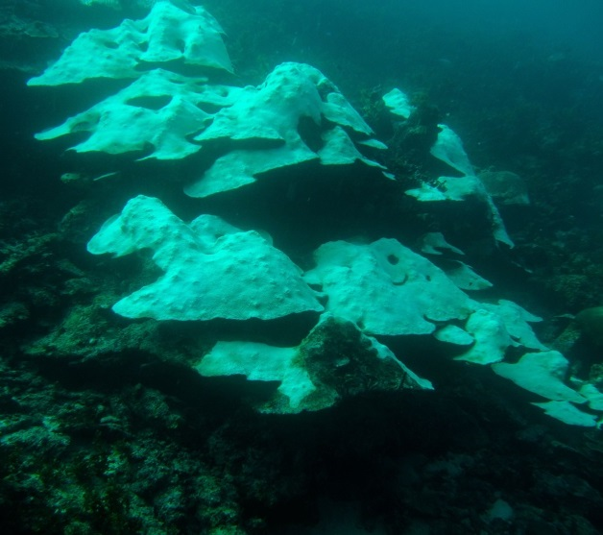
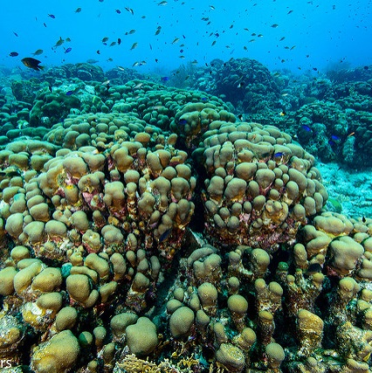
Status and trends of the Corals of the Saba Bank
Erik Meesters
Wageningen Marine Research
December 2016

Slide 2
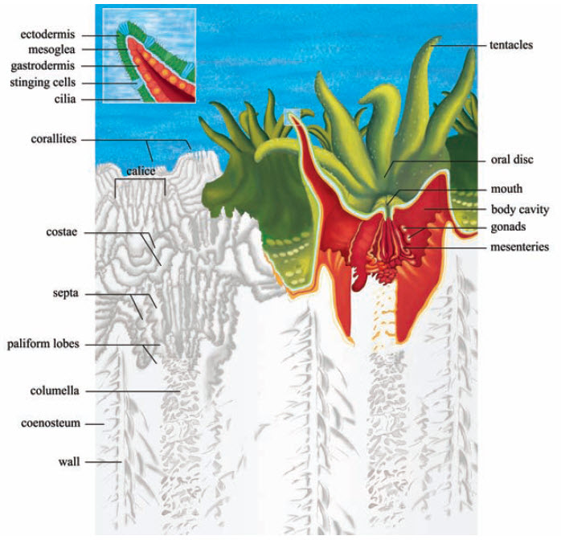
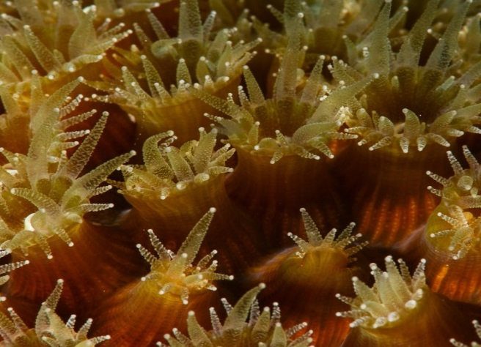
The importance of corals: what is a coral?
Animals with algae!
  A symbiosis that leads to high growth (i.e. Calcium carbonate production).
  Dependent on light.
  Clonal: extremely long lived.
Notes:
Scleractinia, also called stony corals or hard corals, are marine animals in the phylum Cnidaria that live on the seabed and build themselves a hard skeleton.
The individual animals are known as polyps and have a cylindrical body crowned by an oral disc with a mouth and a fringe of tentacles.
Although some species are solitary, most are colonial.
Stony corals are closely related to sea anemones.

Slide 3
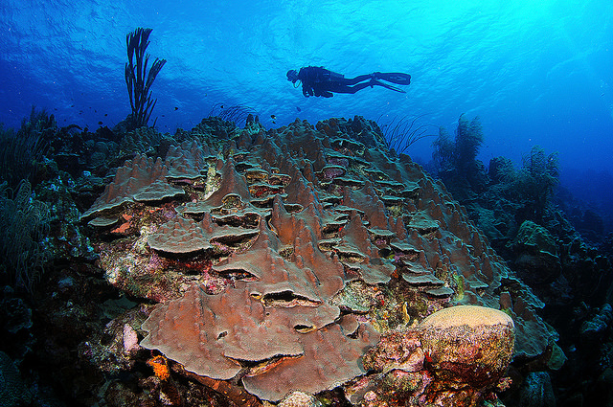
The importance of corals: Habitat builders
Habitat builders
  The coral reef is a building and the coral its brick!
Living space and food for numerous fish, plants, invertebrates.
Highly complex with many feedback loops.
Highest biodiversity and productivity of any marine ecosystem.
Notes:
Eco-engineering
ecosystem functions are the biological, geochemical and physical processes and components
that take place or occur within an ecosystem
'Ecosystem function' is the technical term used in the Framework to define the biological, geochemical and physical processes and components that take place or occur within an ecosystem. Or more simply put, ecosystem functions relate to the structural components of an ecosystem (e.g. vegetation, water, soil, atmosphere and biota) and how they interact with each other, within ecosystems and across ecosystems. Sometimes, ecosystem functions are called ecological processes.
Maintaining ecosystem function is important to maintaining the capacity of the region to supply ecosystem servcies. In the Framework, ecosystem functions are recognised as important for maintaining ecosystems and biodiversity (the diversity of genes, species and ecosystems) for their own sake. As well, they may provide contributions to goods and services (ecosystem services) that people value. People value ecosystem services in terms of the benefits they provide to their life. For example, the ecosystem function 'pollination' is critical to the reproduction of most wild plants. As well, this ecosystem function provides direct contributions to our agricultural sector by pollinating food crops. Our ability to grow food crops, are of value to people because they physically sustain us (contribute to nutrition) and allow us to choose our own lifestyle (social and economic freedom).
Regulating FunctionsMaintenance of essential ecological processes and life support systems.
Supporting FunctionsProviding habitat (suitable living space) for wild plant and animal species at local and regional scales.
Provisioning FunctionsProvision of natural resources.
Cultural FunctionsProviding life fulfilment opportunities and cognitive development through exposure to life processes and natural systems.

Slide 4
The importance of corals: Services for humanity?
Providing food for many subsistence fishermen and their families as well as commercial fishermen (primary and secondary production).
Important for tourism (aesthetic values, cultural services).
Important for coastal protection (regulating against extreme environmental conditions).
Important for (undiscovered) medicines/maintenance of biodiversity/genetic resources.
Important for sand production (e.g. building material).
Notes:
ecosystem services are the good and services provided by (natural and semi-natural) ecosystems
that benefit, sustain and support the well-being of people
Provisioning services: food, building material, ‘Biochemical, medicinal and pharmaceutical resources’

Slide 5
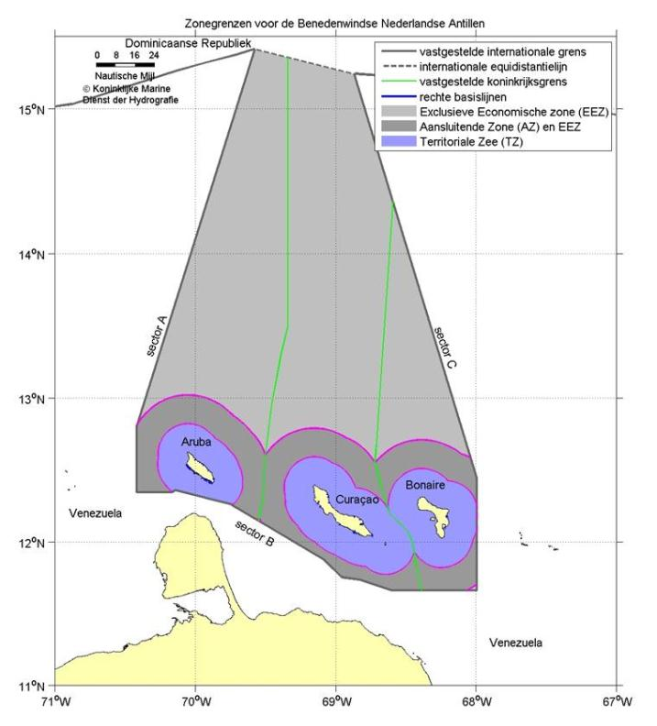
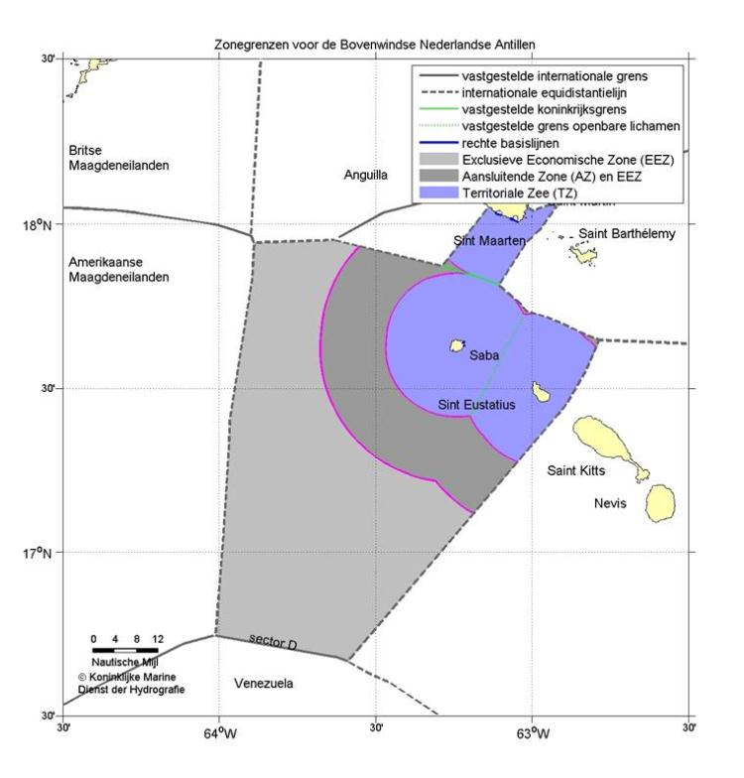
Exclusive Economic Zone (EEZ)Dutch Caribbean
71.198km²
21.803km²

Slide 6
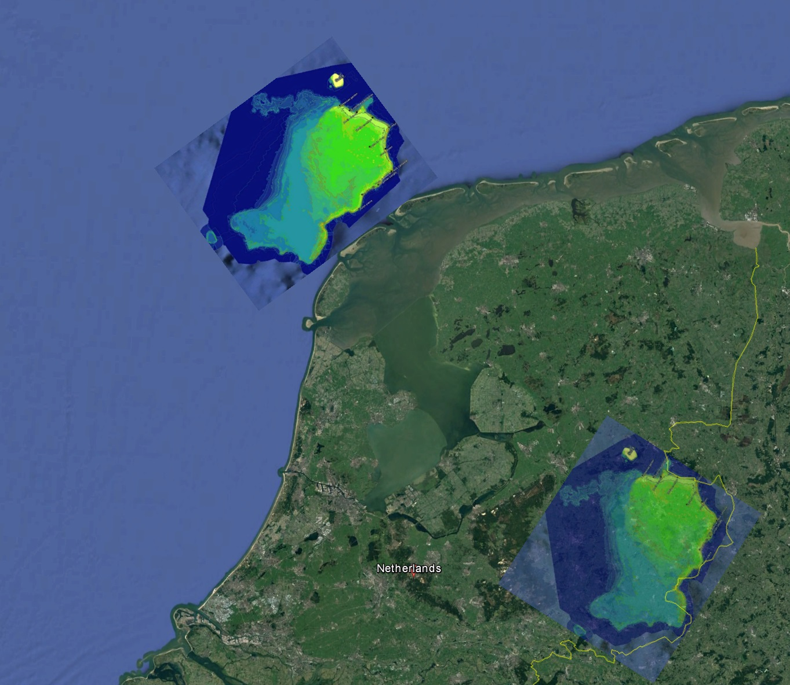
The size of the Saba Bank
Compared to the Netherlands

Slide 7
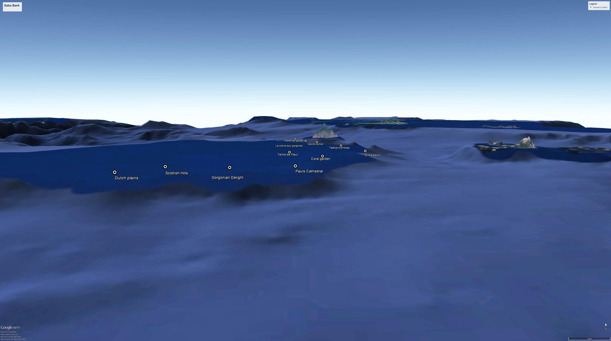
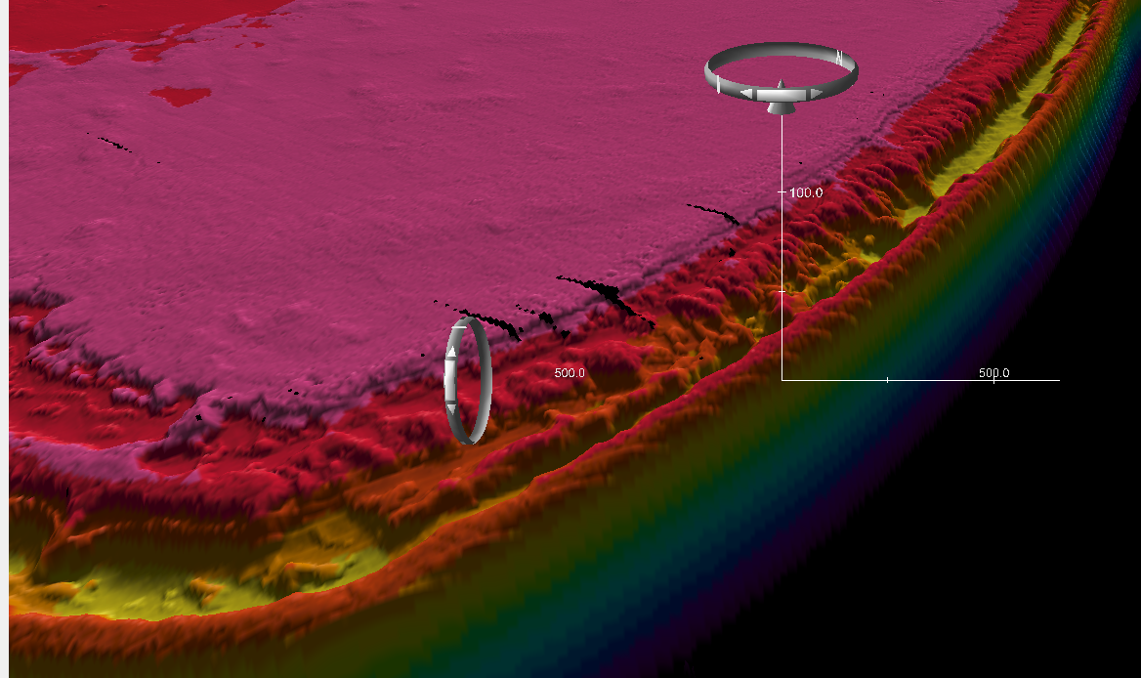
Bathymetry
2200km²
Surrounding seafloor is down to 1000m deep!
The Sababank is a very big mountain with a flat top.
Courtesy Royal Navy

Slide 8
Saba Bank expeditions
Now surveyed:
  1977, 25 diving stations (Van der Land)
  1996, 7 dive locations (Meesters)
  1999, 3 dive sites (Klomp & Kooistra)
  2006, 17 dive sites (Conservation International)
  2010, 200 video drops (CARIPES)
  2011, 10 sites, app. 1500m (IMARES)
  2013, 11 sites, app. 1650m (IMARES)
  2015, 11 sites, app. 1650m (IMARES)
  2016, 30 sites, app. 20.000m (NIOZ)

Slide 9
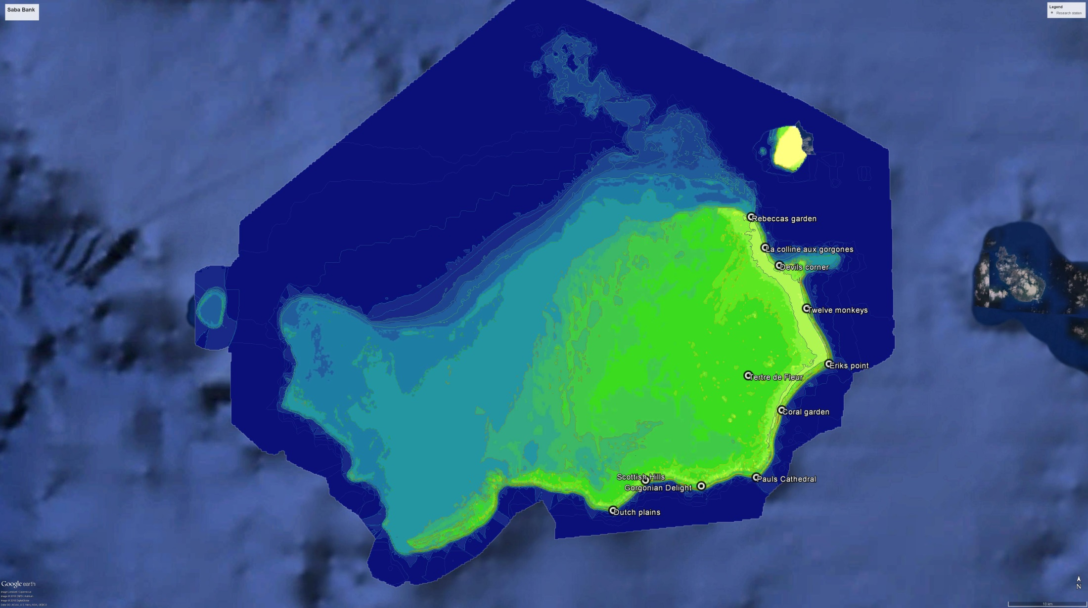
Research locations
2011
2013
2015

Slide 10
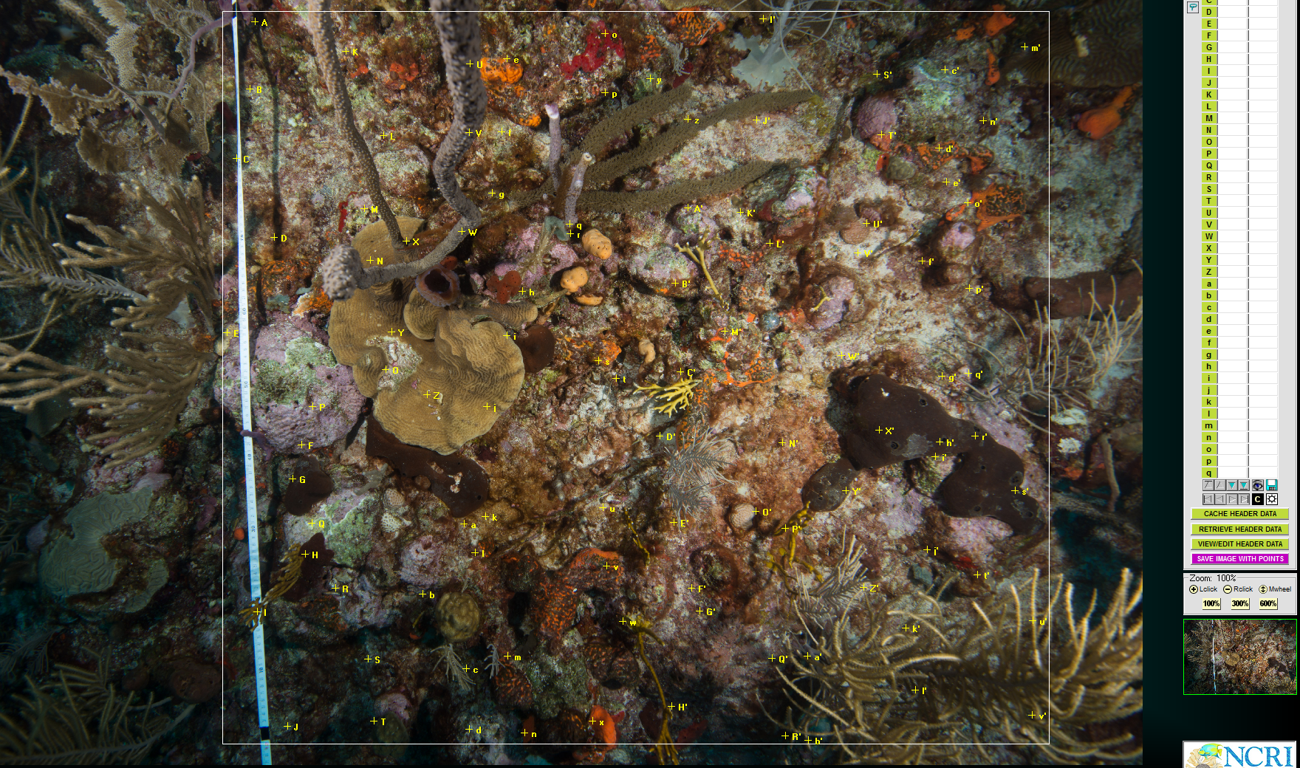
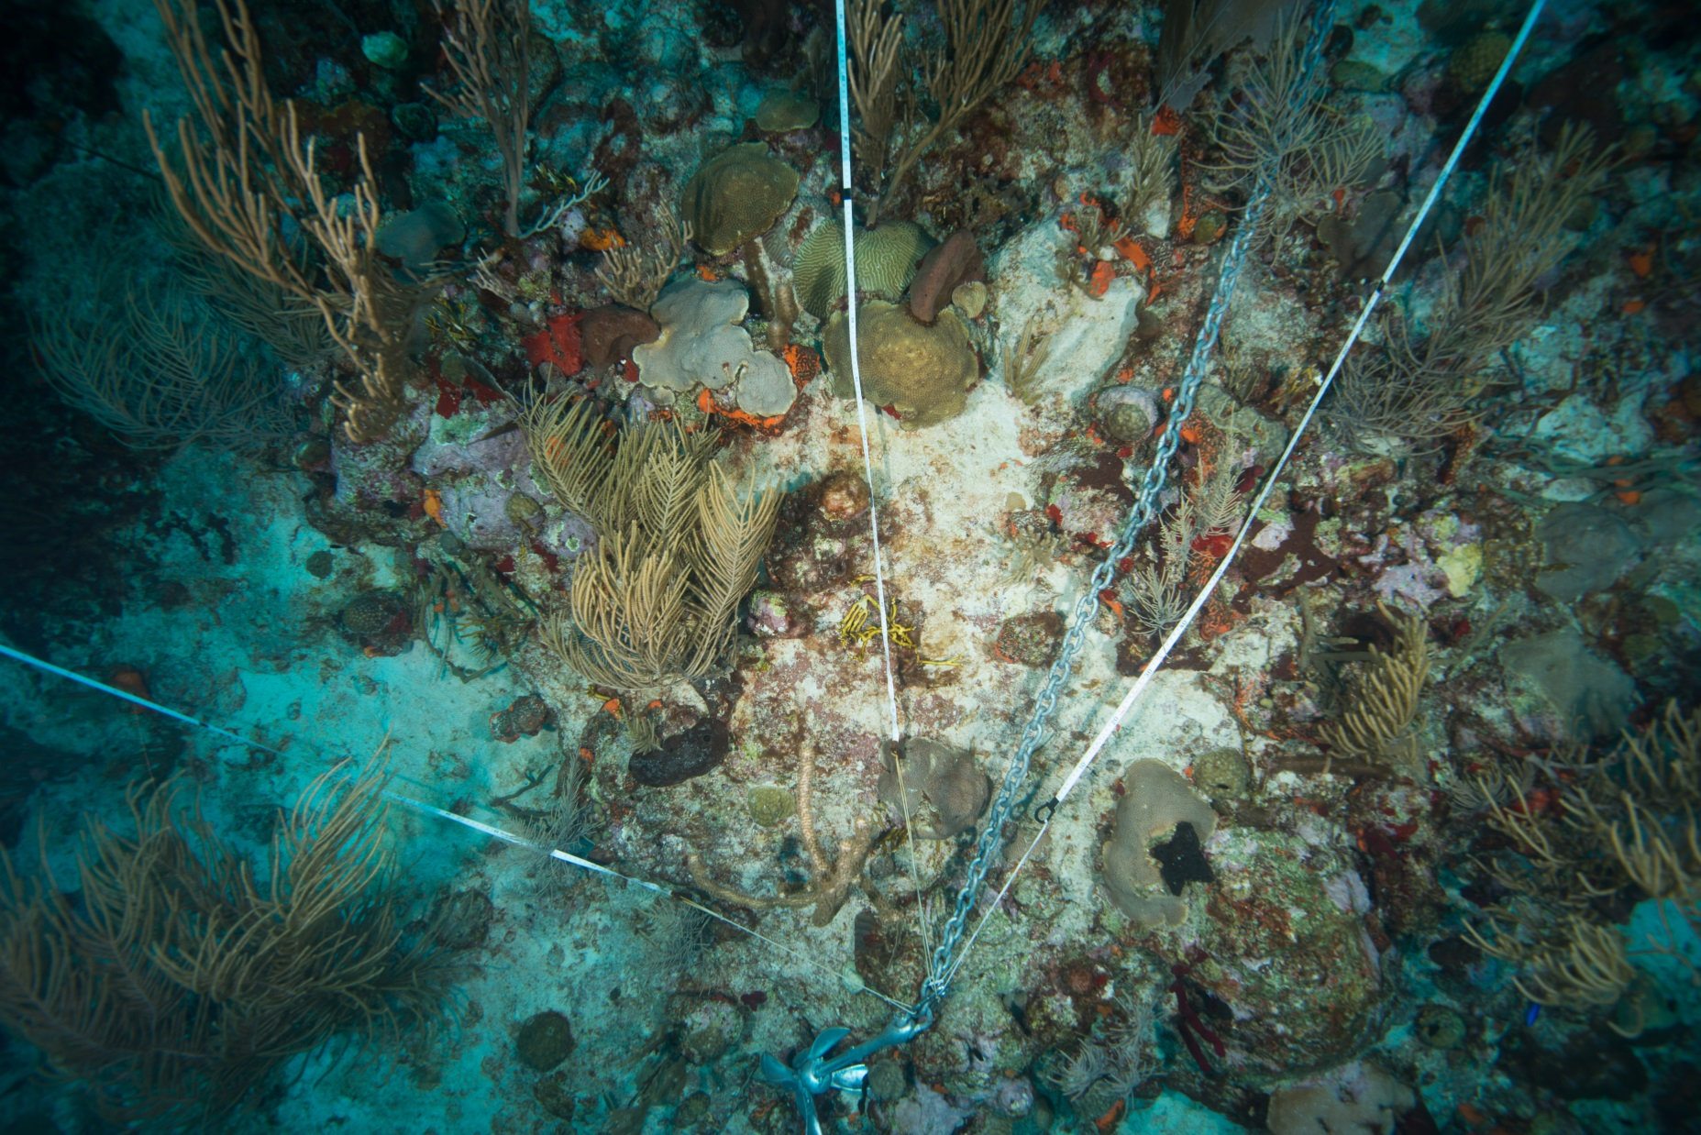
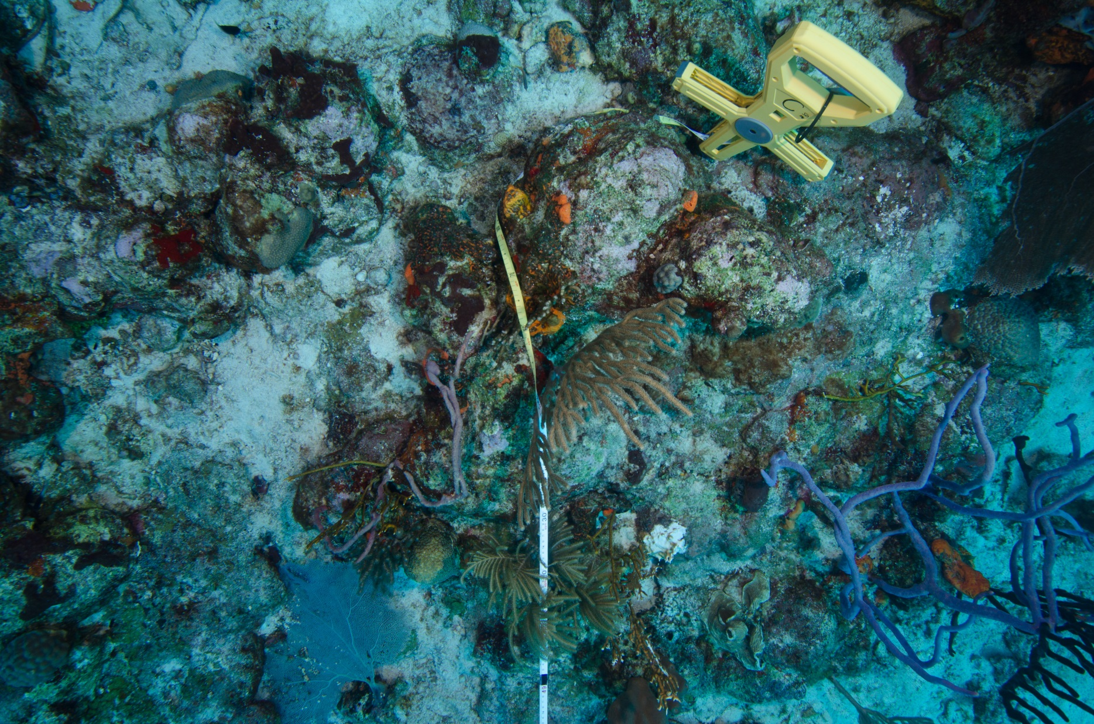
Photographing transect lines

Slide 11
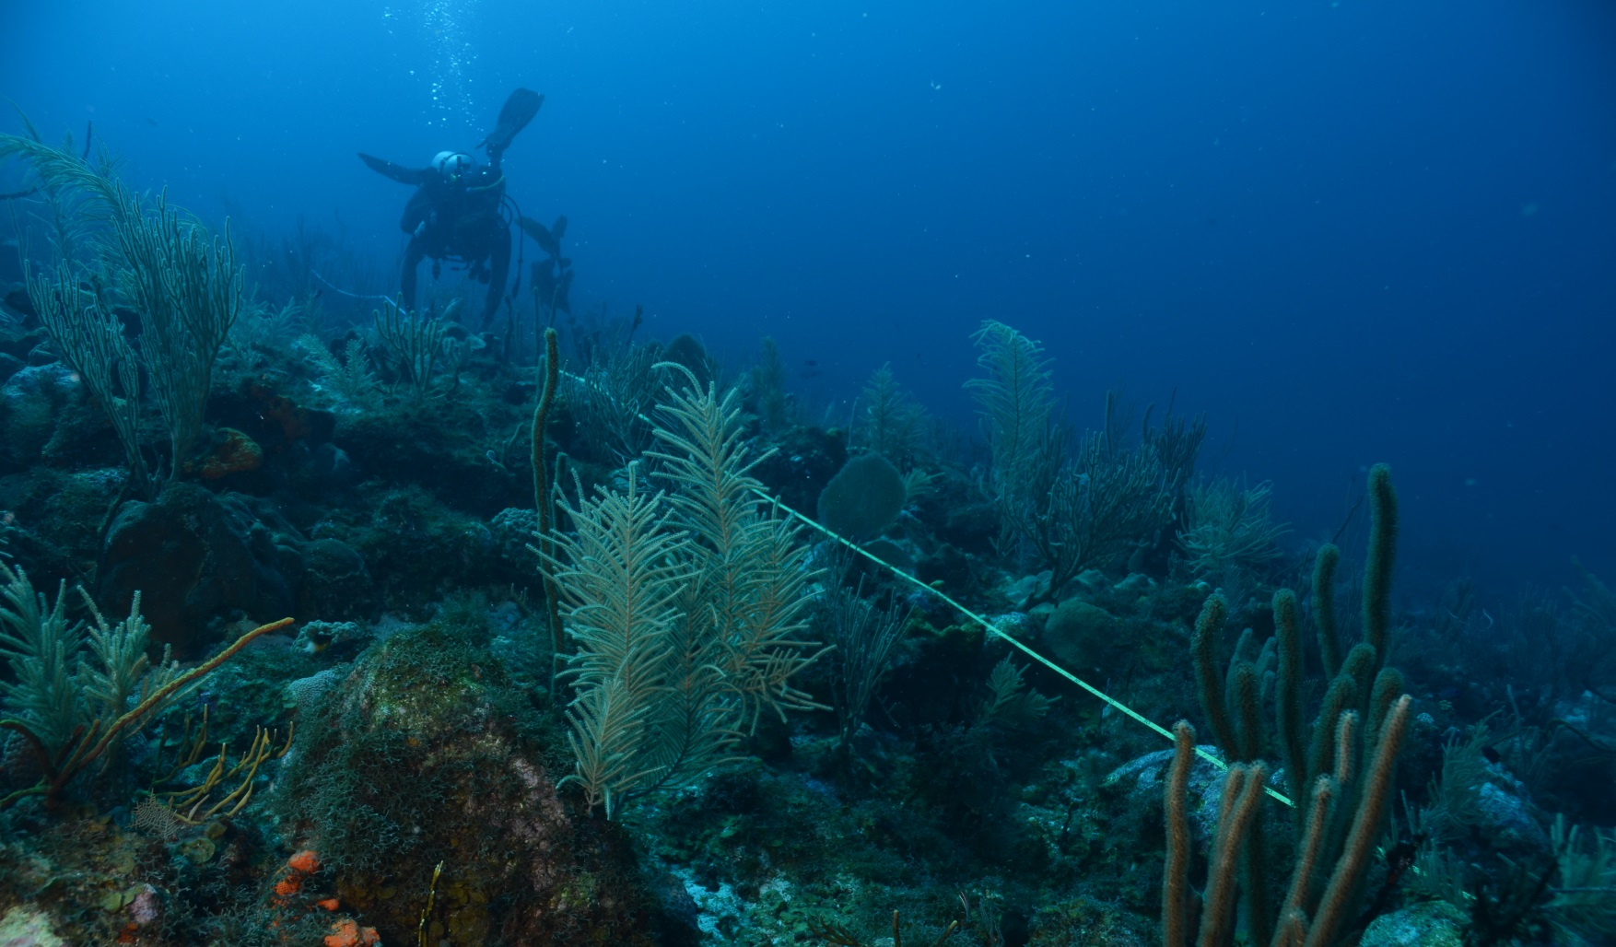
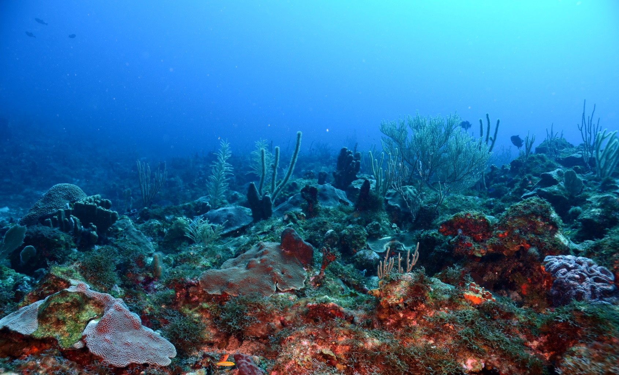
Corals of the Saba Bank

Slide 12
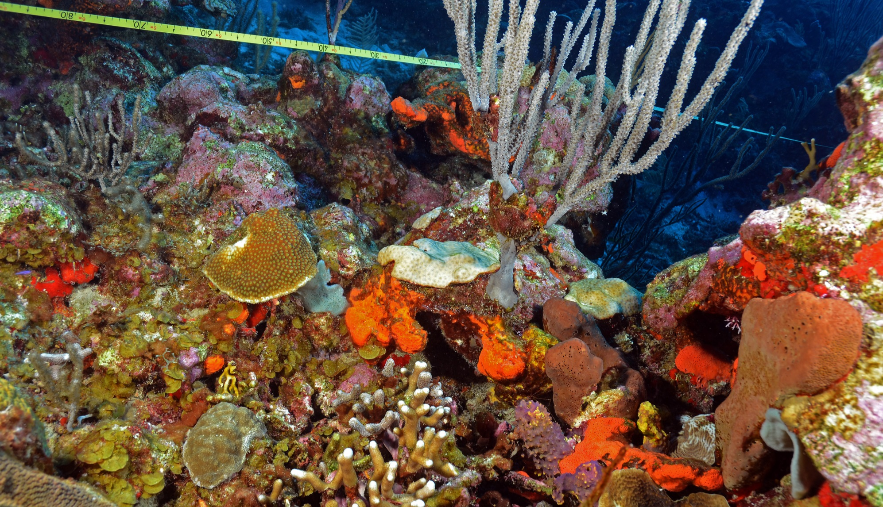

Slide 13
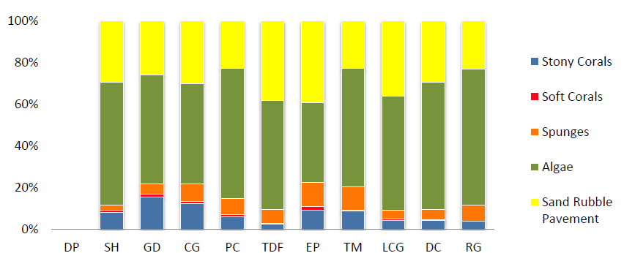
2011 survey: main bottom cover
Sand, rubble, pavement
Algae
Sponges
Soft Corals
Stony corals
Notes:
The stony coral cover ranges in 2011 from 2.63% in Tertre des Fleur(TDF) to 15.55% in Gorgonian Delight (GD)
From south west -> east -> north
Scotish Hills
Gorgonian delight
Coral gardens
Pauls Cathedral
Tertre de Fleur
Erik’s point
Twelve monkeys
La colline aux gorgones
Devils corner
Rebecca’s Garden

Slide 14
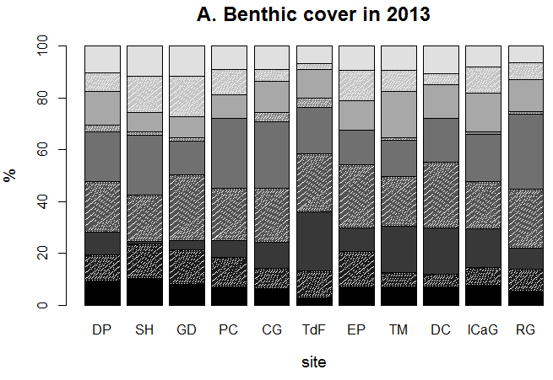
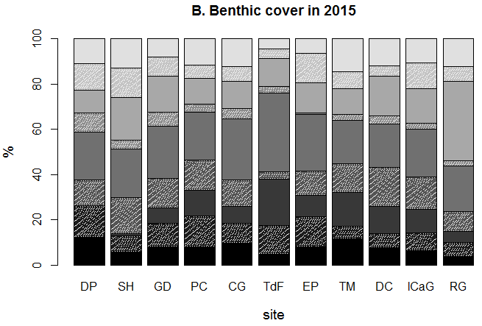
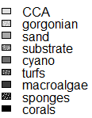
Status and trends of corals of the Saba Bank
Notes:
Dutch plains has been added

Slide 15
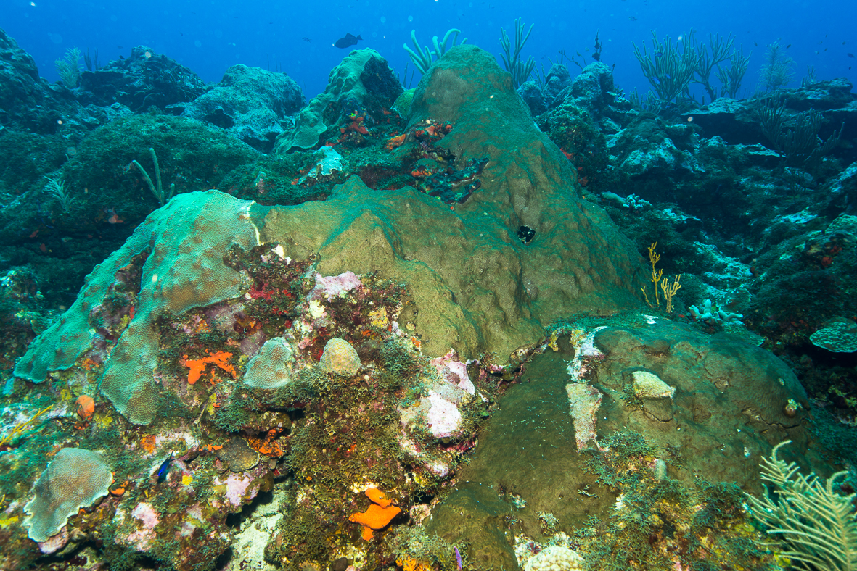
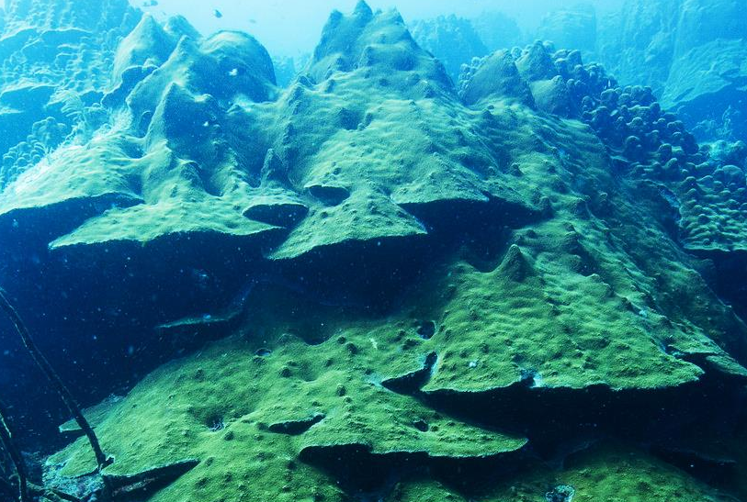
What has happened?

Slide 16
Historic data for coral cover
Range in coral cover estimates
Bleaching (‘98)
Hurricane Lenny (‘99)
The last 20 years severe events have severely reduced the coral cover of the Saba Bank.
It is not clear if the coral community will be able to recover nor do we know the exact impact of fishing on the capacity of corals to bounce back.
Bleaching (‘05)
Notes:
date who disturbances what
1996 Meesters 1998 bleaching, very strong el ninjo
1999 Klomp & Kooistra 1999 hurricane lenny
2007 Toller 2005 bleaching el ninjo
2011 WMR
2013 WMR
2015 WMR

Slide 17
Any reasons for optimism?
+No land based pollution
+Little disease
+Large predators
+No runoff
+high water exchange
-Climate change
-Lion fish
-Fisheries
-Hurricanes
-Few grazing sea urchins

Slide 18
Or not?
Is the Caribbean becoming eutrophied?

Slide 19
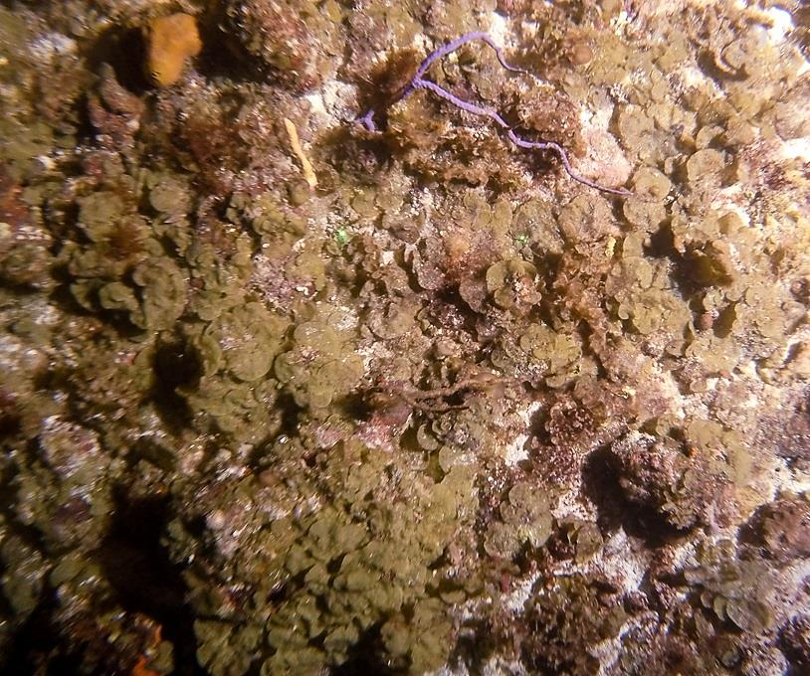
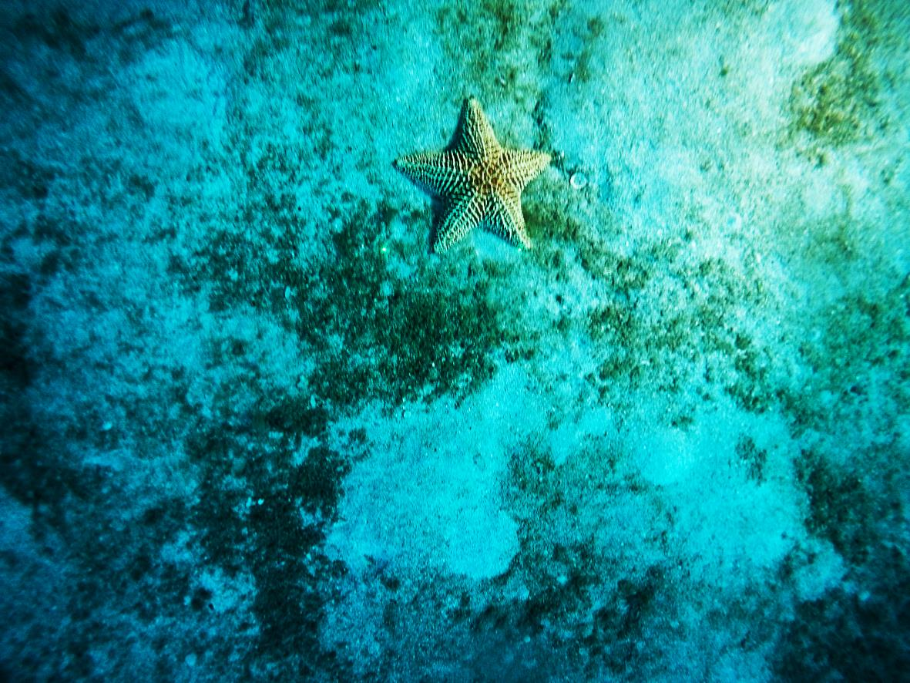
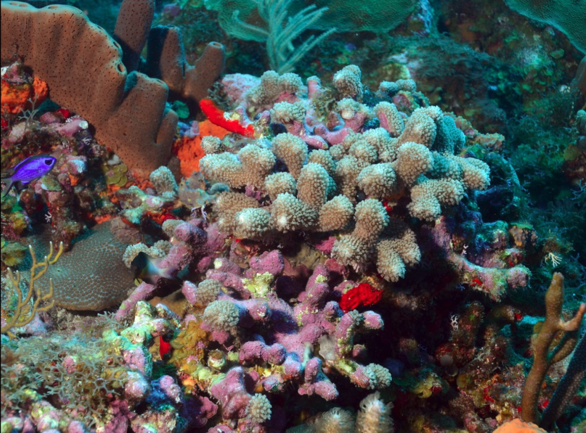
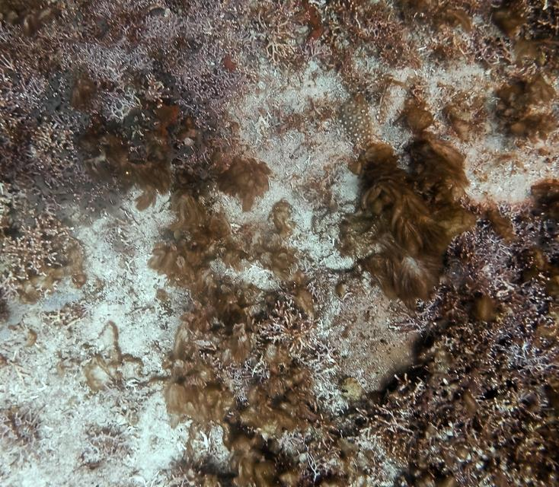
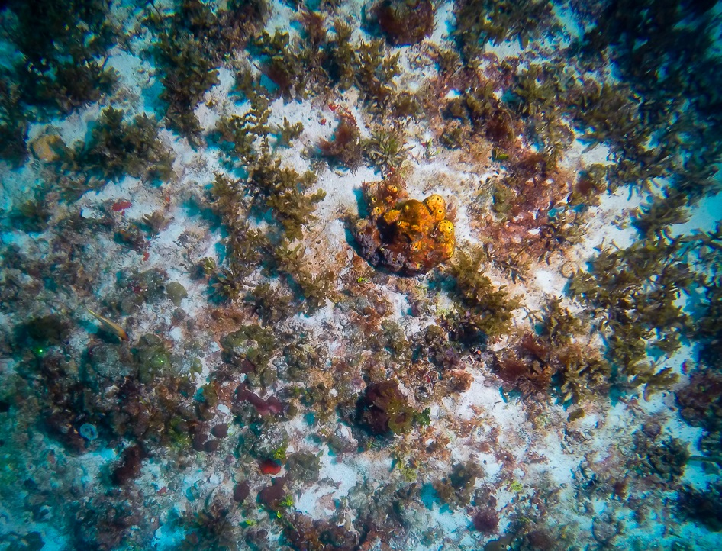

Many different ecosystems on the bank
Coral reefs
Fields of calcareous algae
Sargassum fields
Algal fields
Sand plains
Notes:
We’ve seen this year with the NIOZ expedition that there are a lot of different ecosystems on the bank that are probably functionally linked together. We don’t know exactly how, but they are all important to keep the bank as a whole healthy.

Slide 20
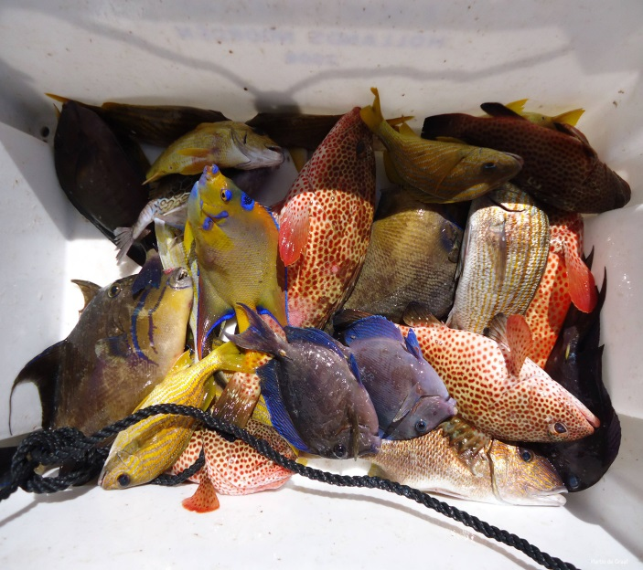
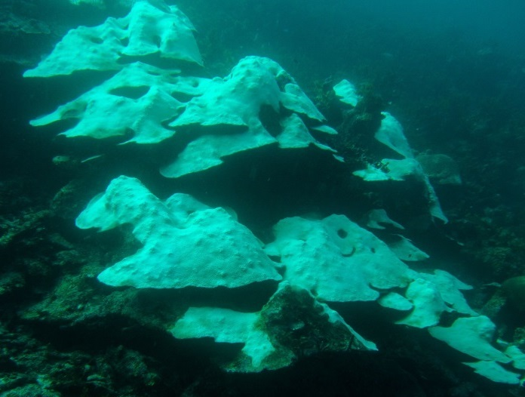
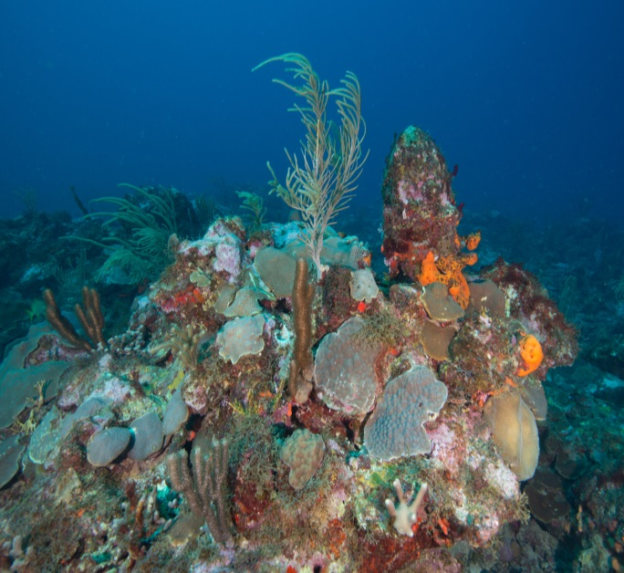
Concluding on the Status and Trends of the corals of the Saba Bank
We need to
Improve resilience of Sababank
to cope with the effects of
Climate change.
Sustainable?
Resilient enough?
Improving?

Slide 21
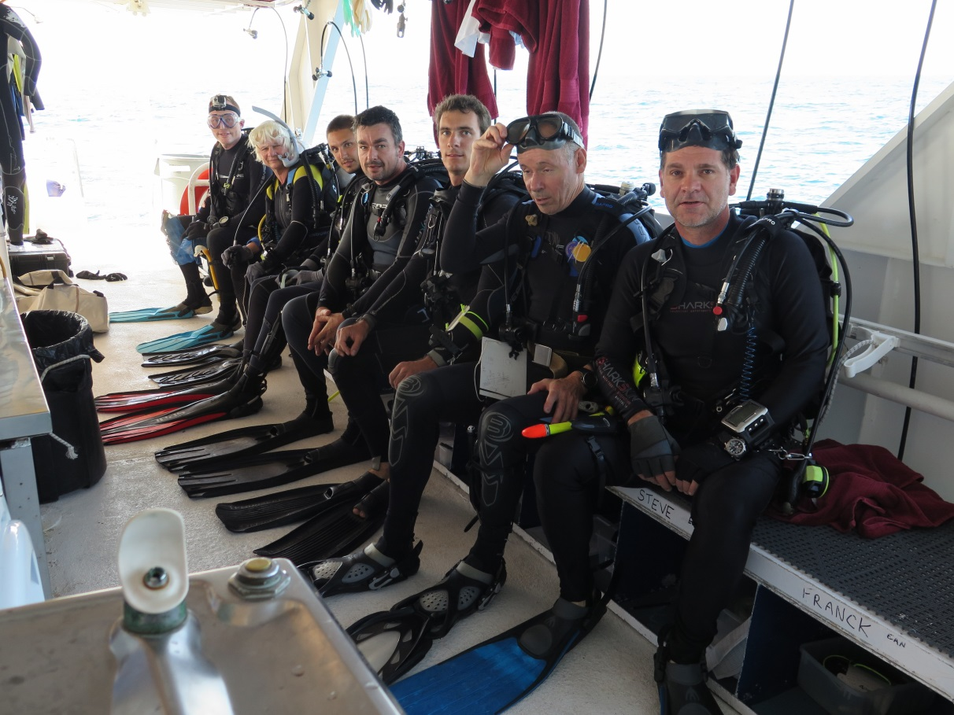





Thank you
Thanks to: Lisa Becking, Oscar Bos, Mirthe Wiltink, Jean Philippe Marechal, Kai Wulf, Fleur van Duyl, Ingrid Van Beek, Paul Hoetjes, Tadzio Bervoets, Joe Phillipson, Dahlia Hassel, Bert Hoeksema, Franck Mazeas, Maggy Nugues, Ewan Tregarot, Marine Fumaroli, David Vermaas, Hans Verdaat, Klaus Lucke, Steve Piontek, Steve Geelhoed, David Stevens, Royal Dutch Navy, WWF, Ministry of Economic Affairs, The different crews of the Caribbean Explorer, and many more.
December 2016

