Slide 1
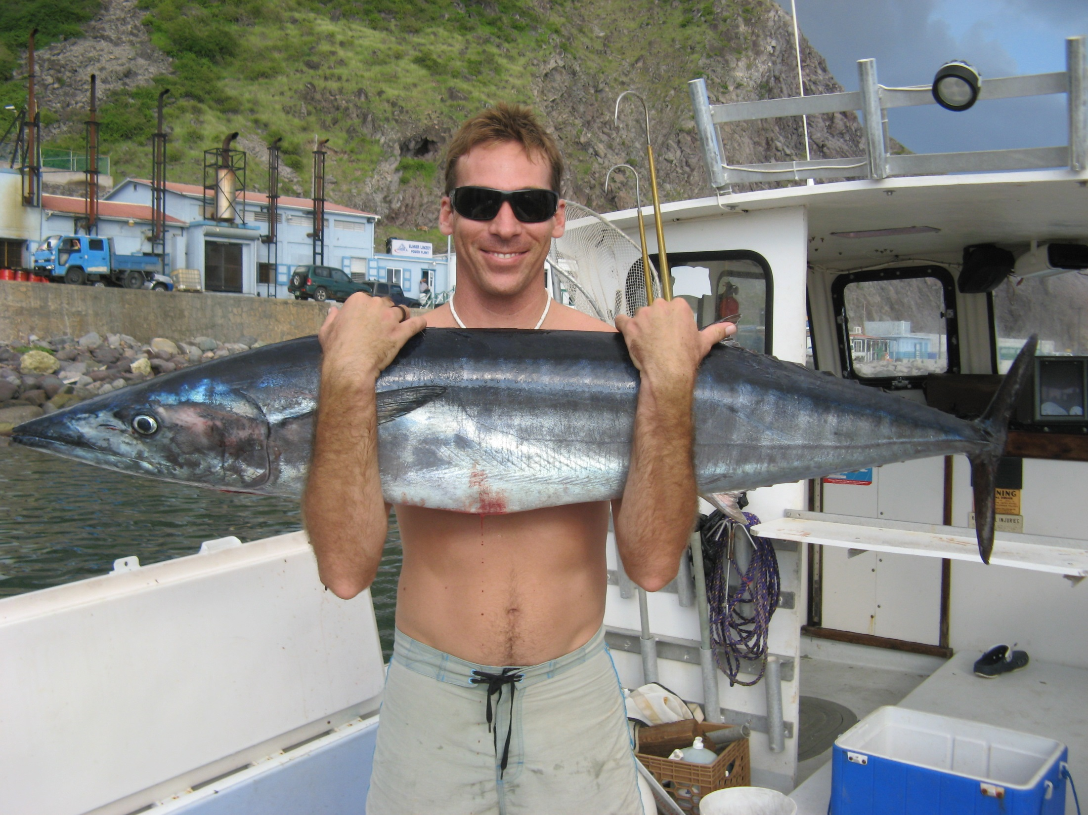
FISH AND FISHERIES RESEARCH CARIBBEAN NETHERLANDS
“supporting local management”
SABA BANK FISHERIES:
Lobster, Reef fish, redfish, ghost fishing, shark, conch
M de graaf, LAJ NAGELKERKE, E BOMAN, T BRUNEL

Slide 2
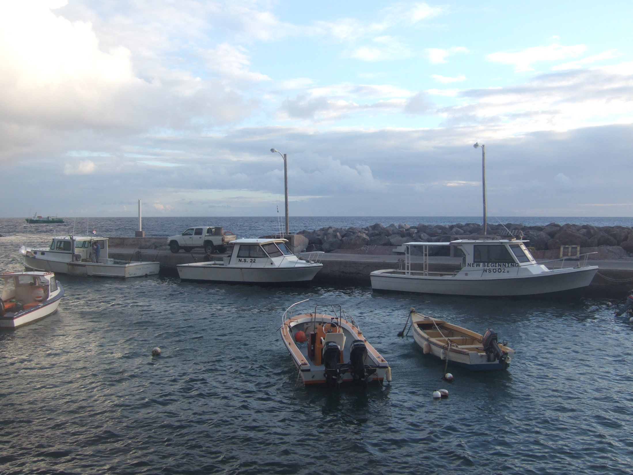
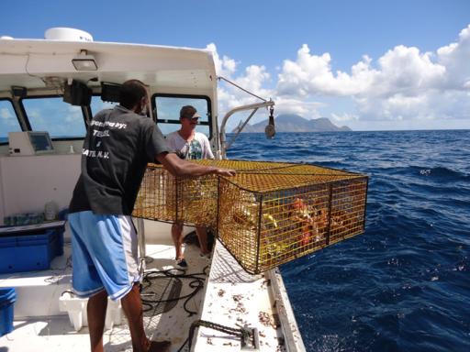
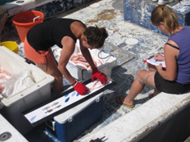
SABA BANK FISHERIES
  10 licenses, all catch landed Fort Bay
  Lobster trap fishery (20m)
  Snapper trap fishery (200m)
  Shallow water Hand lining (red hind)
  Deep water Hand lining (snapper)
  Trolling (pelagics)
  historical data
    Dilrosun (2000) JAN-DEC
    Toller (2007) JUL-DEC
WHY FISHERIES?
ONLY ECONOMIC ACTIVITY
ONLY MANAGEABLE ACTIVITY
IMPACT STOCKS & INTERACTION ECOSYSTEM

Slide 3
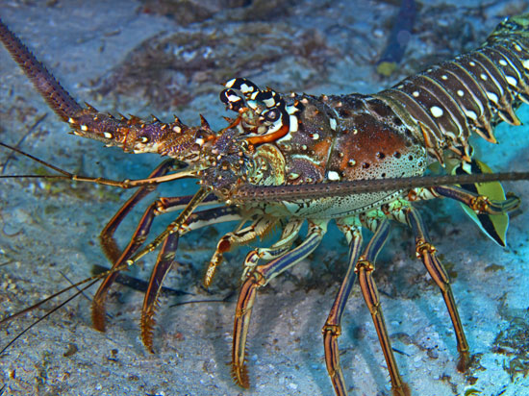
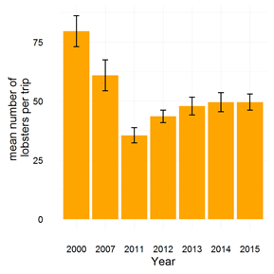
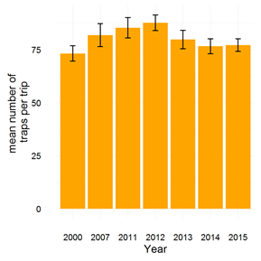
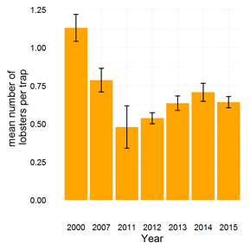
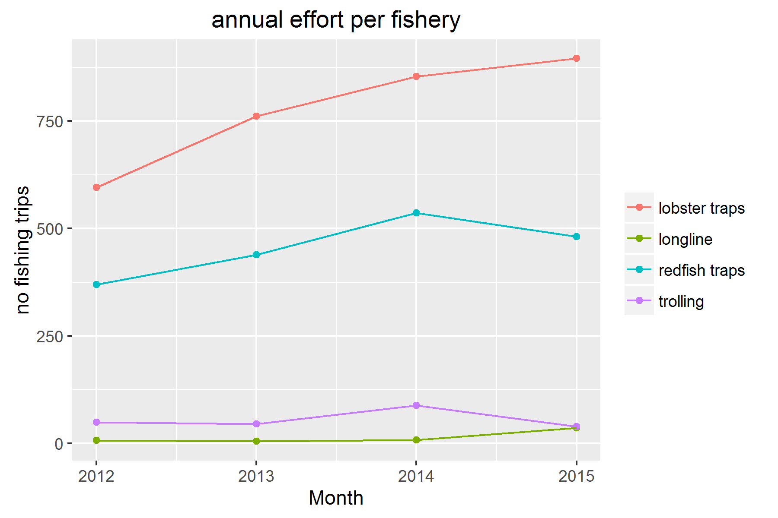
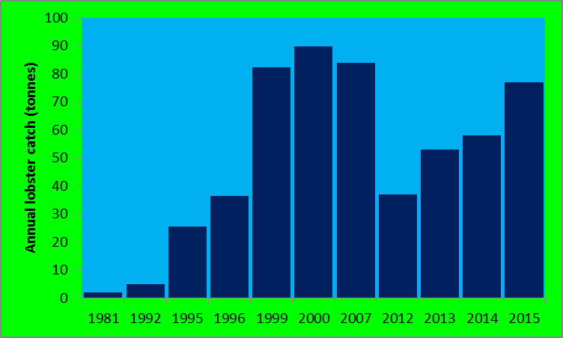
spiny lobster....fishery

Slide 4
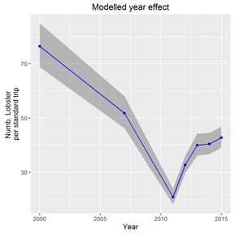
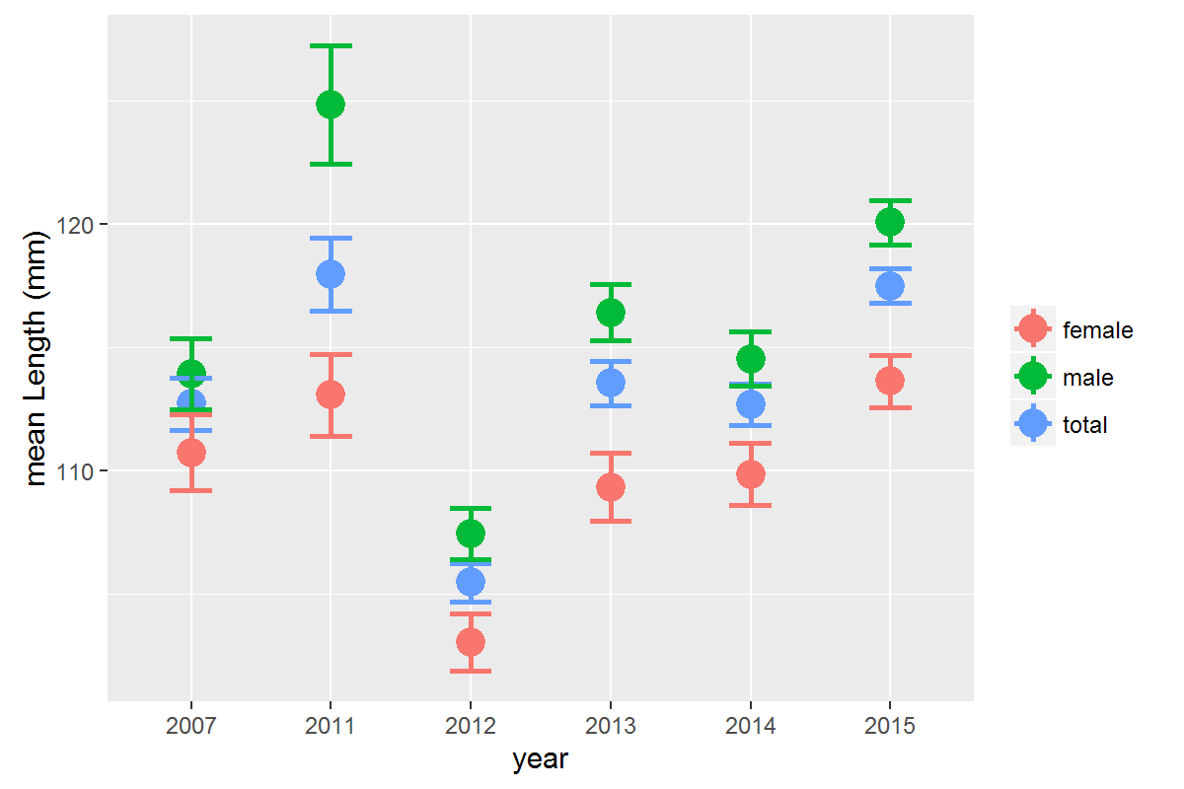
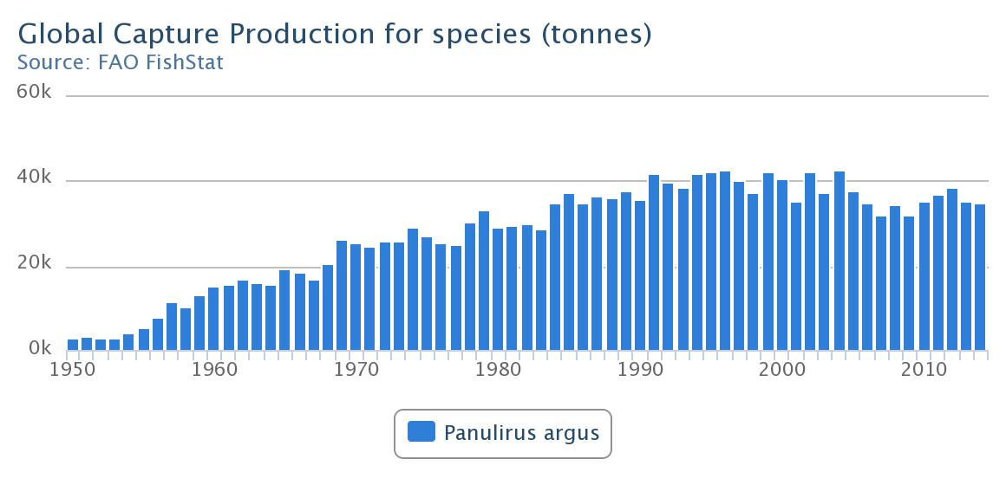
spiny lobster....stock status
Saba Bank 0.1 %
Legal size 95mm
Size-at-Maturity 90mm
Declaration Caribbean Regional Fisheries Mechanism 2015:
  one genetic stock, international co-operation & management
  harmonise min size, closed season etc
  regulate effort, no. gear per license
  recommendation -> follow CRFM

Slide 5

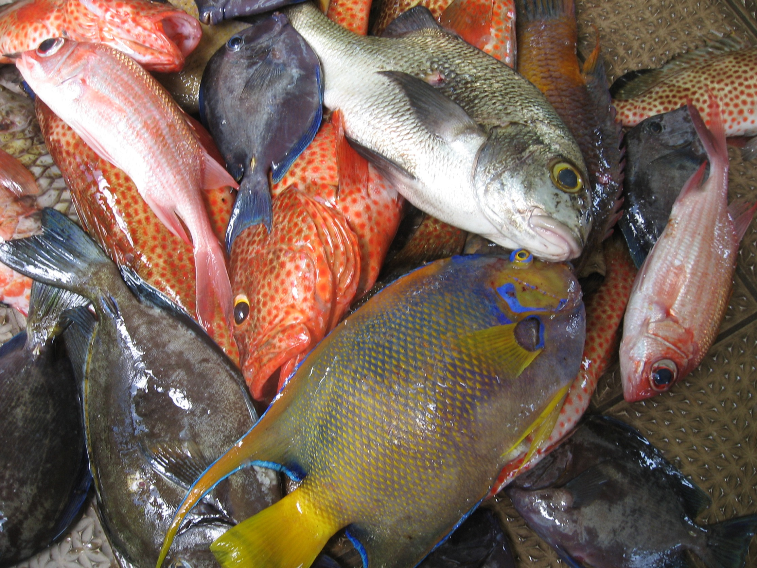
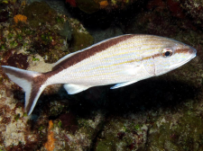





REEF FISH...FISHERIES
2012: Landings ~8 t, Discard ~12 t
van Gerwen (2013)

Slide 6
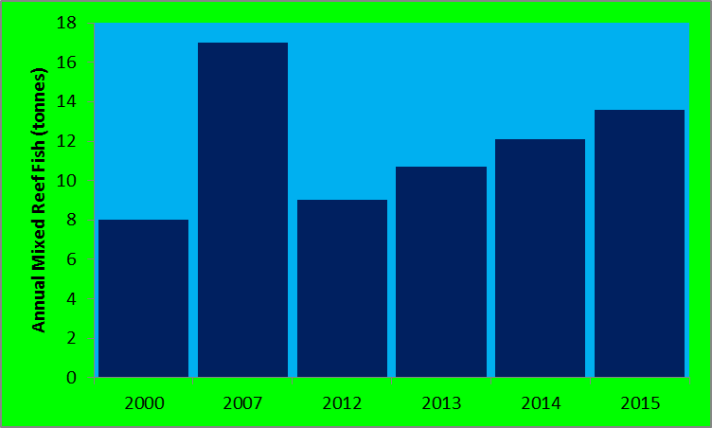
REEF FISH...FISHERIES
Reef fish fisheries:
  low annual catch ~12 t
  100-400 km² -> 0.12 -0.03 t km² -> VERY LOW (Bonaire 2 t km²)
  “Overfished”?
  Low natural biomass (van Beek et al 2014); deep reef & low complexity?
  Lobster, not reef fish, target species?

Slide 7
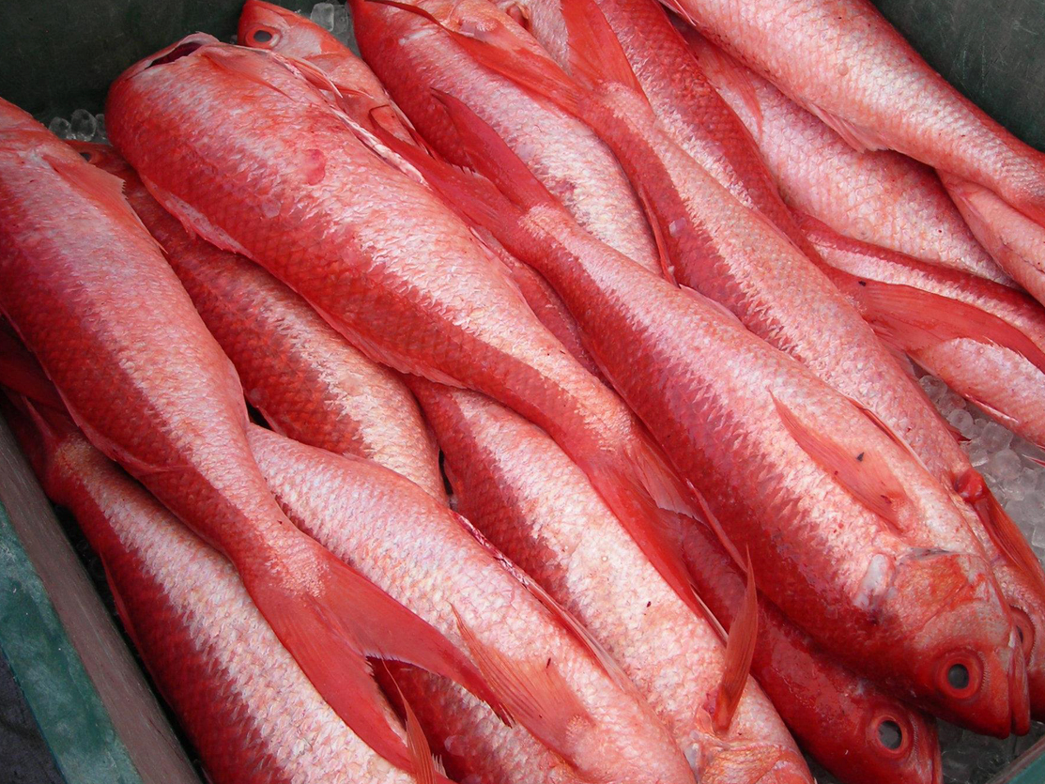
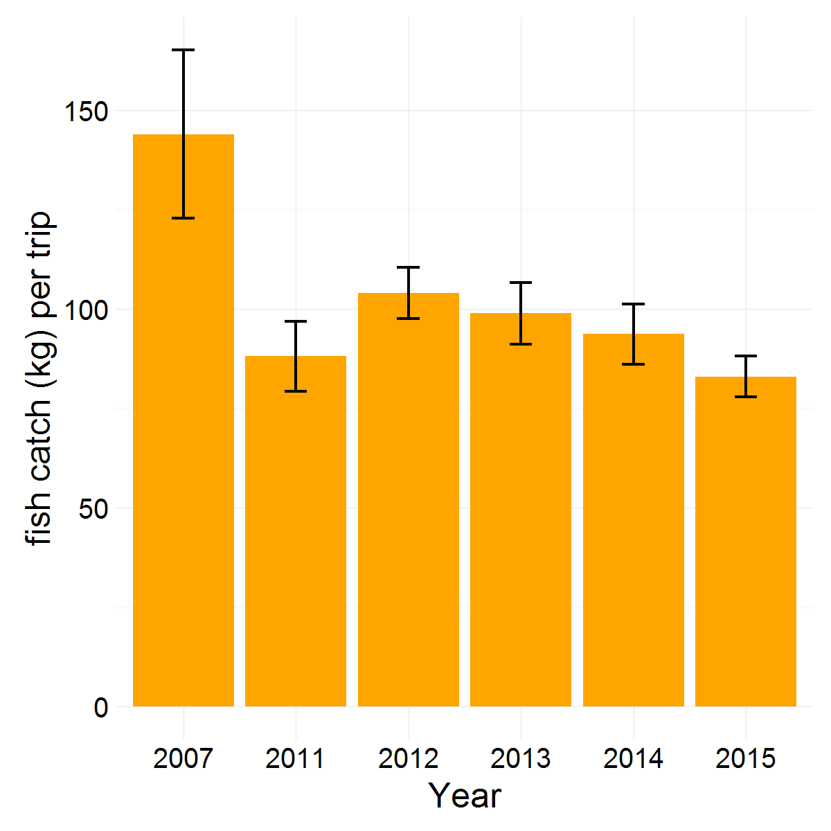
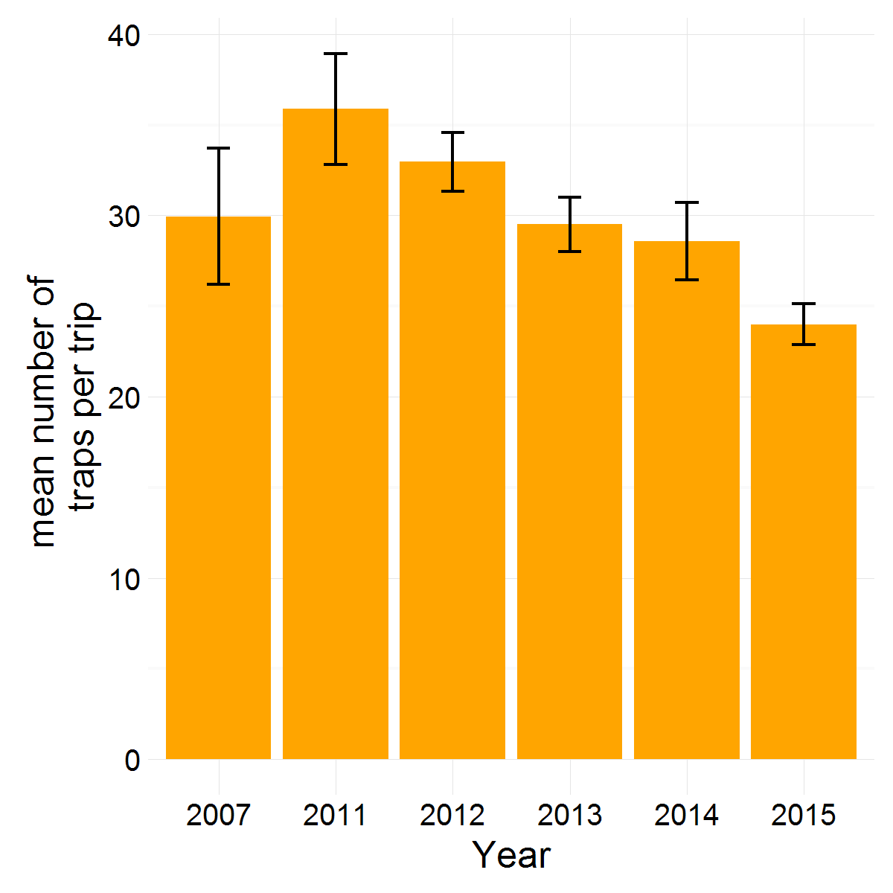
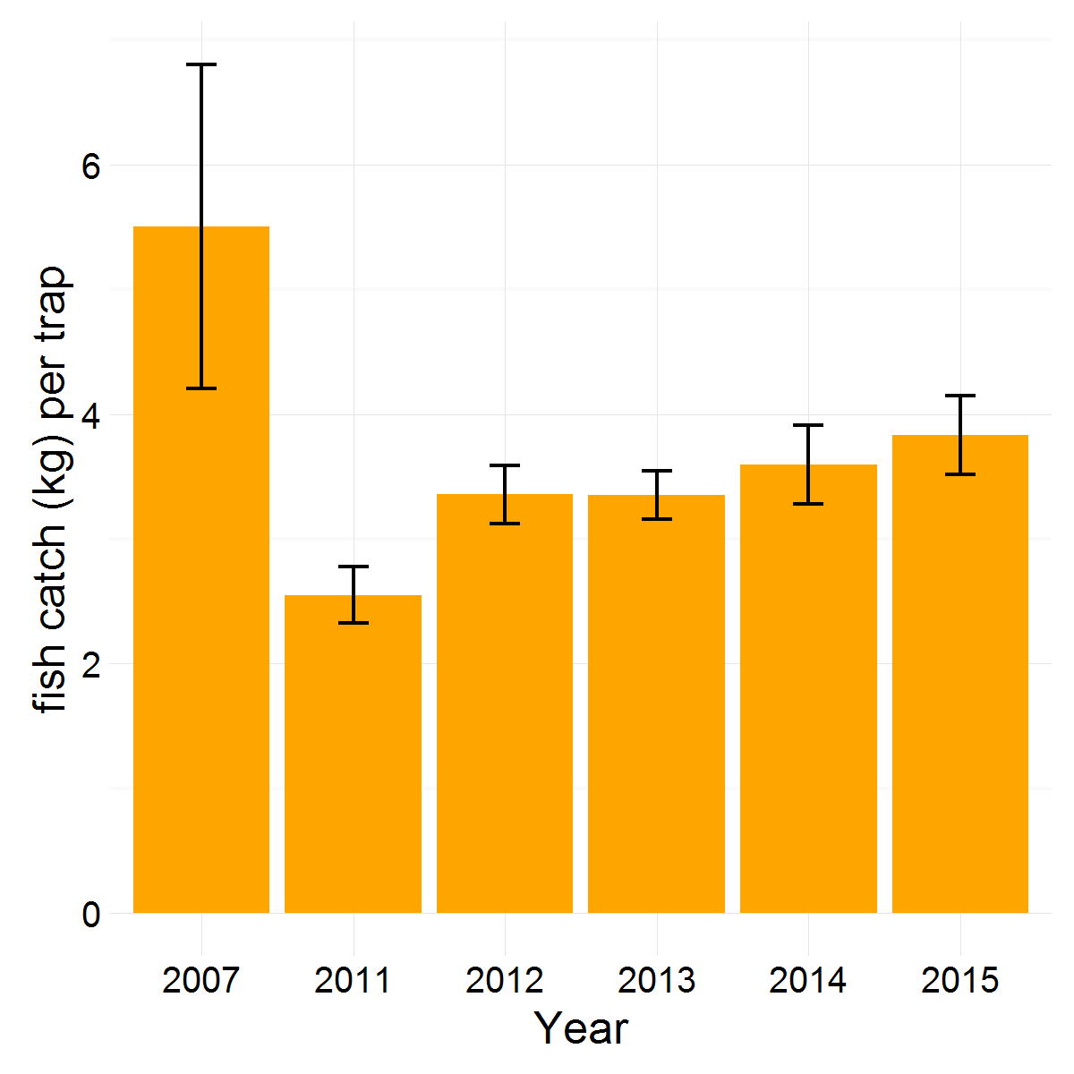
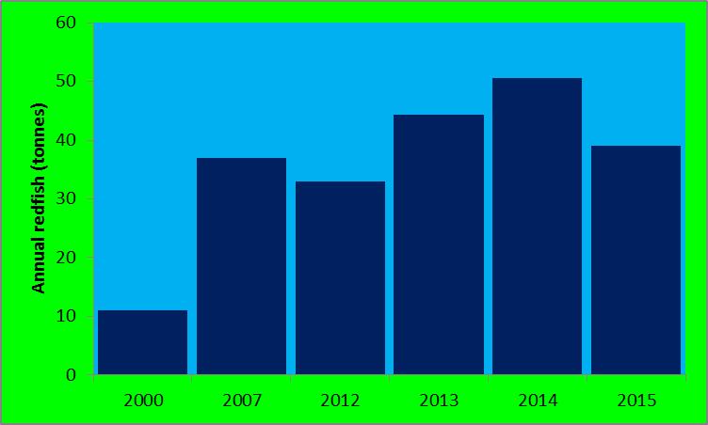
DEEP WATER SNAPPER....FISHERY
closure

Slide 8
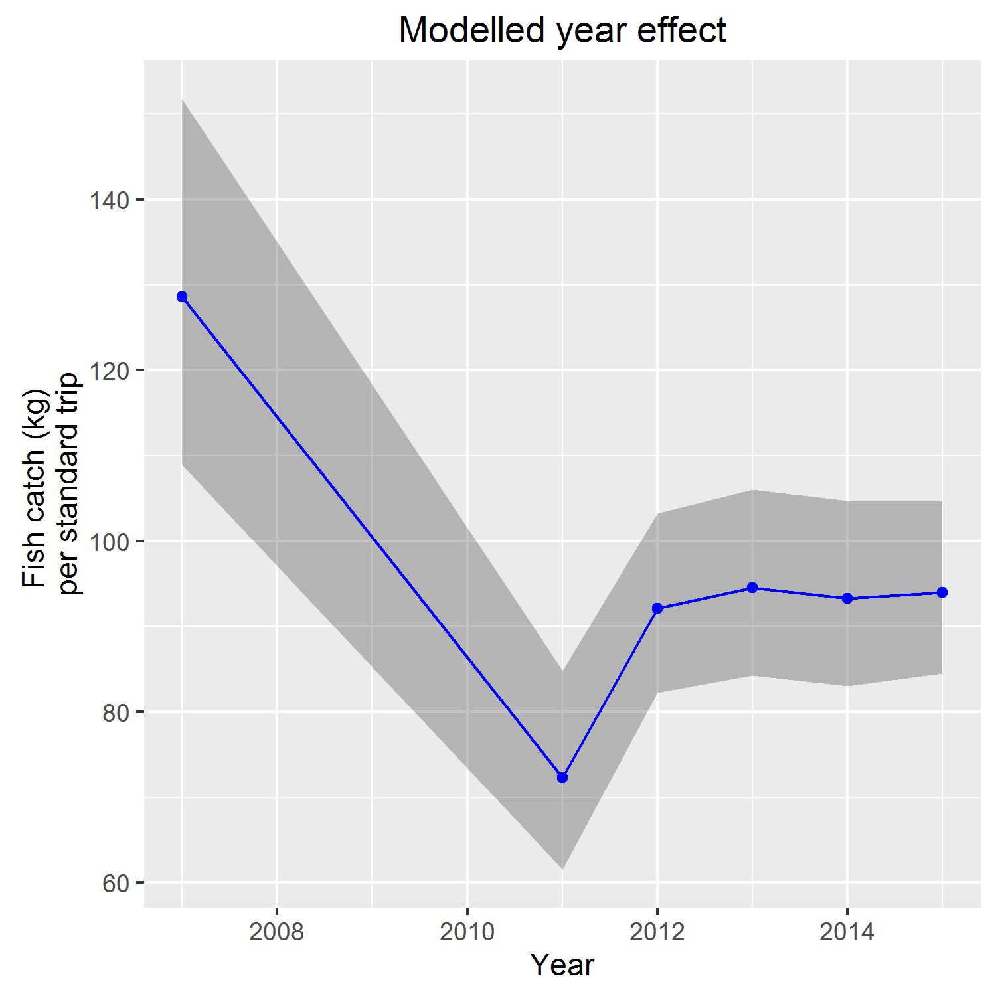
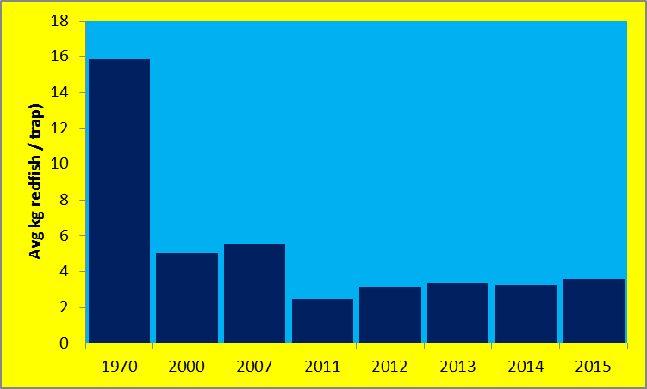
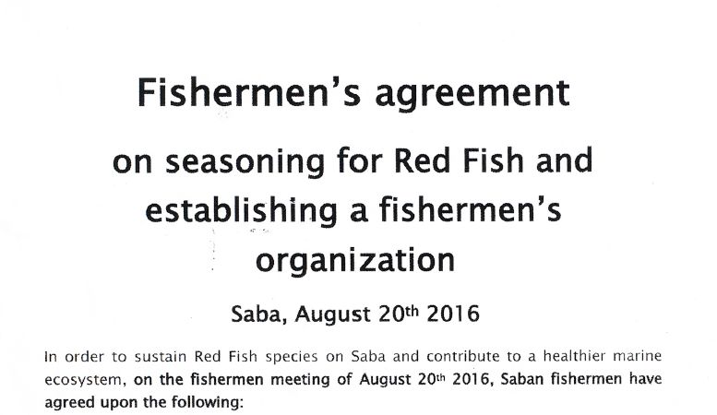
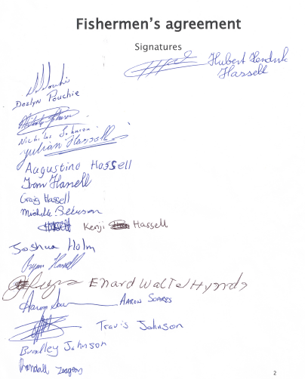
DEEP WATER SNAPPER....FISHERY
Declaration Fishers (2016):
  closed season 6 months; 25 traps per license (?)
  develop management framework and tools

Slide 9
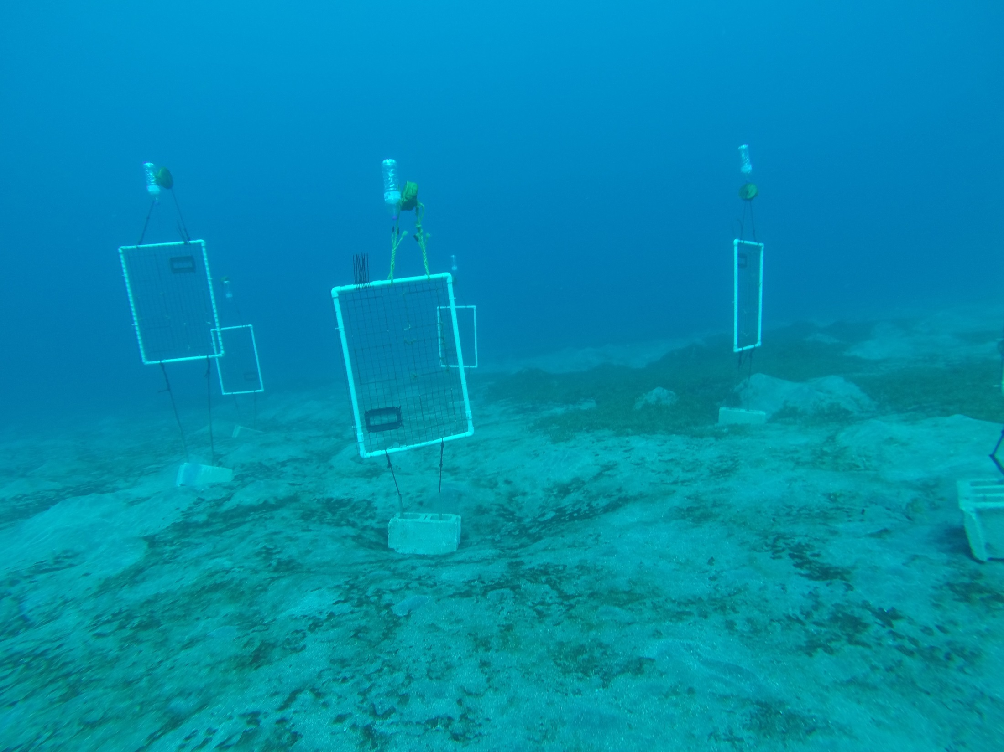
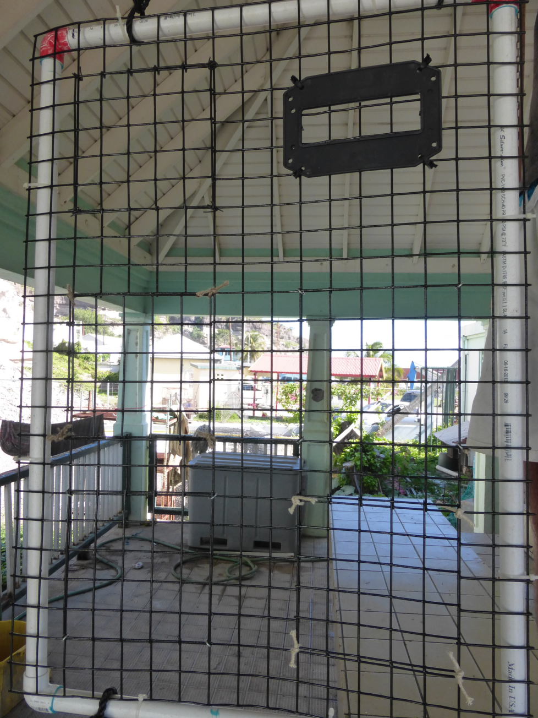
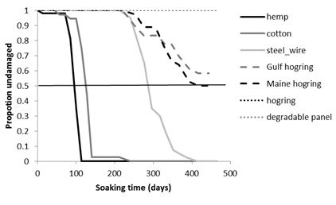
Sustainable traps: biodegradable panel
Current regulation
Biodegradable panel (20 d) obligatory
No enforcement & no compliance (20d)
Ghost fishing a problem?

Slide 10
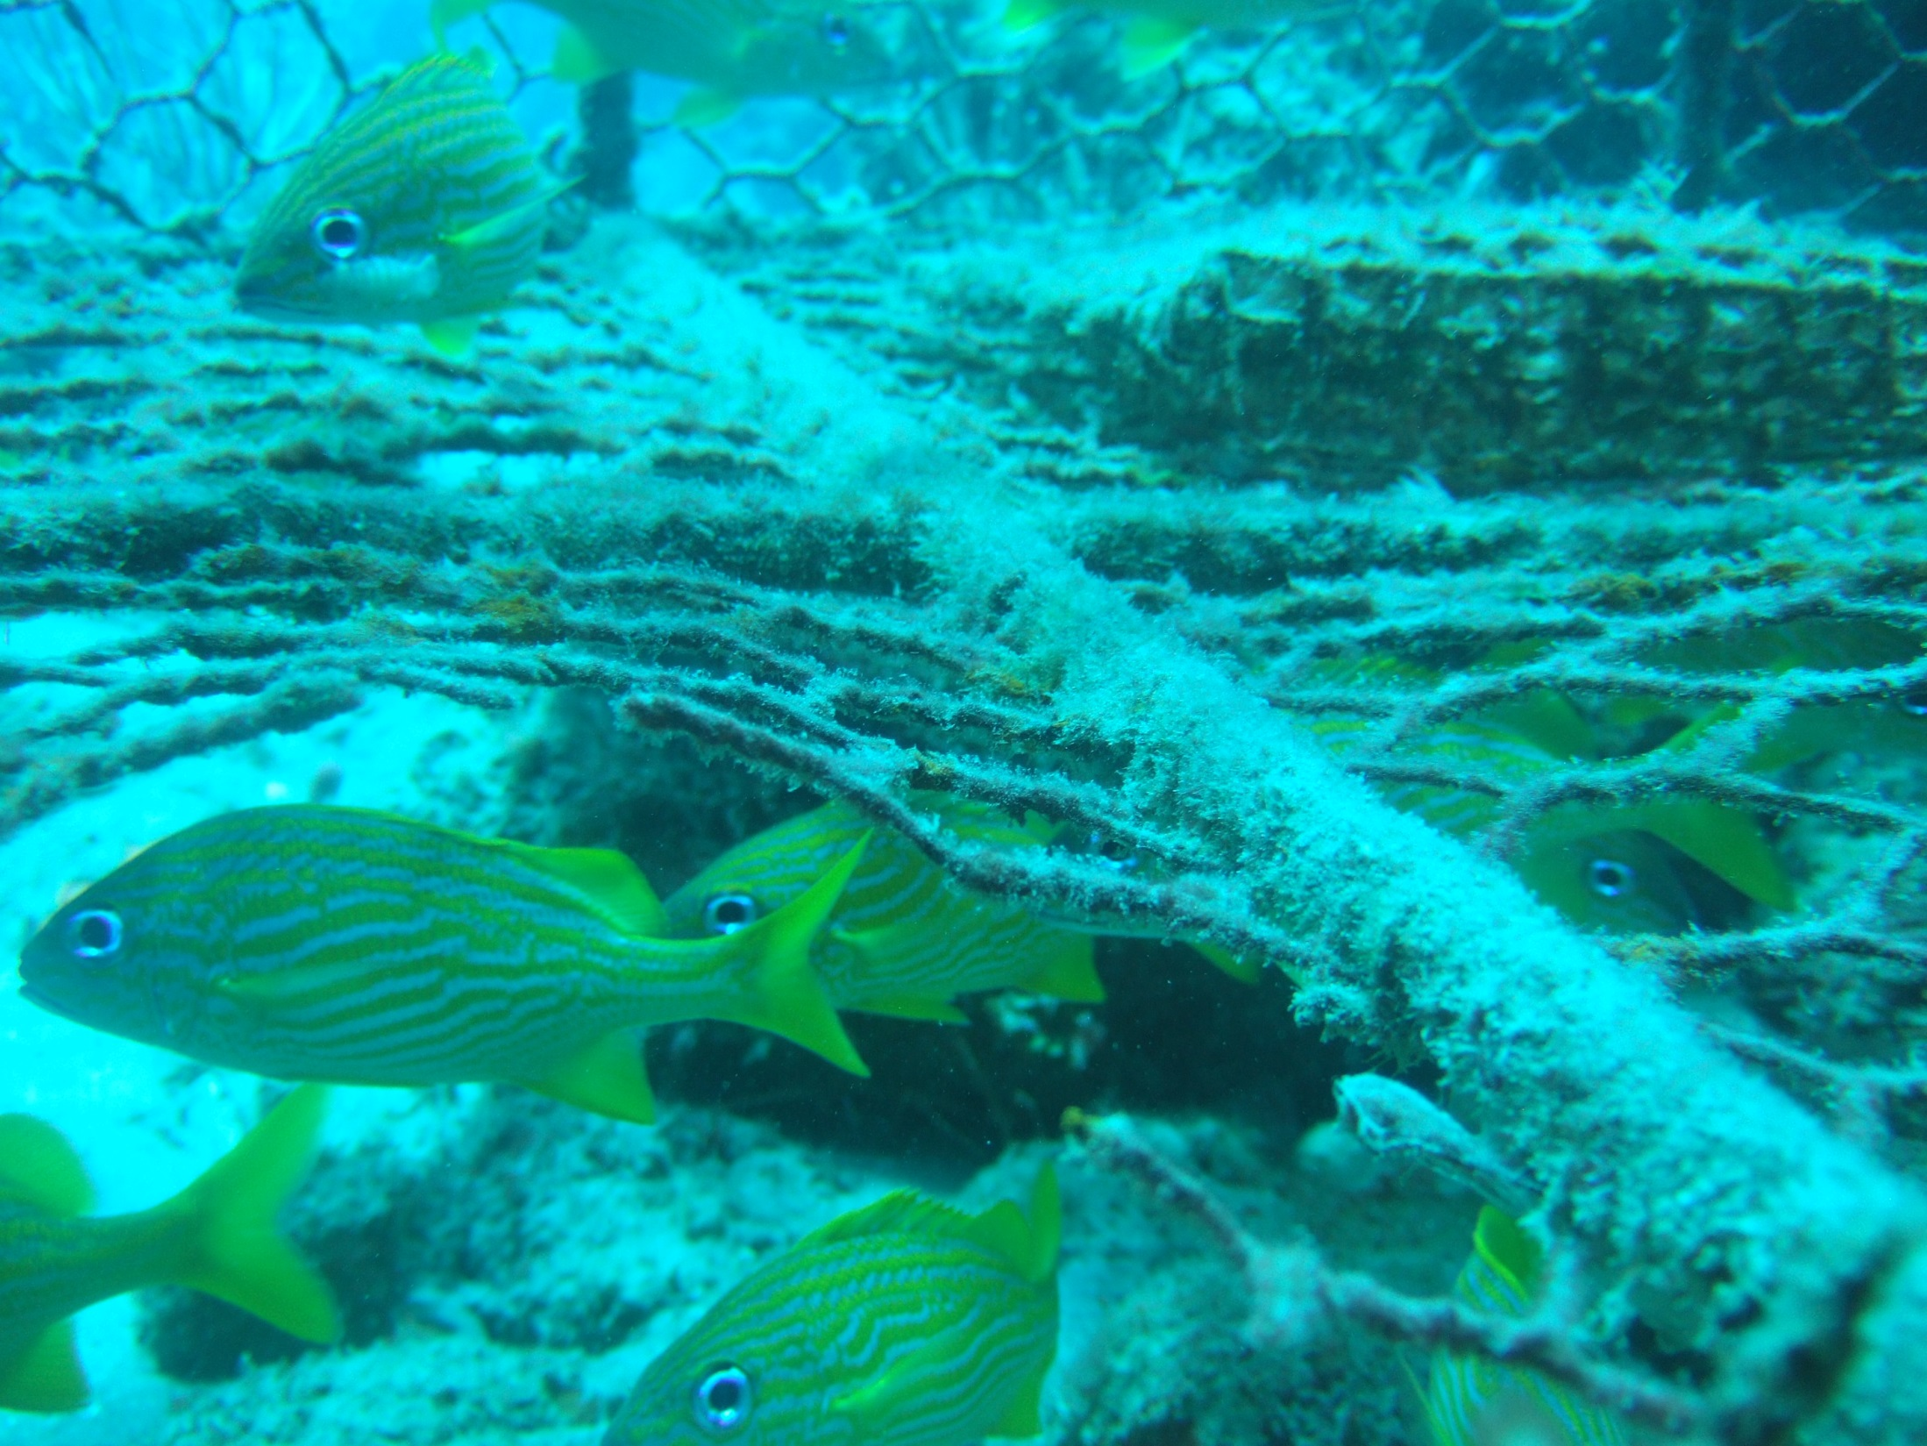
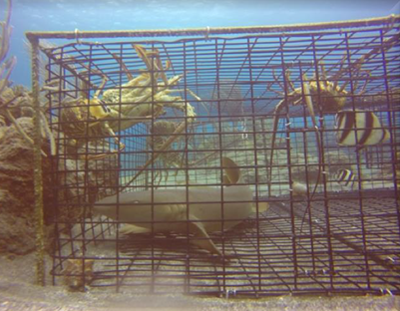
Sustainable traps: ghost fishing
 | This study | Butler & Matthews (2015) | Renchen et al. (2014)
Duration | 3 months | 32 months | 6 months
Reef fish
Avg no live fish per trap | 2.3 | 2.9 | 1.8
Mortality (%) | 2% | 1.7% | 2%
Kg dead / trap / year | 2.7 |  | 3.9
Lobster
Avg no live lobster per trap | 3.5 | 3.9-4.8
Mortality (%) | 0.8% | 1.8%
No. dead / trap / year | 2.7 | 3-7
SABA BANK:
0.6 lost traps per trip, 400-600 annually
FISH: 2160-4680 kg or $23000 - $51000
LOBSTER: 2600-10000 kg or $46000-$176000
Ghost fishing a problem?

Slide 11
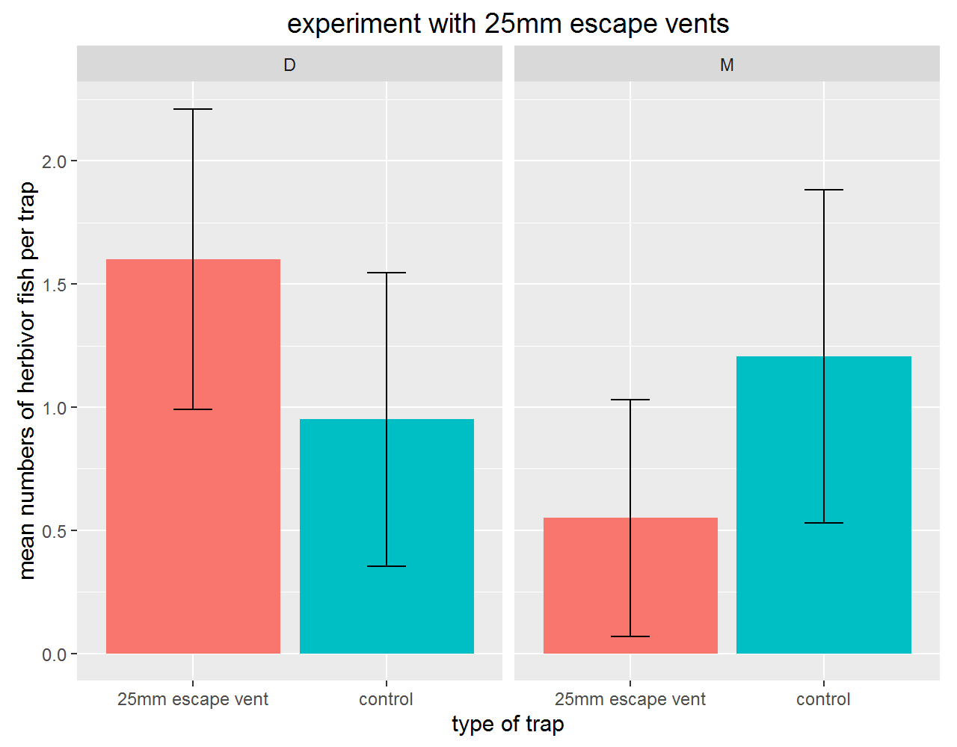
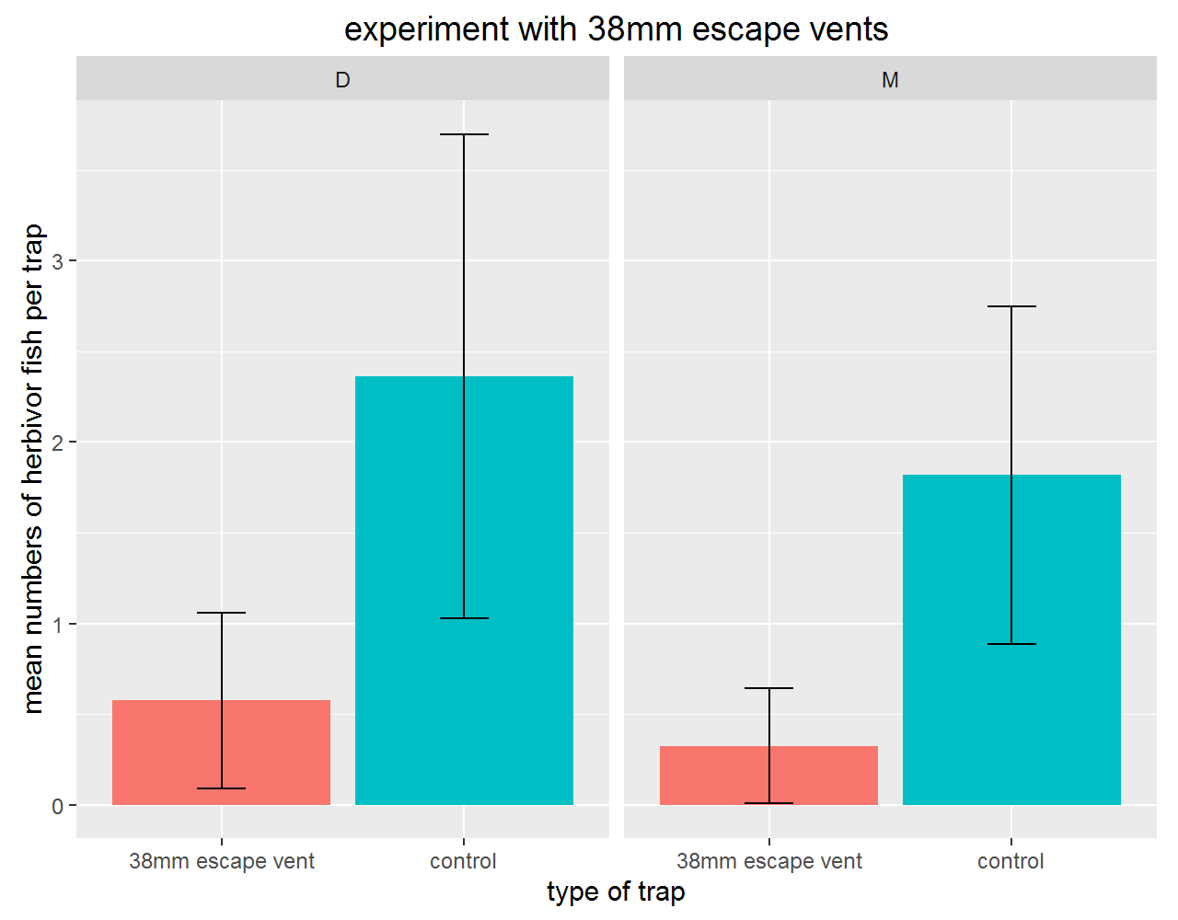
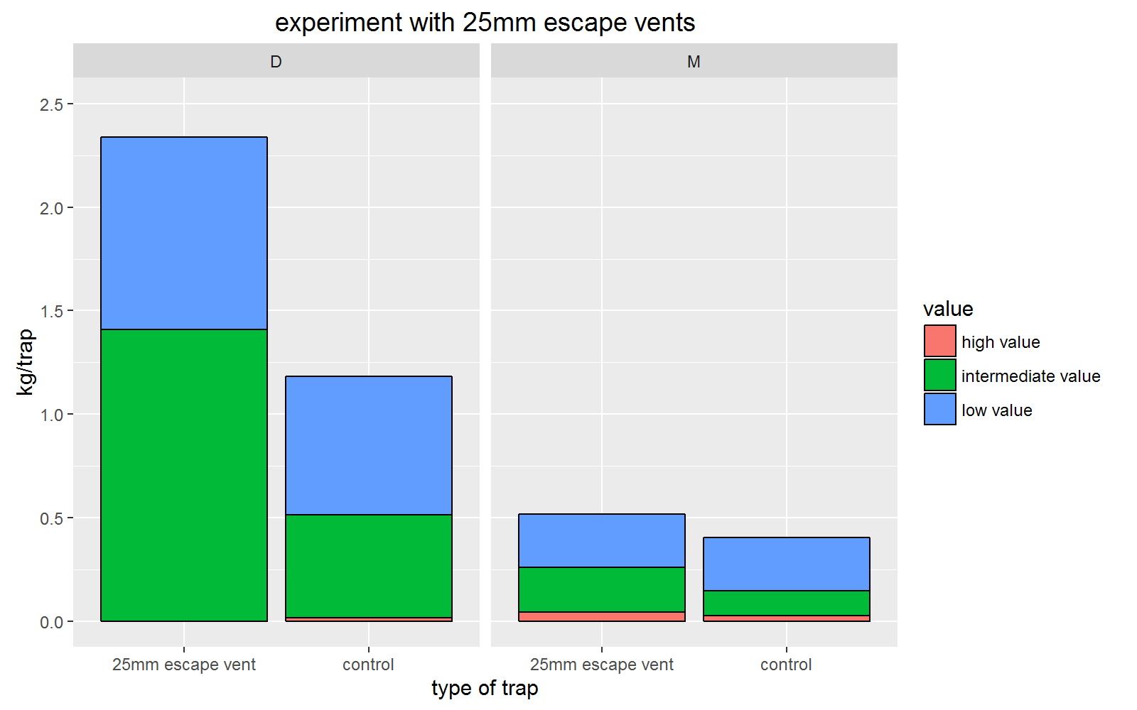
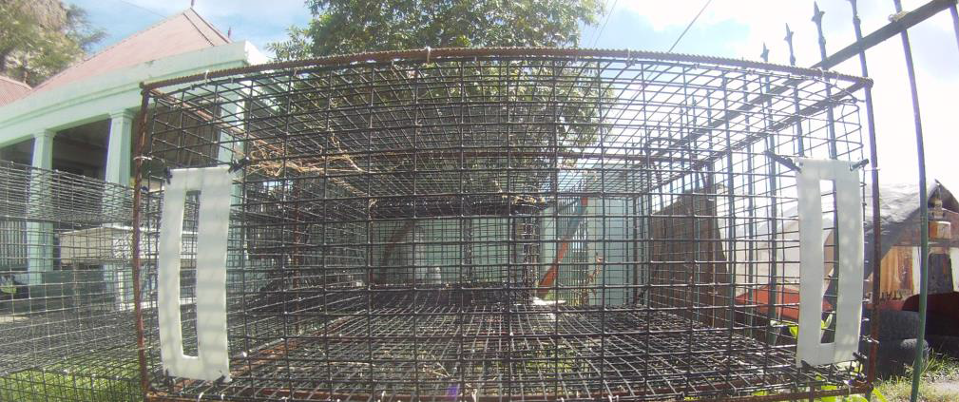
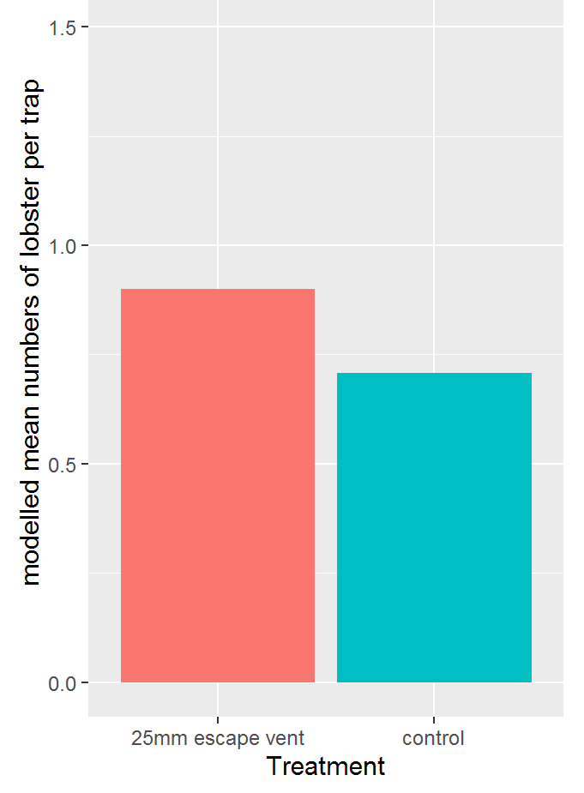
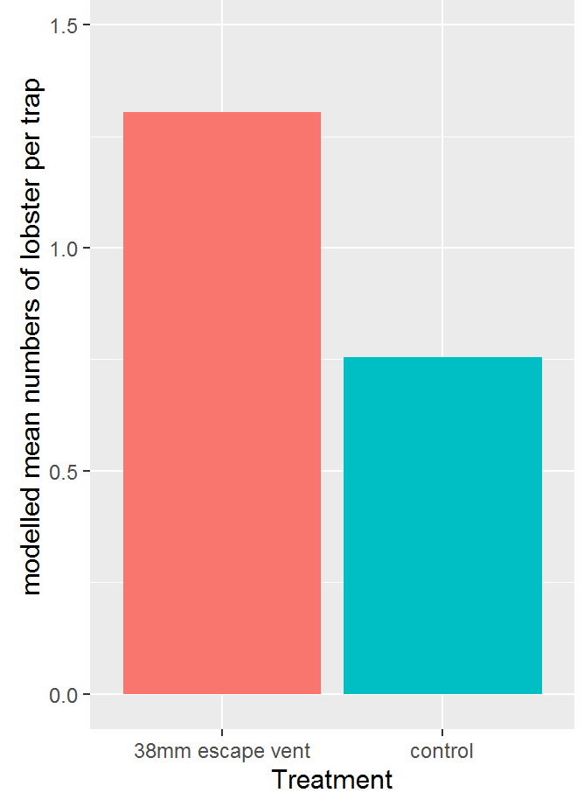
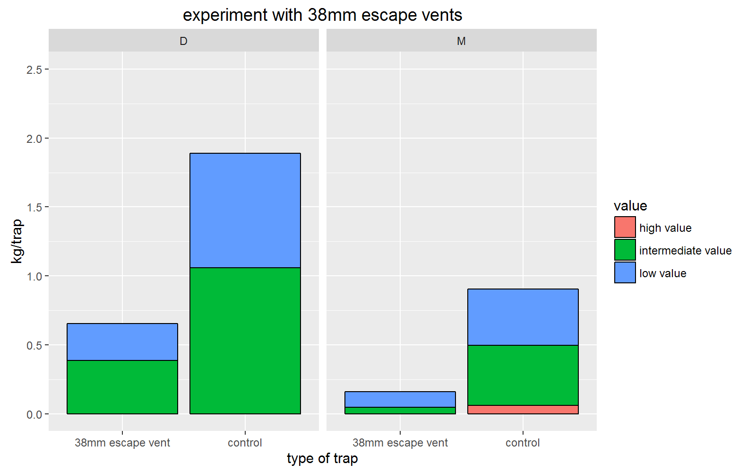
Sustainable traps: escape slot
herbivore
5ft
4ft
5ft
4ft
5ft
4ft
lobster
5ft
4ft
Lobster : no effect trap type or escape slot on catch
Fish: effect trap size and 38mm slot, 25mm slot ambiguous
If lobster, not fish maintarget -> 38mm slot with biodegradable material
DO NOT REMOVE TRAPS: HABITAT & DAMAGE BY REMOVAL

Slide 12
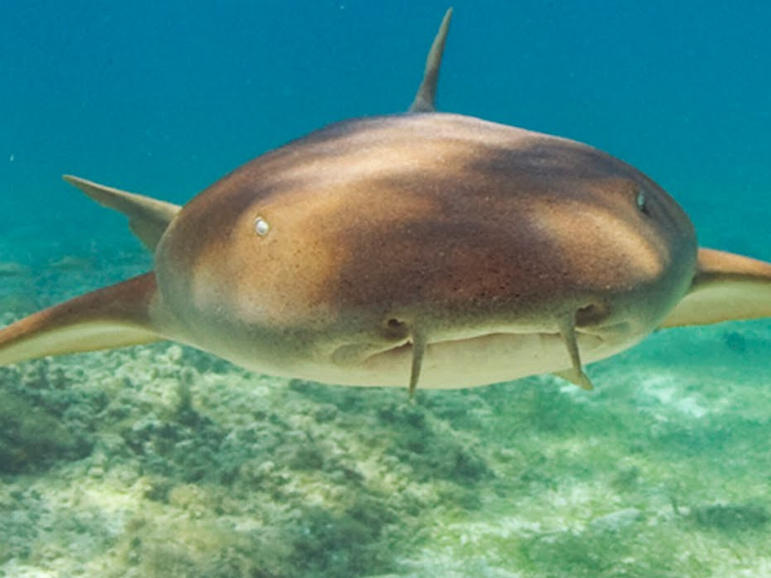
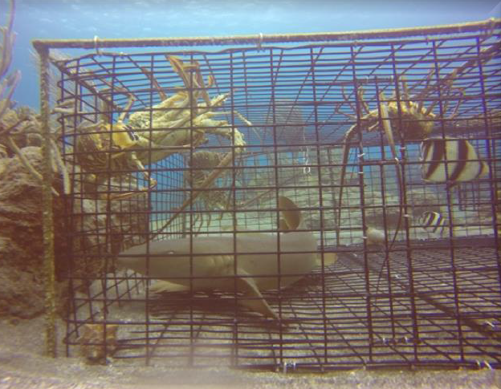
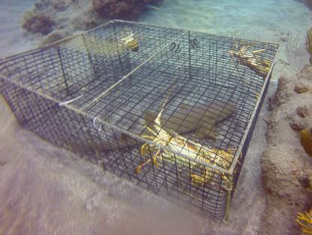
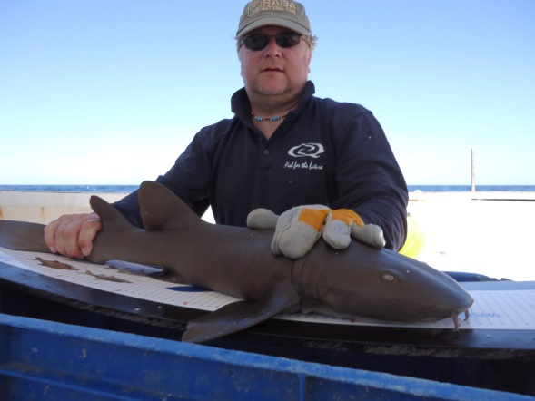
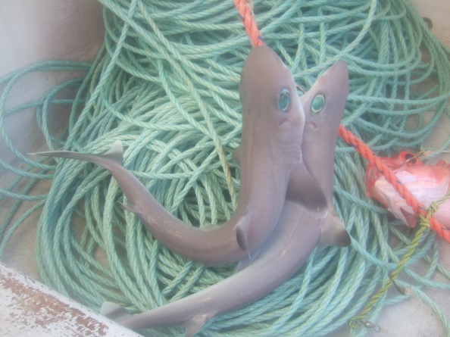
shark catch & discards
LANDINGS
  0.5% in weight = ~50-100 kg shark -> negligible
DISCARD
  0.01 (sampling) – 0.013 (interviews) nurse sharks per trap lift
  50 000 – 75 000 trap lifts -> 500 – 950 nurse sharks
  problem for shark population or predominantly nuisance fishery?
DW Handline
Few trips!

Slide 13
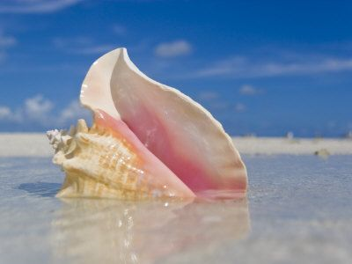
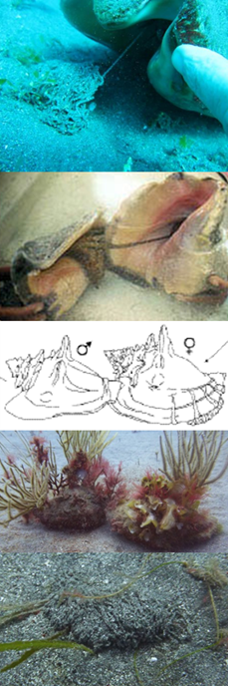
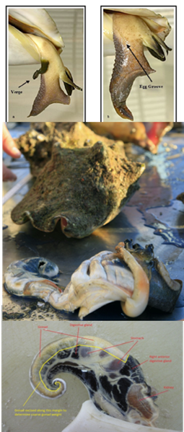
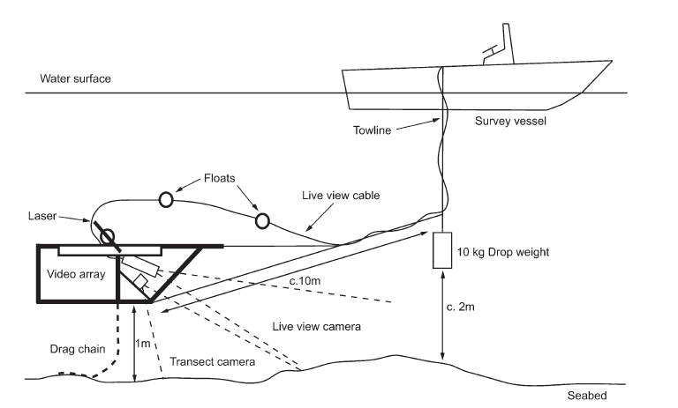
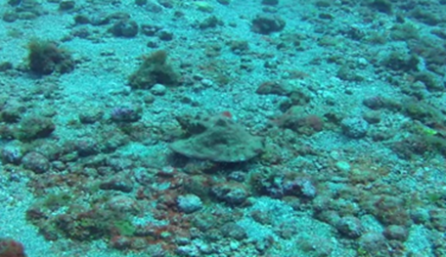
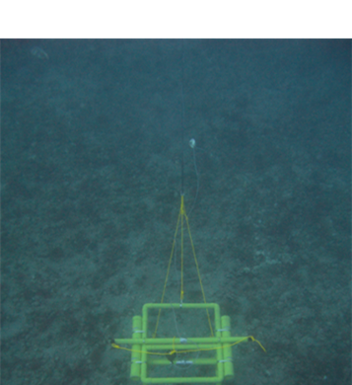
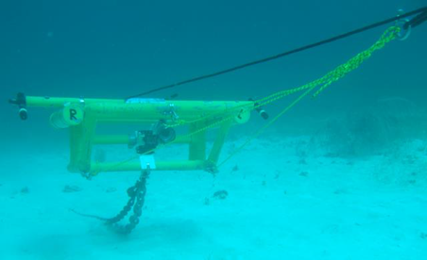
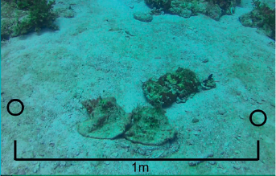

QUEEN CONCH
Size
At
Maturity
Spawning
Season
Distribution
&
Abundance

Slide 14



QUEEN CONCH
Spawning season:
  JUN-SEP
Size-at-maturity:
  LT50% = 10mm
Stock:
  14 million

Slide 15
QUEEN CONCH
Spawning season:
  JUN-SEP
  Policy: season
Size-at-maturity:
  LT50% = 10mm
  Policy: min size
Stock:
  14 million
  Policy: quota
“Policy package”

Slide 16


Acknowledgements
Saban fishers
Students: Michelle, Imke, Melanie, Jimmy, Dagmar, Sander, Wouter
SBMU: Jimmy, Dahlia, Melanie, Brooke, Pouchie
Saba Conservation Foundation: Kai, Jelle, Gregoor
Ministry of Economic Affairs
200m
20m

