Slide 1
‘Sustainability transition’ in rich country agriculture and the global poor
Niek Koning

Slide 2
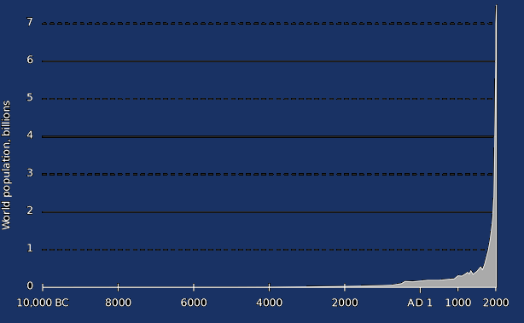
From 19th century: Fossil fuel revolution (motor power, modern transport, artificial fertilizer, synthetic products, etcetera)
World population (billions)
7
6
Strong increase in the global room for human consumption (for as long as it lasts!)
Increase in average welfare
Explosion in world population
5
4
3
2
1
0
Notes:
Technical potential is estimated by combining land / climate data and crop models

Slide 3
Impact on agriculture
Dependence on soil-bound biological processes → Fossil Fuel Revolution revolutionized global production potential, but not economies-of-scale in farming
Consequences:
Squeeze on farm profits (oversupply not compensated by market power)
Farming left to self-employed workers (or 2nd-rate capitalists)
Implementation of Fossil Fuel Revolution in agriculture (‘green revolution’) dependent on government support
Notes:
Technical potential is estimated by combining land / climate data and crop models

Slide 4
Regional differences
N.B.: Some Western countries engaged in aggressive export policies
West & Japan introduced active farm policies from the late-19th century
Early Green Revolution → ‘structural transformation’ (= industrialization etc.)
Demographic slowdown (‘completion of the demographic transition’)
In Asia, colonialism postponed active farm policies
Poverty trap (vicious cycle of resource depletion and high population growth)
Independent governments changed course in the 1960s-70s→ belated Green Revolution → industrialization & dismantling of population bomb
In Africa, neocolonialism blocked a belated turn to active farm policies
Late decolonization and internal factors prevented Africa from introducing active farm policies before the advent of the neoliberal era
No Green Revolution → Africa fell into the poverty trap from which Asia had escaped
Notes:
Technical potential is estimated by combining land / climate data and crop models

Slide 5
Meanwhile in rich countries: Growing uneasiness about the Fossil Fuel Revolution
‘Objective’ reasons:
Climate change and other serious environmental problems
Limits to potential for raising global food production through fossil-fuel-based techniques
Gradual depletion of exploitable fossil fuel resources
‘Subjective’ reasons:
‘Biophilic gene’, alienation and increased welfare leading to romantic longing for naturalness → anti-technologism (especially projected on agriculture)
Notes:
Technical potential is estimated by combining land / climate data and crop models

Slide 6
Arcadianism and the CAP From greenwashing dumping to sacrificing productivity?
From the 1990s, the EU has capitalised on Arcadian sentiments to greenwash its aggressive export policy
‘Green’ direct payments to farmers to continue exporting below cost of production in spite of WTO restrictions on export subsidization
New EU Farm-to-Fork Strategy: 20% less N-fertilizer, 25% of farmland under organic agriculture by 2030
This means a reversal of agricultural intensification
Few hard measures envisaged to reduce EU consumption,
so this would raise international food prices
Model studies: EU farm production will be around 10% lower
Notes:
Technical potential is estimated by combining land / climate data and crop models

Slide 7
How will Farm-to-Fork-type reforms in rich countries impact on the global poor?
Potential positive effects
Higher world market prices may stimulate agricultural development in poor countries (especially if they have active farm policies, but have they?)
Reduced production may reduce incentives for rich countries to pursue aggressive export policies (such as the EPAs the EU is imposing on Africa)
Potential negative effects
Increased structural scarcity may exacerbate food price peaks that wreak havoc in poor countries
More generally: Farm policy Arcadianism may stimulate the idea that poor countries should forgo the agricultural Fossil Fuel Revolution
Notes:
Technical potential is estimated by combining land / climate data and crop models

Slide 8
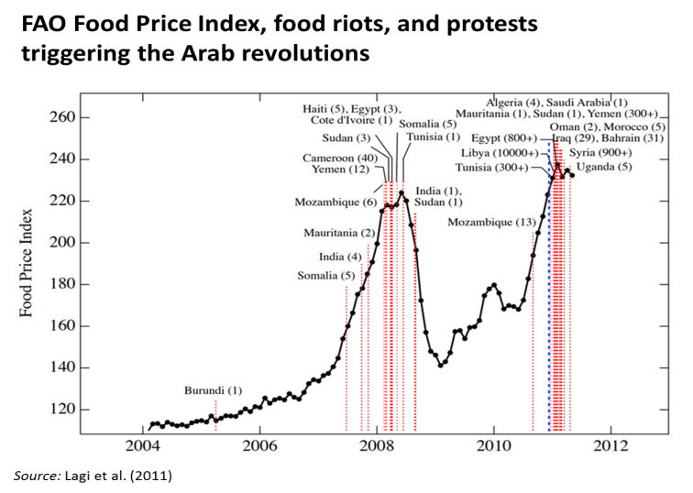
How will Farm-to-Fork-type reforms impact on the global poor?
Potential positive effects
Higher world market prices may stimulate agricultural development in poor countries (especially if they have active farm policies)
Reduced production may reduce incentives for rich countries to pursue aggressive export policies (such as the EPAs the EU is imposing on Africa)
Potential negative effects
Increased structural scarcity may exacerbate food price peaks that wreak havoc in poor countries
More generally: Farm policy Arcadianism may stimulate the idea that poor countries should forgo the agricultural Fossil Fuel Revolution
Notes:
Technical potential is estimated by combining land / climate data and crop models

Slide 9
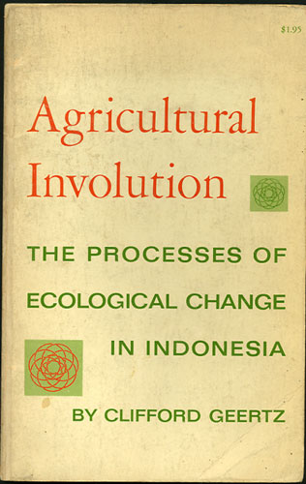
How will Farm-to-Fork-type reforms impact on the global poor?
In Asia before the Green Revolution, low-external-input coping strategies didn’t allow the rural poor to break out of the poverty trap
Potential positive effects
Higher world market prices may stimulate agricultural development in poor countries (especially if they have active farm policies)
Reduced production may reduce incentives for rich countries to pursue aggressive export policies (such as the EPAs the EU is imposing on Africa)
Potential negative effects
Increased structural scarcity may exacerbate food price peaks that wreak havoc in poor countries
More generally: Farm policy Arcadianism may stimulate the idea that poor countries should forgo the agricultural Fossil Fuel Revolution
Clifford Geertz
Notes:
Technical potential is estimated by combining land / climate data and crop models

Slide 10
Why low fertilizer approaches won’t help Africa
African population is exploding
Demographers project a 50% to 100% increase between now and 2050
Land is growing scarcer → preventing high food import bills (which Africa cannot pay for) requires large yield increases
Van Ittersum et al. (2016): without sacrificing biodiversity, yields must grow even faster than during the Asian Green Revolution
On average, natural land productivity in Africa is low → achieving sufficient yields requires large additions of soil nutrients
Today, fertilizer/ha in Africa is only one-seventh of that in rich countries!
Inserting legumes etc. is useful, but far from enough
Approaches that resist strong increases in modern inputs condemn Africa to the poverty trap
Notes:
Technical potential is estimated by combining land / climate data and crop models

Slide 11
Is there an alternative?
Reduce the pressure of the global affluent on land resources
Reduce food waste, feedlot beef & biofuels. Build dense green cities, etc.
Allow poor countries to develop, also to dismantle the population bomb
Stop enforcing free trade, stabilize international commodity markets, co-finance investment in hard & soft infrastructure, co-finance employment programs etc.
Return to a balanced organization of agricultural markets in rich countries, and couple it to responsible environmental policies
Impose sensible environmental minimum norms on farmers. Stabilize prices at a level that allows farmers to respect them, using supply controls to prevent surpluses
Work at a new post-fossil fuel technical revolution that increases the carrying capacity of the planet for human life
Advanced biological/ICT-based farming techniques, ocean farming, decarbonization of the non-food economy
Notes:
Technical potential is estimated by combining land / climate data and crop models

Slide 12
What can Wageningen academics do?
Expose the real problems, including Western trade policies
Criticize romantic ideologies that obfuscate the reality of our world
Work at advanced post-fossil-fuel techniques
Stop asking tax money for biobased economy research
Notes:
Technical potential is estimated by combining land / climate data and crop models

Slide 13
More information:
Notes:
I have written this book. I am not a historian, and it’s not meant as a historical study, but as an attempt to shed light today’s urgent questions about poverty and hunger and fears for food scarcity in the future. But for that, you need to understand the dynamics, and to do that, you cannot do without history.
And so, like many historians, I have been wrestling with the question why hunger and poverty have strongly decreased in some parts of the world but not in others. Many answers have been given: ecological endowments, cultural heritage, inclusive vs extractive institutions, etc. My answer is a bit more complex and multi-causal. It could be summarized like this:

