Slide 1
Erasmus+ papers workshop
First semester 2023-2024

Slide 2
Content
Introduction
Deadline
How to start?
How to save the documents?
Grant Agreement
Learning Agreement
Changed Learning Agreement
OLA (online Learning Agreement)
OLS test

Slide 3
Introduction
Erasmus+ program
Benefits:
No tuition fees
Courses are accepted in Wageningen
Financial support
Notes:
If you want to go on study exchange it’s obligatory to fill in the Erasmus+ document. These will give you the Erasmus+ status. So you don’t have to pay tuition fee and your courses are accepted for your study in Wageningen. Moreover you also apply for the Erasmus+ grant.

Slide 4
Deadline
June 1st
Grant Agreement
Learning Agreement / OLA
OLS test
Remember also to check the application deadline of the host university! → this deadlines differ from the Erasmus+ deadline
Notes:
The deadline for the Erasmus+ documents is June 1st. If you’re too late we cannot guarantee you the Erasmus+ grant, but you still have to hand them in otherwise you cannot go on study exchange with Erasmus+ status.
There is 1 exception: the Learning agreement or OLA, sometimes it’s not possible to hand this in before the deadline. You can hand in this later but make sure to hand it in (only hand it in fully signed) before your departure.

Slide 5
How to start?
Download the documents: www.wur.eu/exchange
Notes:
You can find the documents (and more information) on our website: www.wur.eu/exchange → erasmus+ grant (information and application) → procedure Erasmus+ grant application

Slide 6
How to save & name the documents
Grant Agreement for study
Name: GA [Lastname]
For example: GA [Janssen]
Learning Agreement for study
Name: LA [Lastname]
For example: LA [Janssen]
Notes:
Fill in the documents and safe them by following this example above.

Slide 7
Grant Agreement
‘Contract’
Read the full document
Sign the 6th page
Notes:
The Grant agreement can be filled in with the instructions in the document: how to fill in grant agreement. This is found on our website under: Useful information to fill in the GA and LA.

Slide 8
If you are doing introduction days or a language course, these starting dates can be also included in the Grant Agreement
Notes:
Fill in your wur ánd private e-mail address. And cross at which e-mail you want to receive your emails. Use the list with isced codes to pick the correct one. Read the info in red → don’t forget to sign.
In your current grant agreement you need to cross the box that you’re aware of handing in the Learning Agreement (not yet in this presentation)

Slide 9
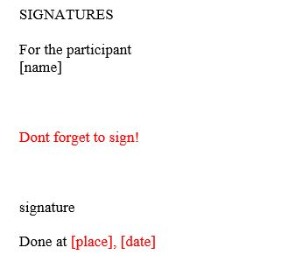
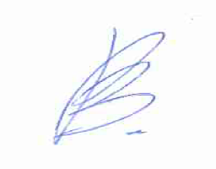
Sign the Grant Agreement
Option 1:
Fill in the document typed by the computer and later print it
Sign with your handwriting
Scan the full document
Option 2:
Sign by scanning/making a picture of your signature
Notes:
There are different possibilities to sign your documents.

Slide 10
Sending the Grant Agreement
Make sure you send the full document (ALL pages)
We need to see what you signed!
See information at the WUR printers/scanners for instruction to scan all pages in one document
If your exchange period exceeds 6 days or more, then you have to mention it on your Grant Agreement, you also need to ask for an extension. Contact your exchange coordinator & the exchange office
erasmus.studentexchange@wur.nl
Notes:
Hand in all pages, preferably in 1 pdf. Check information at the printers. Scanners how to make 1 pdf.

Slide 11
Learning Agreement
See page 5 for explanation of the end notes
Notes:
The Learning Agreement has some footnotes that can help you to fill in the required information.

Slide 12
Notes:
In table A you have to fill in the courses that you want to follow at the receiving institution. Your exchange coordinator and the responsible person of the receiving institution will check if you can follow this courses. At table B you only have to fill in for how many ECTS you go on exchange. At WUR we have free choice ECTS in our Bachelors so you don’t have to replace courses during your exchange. For the language competence your can use the OLS test to confirm your level or assume at which level you currently are.

Slide 13
Option 1:
Fill in the document typed by the computer and later print it
Sign with your handwriting
Scan the full document
Option 2:
Sign by scanning/making a picture of your signature
1
2
3
See information at the WUR printers/scanners for instruction to scan all pages in one document
Notes:
Sign the document yourself after you’’ve filled in everything. Then ask your exchange coordinator to sign or and as third you can send it to the responsible person of the receiving institution.

Slide 14
Sending the Learning Agreement
Make sure you send the full document (ALL pages)
We need to see what you signed!
See information at the WUR printers/scanners for instruction to scan all pages in one document
erasmus.studentexchange@wur.nl
Notes:
Hand in all pages, preferably in 1 pdf. Check information at the printers. Scanners how to make 1 pdf.

Slide 15
Changes to the original Learning Agreement
Write the dates of these changes
See page 2 of the original Learning Agreement document
Include the new courses
All parties have to sign it
1
2
3
Notes:
This part only needs to be filled in DURING your exchange. After you’ve filled in the changes you have to got it signed again by all parties mentioned on the Learning Agreement.

Slide 16
OLA (Online Learning Agreement)
Welcome to OLA | OLA (learning-agreement.eu)
Via this link you can register for OLA
Please make sure that all your personal and academic details are correct.
Please make sure to fill in all the required fields when you submit the OLA otherwise the coordinators will decline it.

Slide 17
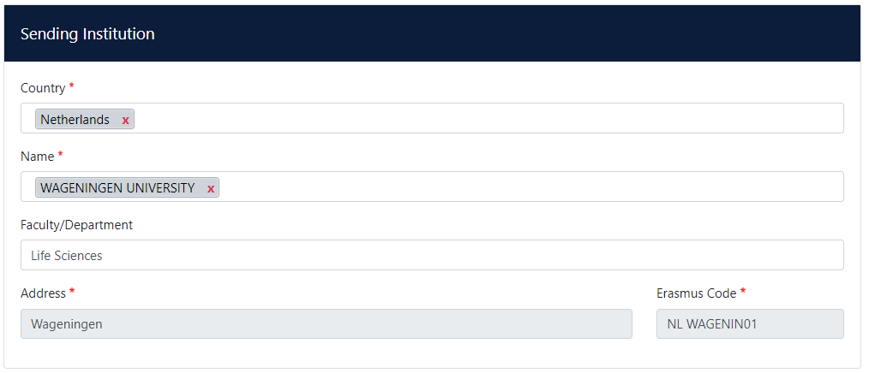
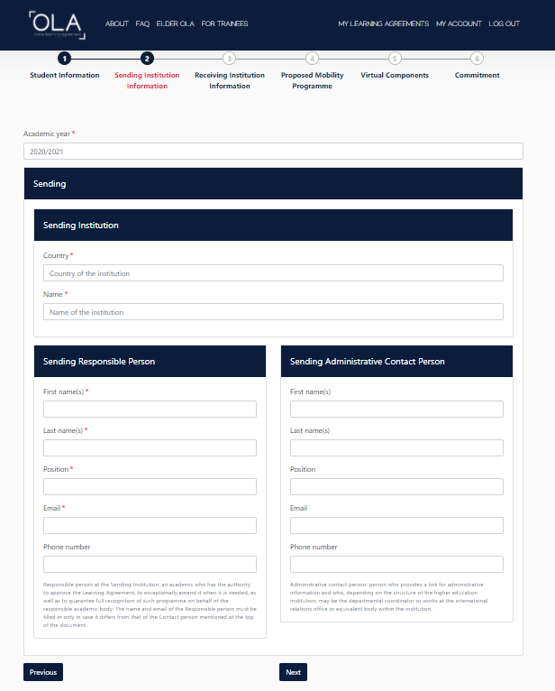
Sending Institution: Select your home institution from the list as shown in the picture on the right side. The WUR has only one Faculty, the Life Sciences, so please fill it in.
Responsible Person at the Sending Institution: Based on your field of study, please fill in your one of the WUR Erasmus Exchange Coordinators (if your field of study concerns life sciences, choose then Hanna Gooren and fill in the contact details as shown in the example on the right side):
Hanna Gooren, +31 317 483956, lifesciences.studentexchange@wur.nl
Dennis Duindam, +31 317 482774, environmentalsciences.studentexchange@wur.nl
Marita van den Bergh, +31 317 482743, socialsciences.studentexchange@wur.nl
Ellen de Jong, +31 317 482591, technology.studentexchange@wur.nl
Sending Administrative Contact Person: you can either leave it blank or fill it in as in the example on the right side.
Hanna
WUR Exchange Team
Gooren
WUR Exchange Team
ERASMUS Exchange Coordinator
ERASMUS Exchange Administrators
lifesciences.studentexchange@wur.nl
erasmus.studentexchange@wur.nl
+31 317 483956
+31 317 485799

Slide 18
Login in to your Online Learning Agreement
Application Erasmus+ grant Study
Creating your Online Learning Agreement
Making changes in your Online Learning Agreement

Slide 19
OLS
Language test – Compulsory before & after exchange
Optional: language course (you can choose the language you would like to learn if available)
You will receive more information after sending the Grant Agreement
Send a print screen of the OLS platform where your name and results are readable
Notes:
We will send information about the OLS test after you’ve handed in your Grant Agreement.

Slide 20
Summary
Send your Grant Agreement
Before June 1st
Send your Learning Agreement as soon as possible
Don’t forget to do the OLS test
erasmus.studentexchange@wur.nl
Notes:
If you still have unclarities after this powerpoint, please e-mail us.

Slide 21
Upon return
Send the following documents to Exchange office
‘Statement of Receiving Institution’
‘Transcript of Records’ from receiving institution
‘Academic Recognition Form’ from Wageningen University
Complete the following requirements:
Second OLS test
Student report (EU report from Mobility website)
WUR goes abroad survey
Notes:
In the month before you return we will send you an e-mail with information about the documents that you’ve to hand in after your return. This information can already be found on our website.

Slide 22
Thank you for your attention!
WWW.WUR.EU/EXCHANGE

