Slide 1

Fighting Food Insecurity:
Lessons and Experiences from Asia
(Joe) Zhangyue Zhou
College of Business, Law and Governance
James Cook University
Australia
zhangyue.zhou@jcu.edu.au

Slide 2
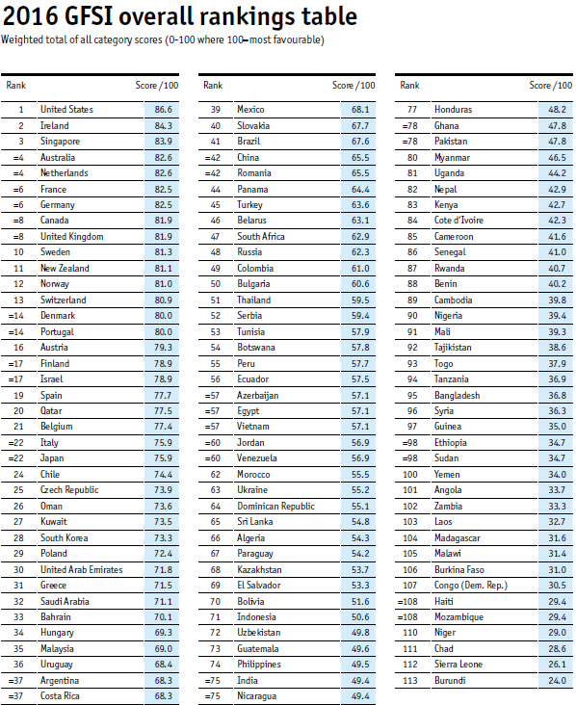






Notes:
The vast difference calls for an examination of food security practices in various Asian countries to identify what forces are ultimately responsible for a country’s food security. If such fundamental forces can be established, many Asian countries with a poor food security status can be assisted in channeling their efforts in the right direction to improve their future food security. This is what we did in a project funded by the ADB on Asia’s food insecurity. We case-studied the PRC, India, Israel, Japan, the Republic of Korea, and the Democratic People’s Republic of Korea. We also looked into the food security practices of Singapore, Indonesia, Bangladesh, and Pakistan. Such cross-country comparisons helped us find out what causes the huge differences in the food security status in different countries and how they can learn from each other to achieve better food security for the growing Asia.

Slide 3
Motivation
To examine key determinants that affect food security in various Asian countries and to derive lessons and experiences from their quest for food security;
To suggest how countries with low levels of food security can learn from other Asian countries to improve their food security for the future.
Notes:
Huge improvements since the 1980s
Current ranking, the Economist
Remaining and emerging issues/problems/challenges

Slide 4
Outline of the presentation
Food, food security, food security evaluation
Food security practices across countries
Major factors affecting food security
What can they learn from each other?

Slide 5
1. Food, food security, food security evaluation
In a physiological sense food is “nutritive material taken into an organism and which fulfils needs for maintenance, growth, work, and tissue repair” (WHO and FAO 1974, p. 10).
As such, food can be any nutritional materials taken by human beings which provide calorie, protein, fat and other essential micro nutrients.

Slide 6
What is food security?
“Food security exists when all people, at all times, have physical and economic access to sufficient, safe and nutritious food that meets their dietary needs and food preferences for an active and healthy life” (World Food Summit 1996).
Key dimensions:
  Food availability (all people … have sufficient … food)
  Supply sustainability (all people, at all times, have … sufficient … food)
  Food quality and safety (safe and nutritious food that meets their dietary needs)
  Cultural acceptability (food that meets their … food preferences)
  Access to food (all people … have physical and economic access to … food).

Slide 7
Diverse ways to evaluate
Examples:
  The Oshaug, Eide and Eide way (1994)
  The USAID way (1999)
  The FAO way
  The Economist way

Slide 8
The Oshaug, Eide and Eide way (1994)

Slide 9
The USAID way (1999)
FOOD
UTILIZATION
Quality
Dietary
Health
of Care
Intake
Status
Knowledge
Social
Cultural Practice
Services/
Time Allocation
Infrastructure
FOOD
Intrahousehold
ACCESS
Allocation
Food Banks
Food
Food
Market
Transfers
Production
Purchase
/Loans
FOOD
Government,
AVAILABILITY
NGO and
Community
Support
Food
Cash
Food Banks
Price
Income
Stocks
Cash Crops,
Imports
Wage Employment,
Food Aid
Other Income
Generating Activities
Community
Natural
Capital
Human
Resources
Resources
Resources
Resources
Natural Environment
Policy Environment
Social Environment

Slide 10
The FAO way

Slide 11
The Economist way

Slide 12
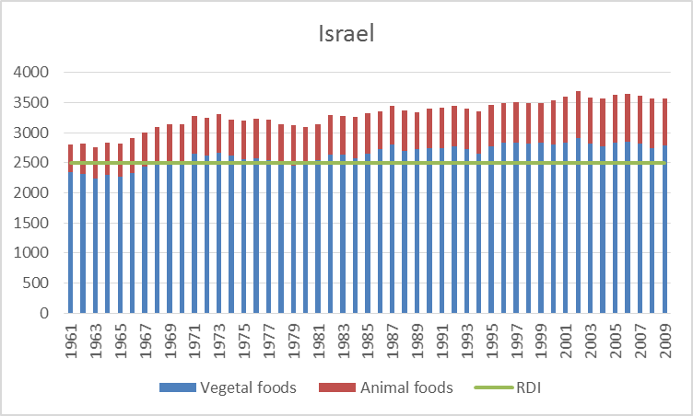
Food availability by country:
Dietary energy supply

Slide 13
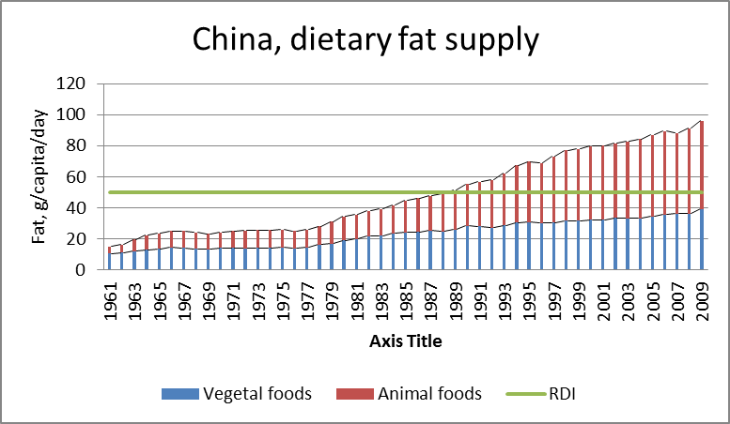
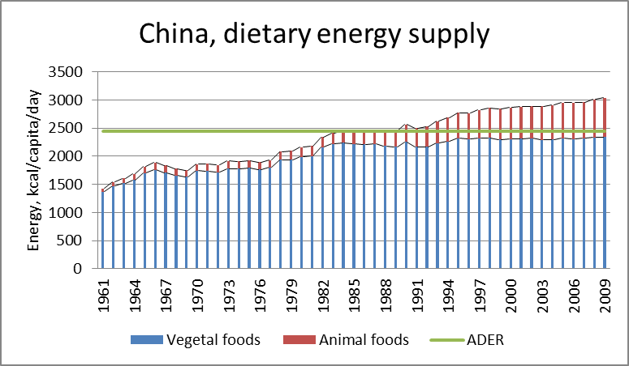
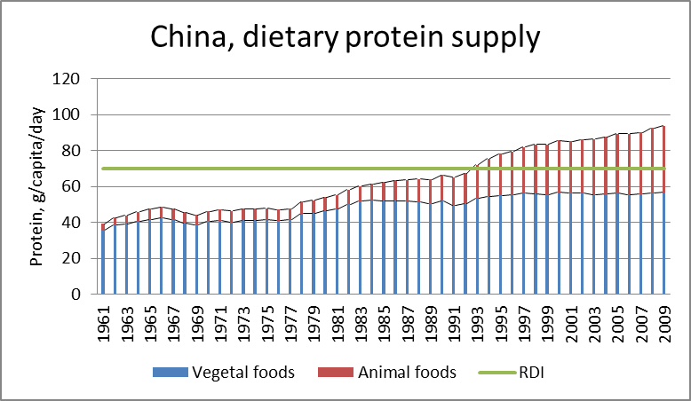
Significantly improved food availability in China since the early 1980s

Slide 14
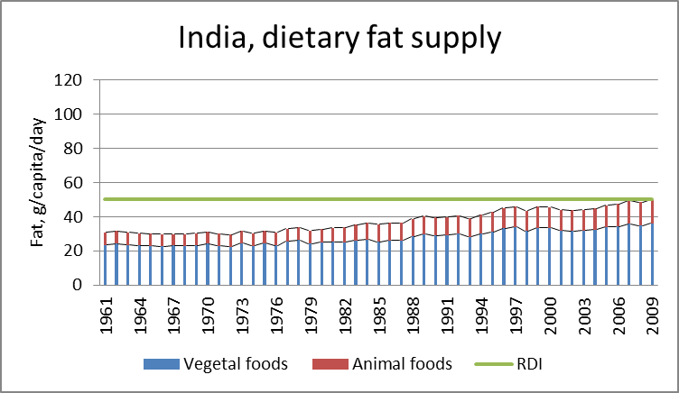
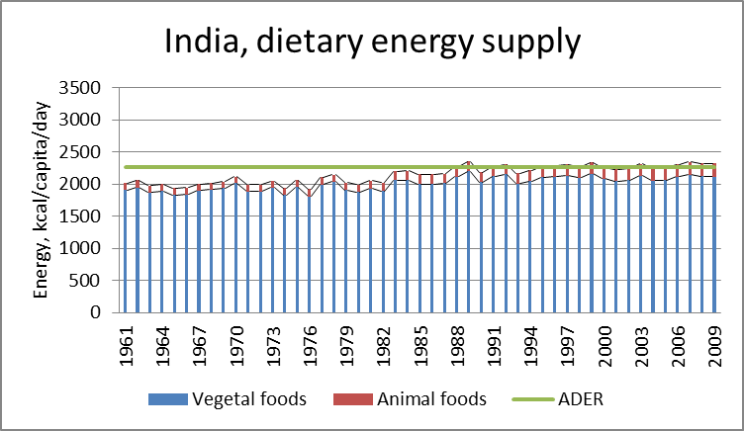
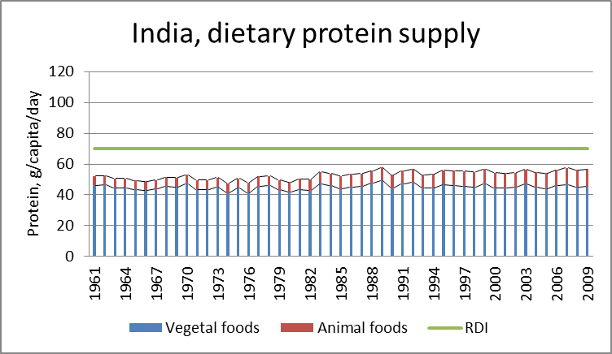
India’s food availability is only marginally adequate

Slide 15
2. Food security practices across countries
Food security:
  Supply of food (production, imports, food aids)
  Demand for food (distribution/market, relief)
China, India, Israel, Japan, North Korea and South Korea
Notes:
What to do to ensure better food security: manage supply and demand.

Slide 16
Managing the demand and supply sides of food security

Slide 17
3. Major factors affecting food security
Factors that facilitate a higher level of food security:
  Responsible governments with accountable officials, efficient operations, and transparent policy processes
  Institutional arrangements that promote sustained economic development and equitable income distribution and redistribution
  Institutions that deter corruption
  Laws and regulations that enable the market to function well
  Adequate levels of investment in agricultural key infrastructure and agricultural research, development, extension, and education.

Slide 18
Factors that impede a country’s food security:
  Forced collective farming
  Compulsory delivery of food from farmers to the government
  Absence of a market or a heavily controlled market
  High incidence of poverty and severe income inequalities
  Inadequate use of trade by a country
  Disharmonious international trade institutions that disturb trade.

Slide 19
Factors that do not have deterministic impacts on food security:
  The size of a country’s population
  The availability of food production resources
  Culture and traditions
  Weather conditions.

Slide 20
Among all the factors that affect food security, institutions matter most.
“Institutions are systems of established and embedded social rules that structure social interactions” (Hodgson 2006: 18).

Slide 21
Five primary institutions among all human groups:
  governmental institutions,
  economic institutions,
  educational institutions,
  family institutions, and
  religious institutions.
Among these five institutions, governmental and economic institutions are the most fundamental as far as the impact on food security is concerned.

Slide 22
Food security, corruption, democracy, resources, population, and income levels

Slide 23
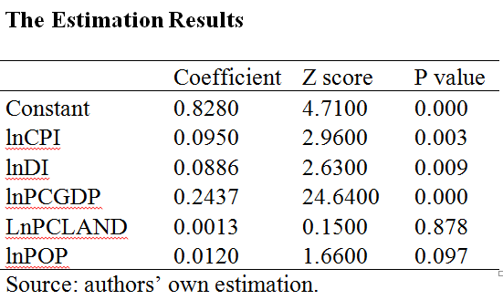
What does the empirical evidence tell us?

Slide 24
Policy implications
Most important implications:
Getting the institutions right
  governments are held accountable to their people
  ensuring food security of citizens is government responsibility
  government operations are transparent and efficient,
  the corruption is effectively curbed
Growing the economy and sharing the proceeds of the growth equitably
Markets are allowed to function more freely
Farmers are offered financial rewards comparable to people working in other industries.

Slide 25
Policy implications
Other important implications:
Having adequate investments in agriculture
Having a designated government body in charge of food security
Handling food emergencies according to their severity
Fostering dynamic food security policies
Encouraging the private sector to play a major role in coordinating food production, distribution and consumption.

Slide 26
Investing in overseas food production and exporting
Contributing to world peace
Supporting harmonious global trading institutions
Reducing food waste
Safeguarding food safety and quality

Slide 27
4. What should food less-secure Asian countries learn from others?
Countries in Asia with low levels of food security need to first look into how they are governed, not how economically poor they are or how short of resources they are.
They need to pay attention to the most fundamental forces that affect food security: get their institutions right and foster strong institutions in their country.
Their governments need to accept that ensuring food security is their responsibility. The right to secure food intake by every individual should be written in, and protected by, law.

Slide 28
What do they need to do?
Carry out institutional reforms.
Reforms to both governmental and economic institutions (and other institutions).
Reforms to economic institutions without to governmental institutions: may help a country to improve food availability but not food security.
Ensure an effective and efficient market.
In peace times, let the market coordinate food demand and supply.

Slide 29
Postscripts (food for thought)
Every country is able to achieve a reasonable level of food security.
  Some countries do not, because their governments/rulers could not care less.
  Some governments/rulers may try to achieve a higher level of food security so that they can continue their ruling (when people have something to eat, they are less likely to rebel; a high level of food security is hard to be achieved; even if achieved, cannot be expected to sustain).
  Some governments try to achieve a higher level of food security in order to promote and sustain a civil society (a high level of food security can be expected to sustain).

