Slide 1


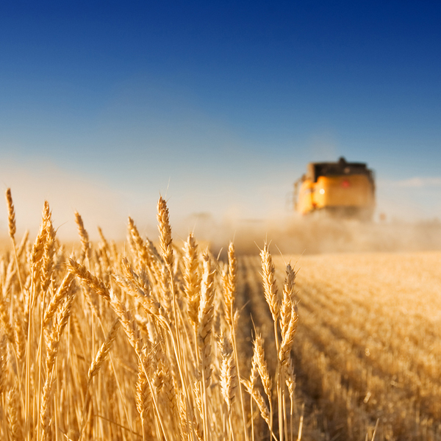
WOFOST- wFLOW KB 35-008-002
Results, insights and progress
Allard de Wit, January 2020

Slide 2
Modelling tools for
KB Food-security and water
Globally >70% of fresh water is used for agriculture
Timeliness and availability of fresh water is crucial for sustaining and increasing agricultural productivity
Modelling tools are useful for:
  Understanding the links between hydrology and agriculture
  Understanding the impact of changes in land use (e.g. increased irrigation) on productivity, hydrology and ecology at catchment scale
  Monitoring current conditions and interventions
  Climate change impacts

Slide 3
About WOFOST & W-FLOW
WOFOST (Wageningen-UR):
Model for estimating crop productivity as a function of weather, soil, management
Operationally applied for crop monitoring and yield forecasting
Drawback: catchment hydrology not included
W-FLOW (Deltares)
Catchment-hydrology model for estimating water fluxes and water availability
Operationally applied for catchment studies
Drawback: has no modules for crop productivity

Slide 4
Connecting WOFOST and W-FLOW
Allows direct coupling between hydrology and agricultural productivity:
  Impacts of changes in hydrology on the local water availability can be simulated
  Realtime status of root zone soil moisture over the catchment can be used by WOFOST in order to predict crop yields
  Changes in the agricultural system (e.g. use of cover crops instead of bare fields) can now be incorporated in WFLOW and its effect on the hydrology can be taken into account
I

Slide 5
Current status
Prototype coupling has been achieved
“Loose” coupling through a BMI interface (no code changes to the model itself)
Current prototype has been implemented for the Moselle Catchment in Germany (200x300 km)
Issues to solve:
  High memory and CPU usage
  Set up of more realistic crop cultivars and spatial distribution
  Evaluating of the coupled system to observations or regional statistics

Slide 6
CPU time usage

Slide 7
Memory usage

Slide 8
Full screen image with title

Slide 9
End slide or section heading
Tekst

