Slide 1
And now the Framework
WP4

Slide 2
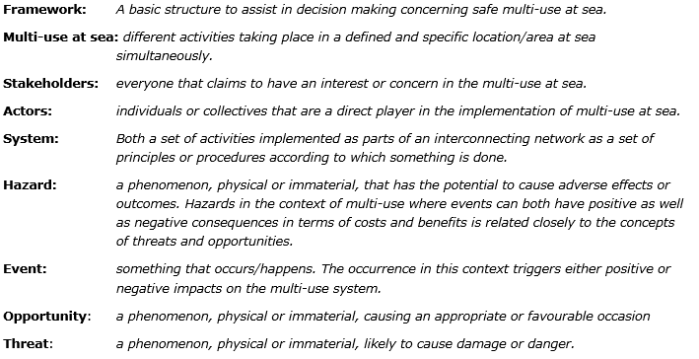
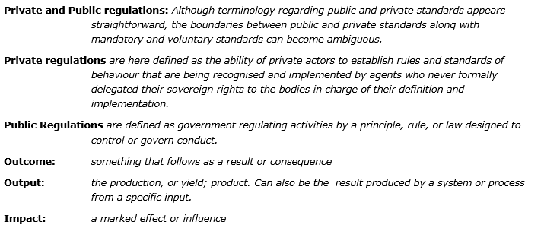
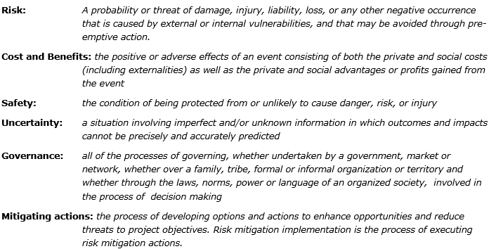
First.... language

Slide 3
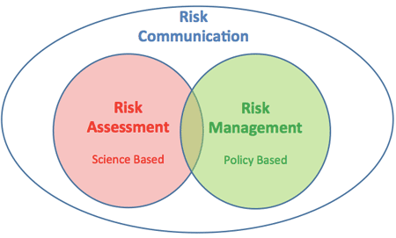
Then...... The frame
FAO, 2017
IMO, 2002
Mazaheri et al, 2016
Grabowski et al, 2000
IRGC, 2012

Slide 4
What we learned
Dynamic & Cyclical
Different perspectives
Different aspects
Stakeholder involvement
Communication
Phases

Slide 5
Socio-ecological factors

Slide 7
Exploring | Identify the multi-use activities planned or taking place Identify relevant actors Describe the multi-use system
Stakeholders | Stakeholders can provide data, information and evidence on crucial steps in the multi-use system
Tools | Policy Analysis Stakeholder Mapping Stakeholder Analysis

Slide 8
Understanding | Identify opportunities and threats (hazards) to the multi-use system Identify ambiguities and uncertainties in the multi-use system Implement a Formal and Participatory Risk Assessment Identify control options, mitigation measures and coping strategies
Stakeholders | Stakeholders assist in developing a shared identification of hazards and risks
Tools | Event and fault trees Probability estimations Bayesian networks

Slide 9
Appraising | Assess hazards, risks, consequences under different scenarios and events, given the current level of knowledge and understanding Appraise risk management options
Stakeholders | Stakeholders provide norms and values to be included in the appraisal of scenarios, likelihoods and consequences and in the development of acceptance criteria for mitigating measures.
Tools | Identification critical hazards Cost-Benefit Analysis Multi-criteria Analysis Societal Cost-Benefit analysis

Slide 10
Deciding | Decide on actions to be taken
Stakeholders | Stakeholders are involved in the process via co-decision
Tools | Bayesian networks Decision Support Systems

Slide 11
Implementing | Implement actions on safety recommendation
Stakeholders | Actors implement the mitigating measures
Tools | Policy implementation

Slide 12
Evaluating | Review the safety concerns and action that were taken Determine if additional measures need to be included
Stakeholders | Stakeholders are involved in the analysis of the results
Tools | Participatory Evaluation Techniques Efficiency & effectiveness Evaluation

