Slide 1
UTZ Certified Business to business certification Marg Leijdens Standard & Certification Department - Cocoa June 2015
Notes:
This is the first Chapter, in which we offer you a general introduction to Utz Certified.

Slide 2
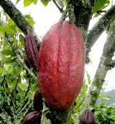
What is UTZ Certified?
UTZ Certified is a program and label for sustainable farming worldwide
Independent foundation since 2002
Developing sustainable agricultural supply chains through certification programs and traceability services for agricultural commodities
Coffee since 2002
Cocoa and tea since 2007 (Rooibos 2012)
Palm oil (traceability services)
Hazelnut (2014)

Slide 3
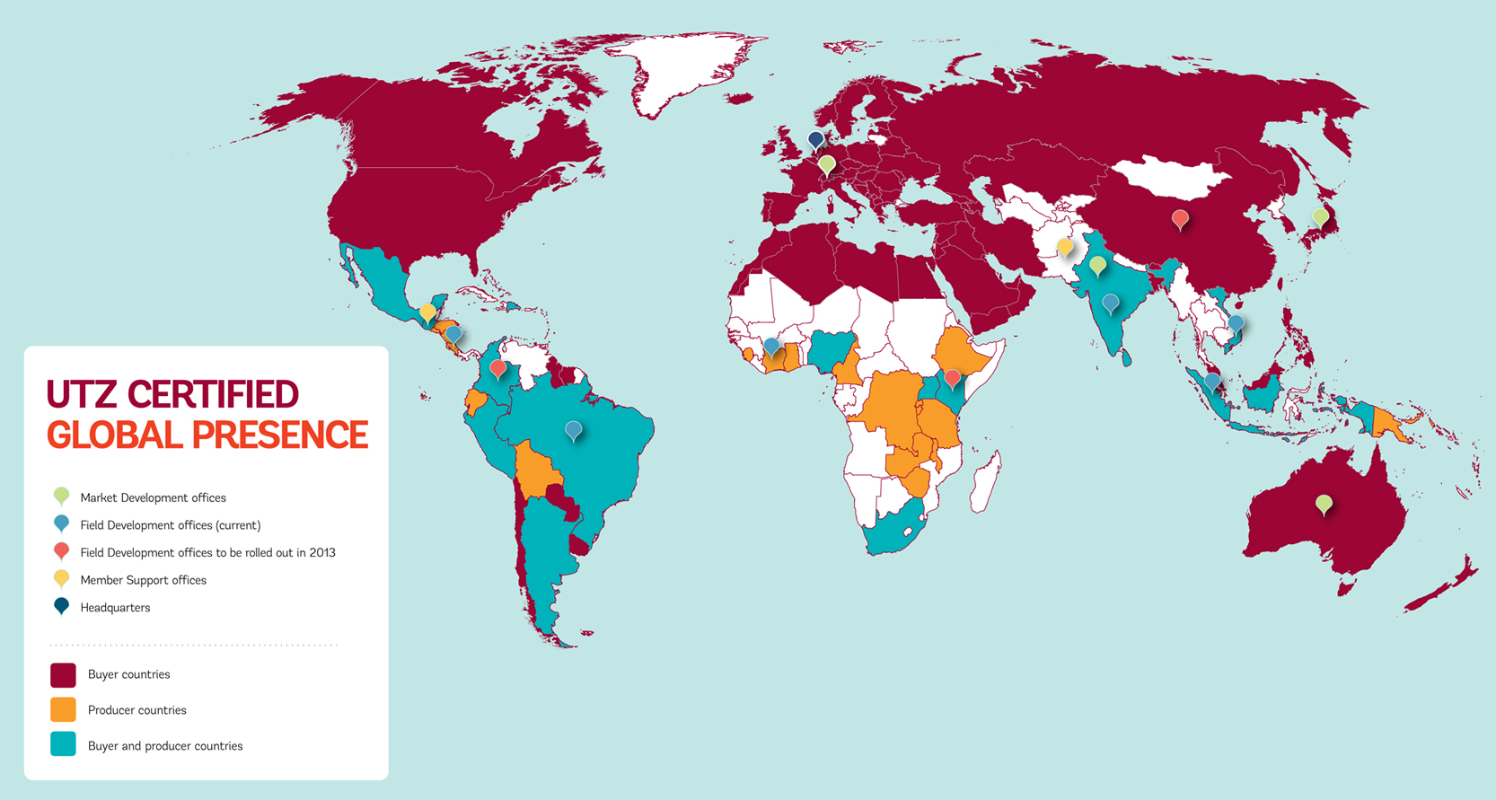
Where do we work?
Notes:
Turkey

Slide 4
UTZ Coffee Program
The largest coffee sustainability program worldwide (both in sales and supply).
UTZ Certified Coffee Sales
224,028 MT of UTZ coffee sold in over 62 countries
Production potential of 715,000 MT from 23 countries
The average weighted premium for UTZ certified coffee was 4.29 $c/lb.
x 1.000 MT
Notes:
Wat beceoelt met production potential
Sales zijn green beans of roasted? level?

Slide 5
UTZ Cocoa Program
UTZ Certified cocoa (MT) produced
Program launched in 2007, grown to be the leading one only in 5 harvests
Over 3.000 new UTZ chocolate products on the market throughout Europe, Asia, Australia, North and South America in 2012
118.641 MT cocoa sold in 2012.
Notes:
Distinction betweem 118.614 en 534,614
WWF
Prepare numbers on tea and rooibos

Slide 6
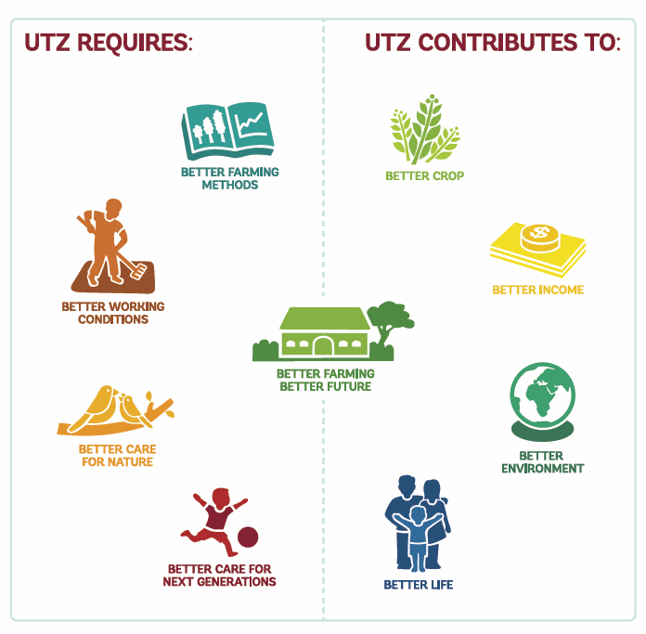
Theory of Change
Notes:
Bedenk een voorbeeld – dat een standaard / ontrol point anders is dan direct requirement
Verwijs ook naar poster

Slide 7
How does certification and traceability work?
P1
P2
Mill
Exporter
Brand
Retailer
P3
Support
Smallholder
Groups /
Estates /
Farms
‘Code of Conduct’
‘Chain of Custody’
Capacity Builders
Certification Body
Partnership
Standard setting
Notes:
7

Slide 8
What do we do?
Field development
Standards and certification
Traceability
Market development
Enable farmer to become enterpreneurs
Set the Standard and assure quality
Connect parties in a transparent chain
Tell the story & create demand
Notes:
Geen regisseur zonder goede spelers -- > link naar Heinz

Slide 9
What does a standard look like:

Slide 10
Certification and premium
Producer income improves
Premium markets
Mainstream markets
Fairtrade/ organic premium
UTZ premium
Increase due to good practices
Price
Price
Baseline
farm income
Baseline
farm income
Volume
Volume

Slide 11
What’s in it for the farmer?
Better farming and management practices
Productivity
Quality
Efficiency
Better terms of trade
Access to markets
Long-term relationships / confidence in the future
Framework to share ‘sustainability costs’ with buyers
Better living and working conditions
Health and safety
Labour rights
Environmental protection
Education

Slide 12
Value of traceability
Assurance that certified products are linked to certified sources
Proof to the logo and/or claim on the product
Link certified producers and buyers
Monitoring of volumes and premiums
Transparency & trust

Slide 13
Focus on
Living wage / living income

Slide 14
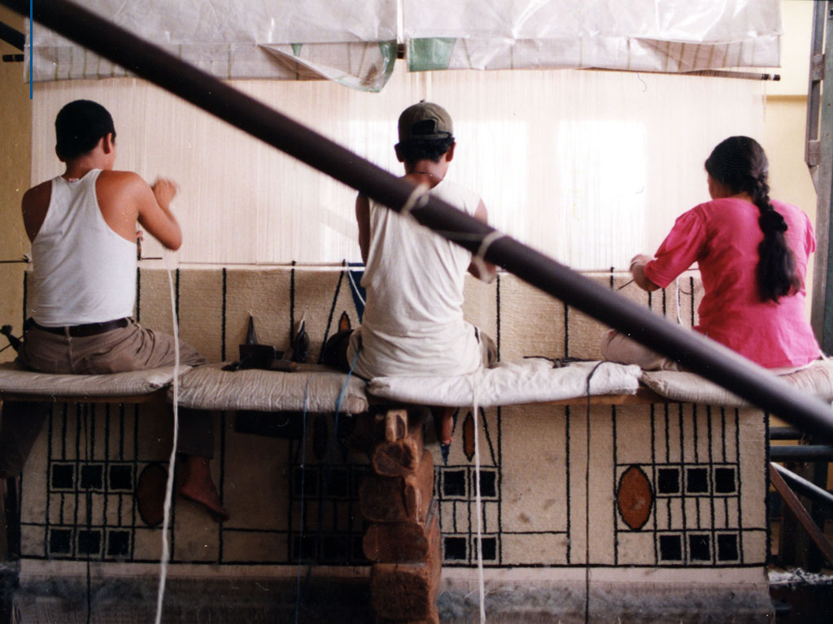
Towards a shared approach to living wage
A collaboration of six sustainability standards
© Marvin del Cid, Fairtrade Austria

Slide 15
Standard systems can do a lot…
By reaching many workers
And offering…
capacity building
requirements and guidance
auditing of compliance
monitoring and evaluation
outreach to stakeholders
… but they can’t solve wage issues alone
Photo © Robin Romano, Goodwave

Slide 16
Shared definition. Living wage is…
“The remuneration* received for a standard work week* by a worker in a particular place sufficient to afford a decent standard of living for the worker and her or his family.
Elements of a decent standard of living include food, water, housing, education, health care, transport, clothing, and other essential needs including provision for unexpected events. “

Slide 17
Methodology…
With Dr. Richard Anker and other experts

Slide 18
UTZ LW approach:
The proposed approach deploys the following elements:
Encouraging Negotiation and monitoring progress (Development of an agreed upon progress action plan with defined milestones and monitoring it)
Improving the bargaining position of workers (through the review of a wider range of workers related criteria including freedom of association, grievance criteria; documentation requirements etc.).
Avoiding the imposition of a single monetary value
Benchmarking Living Wage (to facilitate the negotiation process, we will identify a national benchmark for the living wage).

Slide 19
LW implementation - Auditing
Evaluate cash wage
Evaluate basic needs provided at farm level against critieria on: housing, food, water, transport, medical care
Evaluate both the cash & in kind (monitised) against a LW value.
Develop action plan with concrete improvement milestones (eg.: providing mobile clinics, % increase in cash wage; yearly wage adjustement to inflation; day care facility etc.).
In Kind (Housing - monitised)
In Kind (check compliance to characteristics)
Cash wage

