Slide 1
Identity and Belonging
Dr. Krisztina Lajosi
k.k.Lajosi@uva.nl
@KrisztinaLajosi

Slide 2
Discussion Points
Models for the seminal role of culture in nationalism
The “psychology” of nationalism and national identity
National typology and national identity in a historical perspective
Banal and everyday nationalism
The future of nationalism

Slide 3
Ernest Gellner’s model – Ruritania & Megalomania
Megalomania = empire (Gellner’s model fits the Habsburg Empire)
Ruritania = peripheries of the empire; mainly peasant population;
Megalomania oppressed the peasants
- Peasant grievances against hard social and economic conditions recorded in lament songs in Ruritania;
- Guerilla resistance led by a bandit;
- 19th-century intellectuals collect these songs;
- Bandit celebrated as hero of Ruritania;
- his deeds preserved in folk traditions & in high-brow literature and art;
- The grievances in songs concerned the conditions of the peasant; issues about cultural nationalism were not raised

Slide 4
From Megalomanian industrialization to Ruritanian independence
Megalomanian industrialization --»
labor migration from Ruritania to Megalomania;
- Ruritanian peasant boys destined for church educated in Megalomania became teachers, journalists, lawyers;
Ruritanian intellectuals influenced by Megalomanian liberalism agitate against discrimination of co-nationals & the alienation of peasants from their own native culture
Ruritanian independence as a result of international favorable conditions;
- Ruritanian borders, guardian state & high culture;

Slide 5
Cultural nationalism and identity
“In the old days it made no sense to ask whether the peasants loved their own culture: they took it for granted, like the air they breathed, and were not conscious of either.”
“In stable self-contained communities culture is often quite invisible, but when mobility and context-free communication come to be of the essence of social life, the culture in which one has been taught to communicate becomes the core of one’s identity.”
(Ernest Gellner: Nations and Nationalism, Oxford: Blackwell, 2003, 61.)

Slide 6
Who are “we”? – Robert Musil’s answer
Fragte man [...] einen Österreicher, was er sei, so konnte er natürlich nicht antworten: ich bin einer aus den im Reichsrate vertretenen Königreichen und Ländern, die es nicht gibt – und er zog es schon aus diesem Grunde vor, zu sagen: Ich bin ein Pole, Tscheche, Italiener, Friauler, Ladiner, Slowene, Kroate, Serbe, Slowake, Ruthene oder Wallache, und das war der sogenannte Nationalismus.
(Robert Musil, Der Mann ohne Eigenschaften, 1952, p. 462)
And so if one asked an Austrian what he was, obviously he couldn’t answer: “I’m from one of the non-existent kingdoms and lands represented in the Imperial Council.” So for this reason alone he preferred to say: I’m a Pole, a Czech, an Italian, a Friulian, a Ladin, a Slovene, a Croat, a Serbian, a Slovak, a Ruthenian, or a Wallachian, and that was the so-called nationalism.
(Robert Musil, The Man Without Qualities)
(The problem of “Kakania” = from “k.u.k,” “kaiserlich und königlich”.)
- Magnifying small differences

Slide 7
Miroslav Hroch’s model about the 3 phases of nationalism
Phase A
cultural activism
Phase B
political activism
Phase C
mass mobilization
Scholarly interest
Patriotic agitation
Mass diffusion of patriotism
- Culture remains an important element in all these phases

Slide 8
Psychology of Nationalism & National Identity
Nationalism understood as:
“the narcissism of small differences”
Sigmund Freud: Civilization and its Discontents (1929–30)
Social Identity Theory (Henri Tajfel, 1980s)
- in-group favoritism & out-group discrimination
- stereotyping is a cognitive process
Category Differentiation Theory
– cognitive framing strengthens in-group identity
– you feel more similar to your own group members, which exacerbates differences with members of the out-group
--» intragroup homogenized and intergroup differentiation

Slide 9
Divisiveness & Unification
“Divisiveness is an ideological position and it can magnify minor differences; indeed, it can manufacture differences in language as in other matters almost as easily as it can capitalize on more obvious differences. Similarly, unification is also an ideologized position and it can minimize seemingly major differences or ignore them entirely, whether these be in the realm of languages, religion, culture, race, or any other basis of differentiation.”
(Joshua Fishman, “Nationality-nationalism and nation-nationalism,” in Fishman et al., eds., Language Problems in Developing Countries, New York: Wiley, 1968, p. 45.)

Slide 10
Ethnic identity --» nationality --» nation
Ethnic group = tradition-bound
Nationality = socio-cultural entity
Nation = politico-geographic entity
“This process of transformation from fragmentary and tradition-bound ethnicity to unifying and ideologized nationality may well be called nationalism.”
(Joshua Fishman, “Nationality-nationalism and nation-nationalism,” in Fishman et al., eds., Language Problems in Developing Countries, New York: Wiley, 1968, p. 3. https://files.eric.ed.gov/fulltext/ED055470.pdf )

Slide 11
National character
Early-modern Europe
- Julius Caesar Scaliger – classification of national differences
- national temperaments and personality-attributes - every nation has its own national character
18th century
- J. G. Herder – culture became an anthropological category
- celebration of difference (linguistic and cultural)
- national culture - nations defined by culture
- against the uniformization of humans in the Enlightenment
19th century
- J. G. Fichte and G. W. F. Hegel - Volksgeist
- inner spirit of the nation
20th century
- ethnic stereotypes regarded not as inherent or “real”, but as constructions

Slide 12
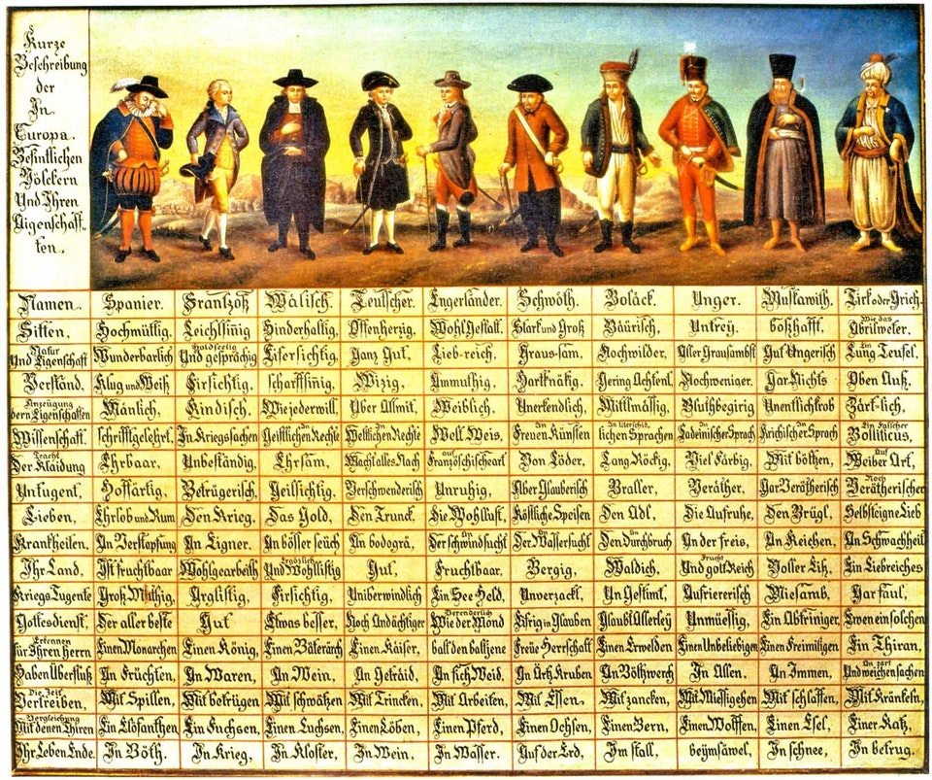
Völkertafel comparative matrices popular in the 17th and 18th centuries

Slide 13
From types to character
Aristotle: Poetics – connection between plotline and character (heroic deeds by heroes)
Neo-Classicist (Neo-Aristotelian) theater – vraisemblance (the playwright has to use the unity of time, place, and plot, and rely on types – always the same – to have convincing effect)
Jules de La Mesnardière (1640) – Poétique – characters in a play should be typified according to their function in the plot and matching ethnic and social attributes (Germans are proverbially dull and boorish; a German character in a play should always be shown as such)
typicality effect – ambiguity: individual conforming to the type, individual selected according to the type; maximizing salient aspects;
the word ”character” – whether personal or national – became popular in the 17th century through the theater

Slide 14
Character as a personality blueprint, as motivating essence for behavior
You ARE like this
You ACT like that
- National character - systematization in 18th-century encyclopedias and philosophical treatises

Slide 15
Natural determinism versus Social and Cultural constructivism
Nature
(climate)
Montesquieu
Nurture
(culture & society)
Hume

Slide 16
Stereotyping
stereotypes
(pictures in our head)
valorizing the Other
selective value judgement
Partial representation for the whole
Preconditioned by
cognitive frames &
codified mental images
One’s own
point of view

Slide 17
Images, national stereotypes
“Literary – and, more particularly, comparatist – imagology studies the origin and function of characteristics of other countries and peoples, as expressed textually, particularly in the way in which they are presented in works of literature, plays, poems, travel books and essays.”
(Manfred Beller/Joep Leerssen: Imagology, Amsterdam: Rodopi, 2007, 7.)
Tradition of topoi (common places, clichés) concerning the characteristics of peoples and places
Daniel-Henri Pageaux – “l’imagerie culturelle” (1983)
Historical changeability & perspectival situatedness of these images
Stereotypes combine minimal information with maximal meaning
(Stanzel: Europäer: Ein imagologischer Essay, Heidelberg, 1997, 12.)

Slide 18
Images, Imagined Communities, and Nationalism
Joep Leerssen (University of Amsterdam) – studying the political instrumentalization of national images of the self and the other
The origin, function of stereotypes --» make people rationally aware of them, but it does not take away their affective edge
Cognitive
dimension
Affective
aspect
stereotypes

Slide 19
Imagology as a method
Imagology is a theory of cultural and national stereotypes and not a theory of national identity.
images ≠ national identities
images --» constitute possible identifications
imagology studies the traditions of tropes and the historical appreciation and depreciation of images

Slide 20
Discursive representations of nationalities
spected
(nationality represented)
spectant
(representing text or discourse)
hetero-images
(images of the Other)
auto-images
(images of the self)

Slide 21
Imaginated = based on images
“France is a republic.” = not imaginated statement
“The French are freedom-loving individuals.” = imaginated statement
Typical national feature
Moral,
collective-psychological motivation
Imaginated discourse

Slide 22
National identity = cognitive + emotional
“national identity is a conceptual chimera not worthy of serious analytical pursuit. It is a concept that is theoretically vapid while also lacking clear empirical referents.”
(Siniša Malešević: Nation-States and Nationalisms, Cambridge: Polity, 2013, 155.)
the fact that it is highly valued does not make it true
always contingent on the larger historical, economic, social contexts

Slide 23
Collective identity
Identity politics

Slide 24
Belonging
Identity = belonging + exclusion
belonging by choice & belonging by coercion or by assignment (born into)
individuality emphasizes difference & collective identity stresses similarity
Belonging by choice
- empowering
- active engagement
- constricting, “overriding identity” --» no choice
Assigned belonging
- determining
- passive acceptance
- freedom within constraints

Slide 25
Conditions of national belonging territory and/or kinship
Reciprocal commitment – state for citizens, citizens for the state;
Familiarity – feeling at home; the individual is recognized as “one of us”;
Homeland – distinct territory and landscape;
Trust – distinction between whom to trust and whom not to trust;
Membership vs. strangers – reassuring emotional warmth and a sense of protection
Shared values - re-cognition as a member of the group, solidarity
(Montserrat Guibernau: Belonging: Solidarity and Division in Modern Societies, Cambridge: Polity, 2013.)

Slide 26
Belonging and National Identity
national identity = “a collective sentiment based upon the belief of belonging to the same nation and sharing most of the attributes that make it distinct from other nations”
(Montserrat Guibernau: Belonging: Solidarity and Division in Modern Societies, Cambridge: Polity, 2013.)
national identity = citizens of a nation-state
outliers – nations within the boundaries of other nation-states
belief in common culture, language, kinship, history, territory, founding moment, and destiny – strong element of national identity
Strong image of nationhood, dissemination of symbols, education, media, legal rights and duties, creation of common enemies

Slide 27
Banal nationalism
Nationalism as “endemic condition,” according to Michael Billig
“our” identity is constantly flagged discursively; we are constantly reminded of our national identity;
Daily deixis of the nation – “this,” “here”, “our country”;
“Nationhood is near the surface of contemporary life”
small, prosaic, routine words, “rather than grand memorable phrases, offer constant, but barely conscious reminders of the homeland”
“The spread of democracy, far from eradicating nationalism, consolidates its banal, but not necessarily benign, form.”
(Michael Billig: Banal Nationalism, London: Sage, 1995, 93-94.)

Slide 28
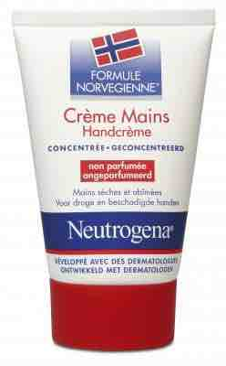

Slide 29
Banal nationalism & Everyday nationalism
banal nationalism
(discourse, system)
everyday nationalism
(human agents)

Slide 30
Everyday nationalism and official nationalism
“banal nationalism” versus “nationalism on steroids” (Jon E. Fox)
“taken-for-granted everyday nationhood” visible when well-known order is disturbed
everyday nationalism
visible at the “edges”
spatial
(at borders)
political
(immigration)
temporal
(children, before socialized as national citizens)

Slide 31
The end of nationalism?
Many postmodern thinkers have predicted the end of nations and nationalism
Zygmunt Bauman – “Exit the nation-state, enter the tribe.”
(Z. Bauman: Postmodern Ethics. London: Routledge, 1993, 141.)
- “Nation-building coupled with patriotic mobilization has ceased to be the principal instrument of social integration and states’ self-assertion.”
(Z. Bauman: Society under Siege, Cambridge: Polity, 2002, 84.)
Ulrich Beck – “We live in a world where the the cosmopolitan project contradicts and replaces the nation-state project.” (Ulrich Beck: “The Cosmopolitan Perspective: Sociology of the second age of modernity,” in the British Journal of Sociology 51/1, 79-105, 85.)
Stuart Hall and David Held – “everywhere the nation-state is eroded and challenged” […] “the rise of regional and local nationalisms’ are beginning to erode it from below.”
(S. Hall and D. Held: “Citizens and Citizenship”, In. S. Hall and M. Jacques (eds.), New Times, London: Lawrence and Wishart, 1989, 183.)

Slide 32
Bureaucratic coercion and nationalism
We live in a world divided into nations;
National sentiments have become stronger, not weaker in the past few decades;
Nation-states have more administrative control over their citizens;
Surveillance of borders and control of population has become more sophisticated;
The “banal discourse” about immigration almost always takes place within the nationalist frame.

Slide 33
Capitalism, globalization, religion as antidotes to nationalism?
CAPITALISM
Capitalism and nation-state building went hand in hand;
Consumerism reinforces nationalism (for example the new affluent middle-class in China is more nationalistic);
GLOBALIZATION
Globalization does not result in more homogeneous global, cosmopolitan societies;
it has made nation-states more diverse, communities more heterogeneous. «-- nationalist reaction
Lack of convincing global narrative;
RELIGION
Religious revivals have also strengthened nationalism;

Slide 34
Ideological penetration of nationalism
“Unlike any other ideology, nationalism when successful is capable of tapping into our everyday micro-universes”
“although nation-states are coercive bureaucratic organizations, they are also considered by their own citizens as the most legitimate form of rule. No other polity in history could claim that level of popular legitimacy.”
“in the era of nation-state, not being national is hardly an option any more”
(Siniša Malešević: Nation-States and Nationalisms, Cambridge: Polity, 2013, 197.)

Slide 35
The Internet and Nationalism
more than 4 billion people are connected to the internet (half of the world’s population) - https://www.internetworldstats.com/stats.htm
nations thrive in cyberspace
deterritorialization of nations on the Internet (mass media in a transnational age of information technology)
we create our digital identities, but identity is also created for us
we are being reconfigured as citizens
algorithmic national identities – are we all data?
check out: http://citizen-ex.com/citizenship
information bubbles, echo chambers & national identities
long-distance nationalism in the digital age

Slide 36
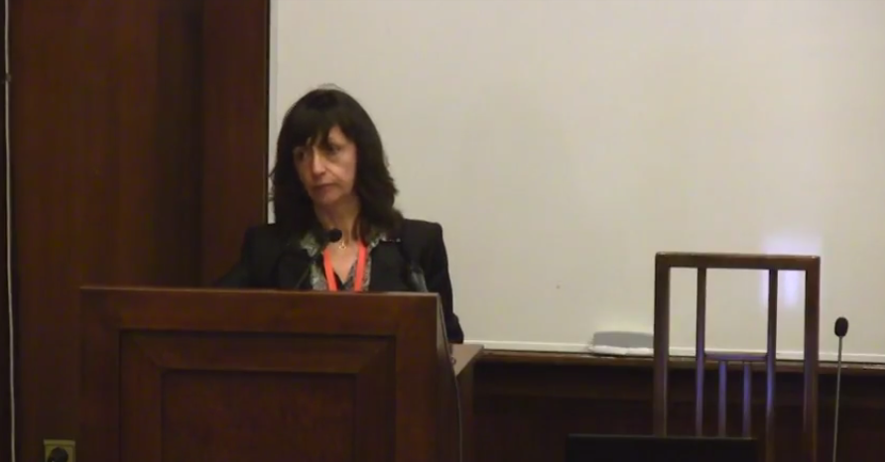
A video with Montserrat Guibernau, the author of the book Belonging: Solidarity and Division in Modern Societies, Cambridge: Polity, 2013.
https://www.youtube.com/watch?v=N5fSaEB8IAo

Slide 37
Thank you!
Any questions?

