Slide 1
Is China a threat or a partner? Based on my book The New presence of China in Africa, Amsterdam: University Press
Presentation for SKOV Study circle for Development issues
Meine Pieter van Dijk em. Professor at IHS & ISS of Erasmus University Rotterdam, Wageningen 20-6-2019

Slide 2
The issue is the trade war between China and the US, which is a fight for supremacy!
It is about technology and innovation
Tariffs are just the stick to beat the dog
China is speeding up the development of its own chip industry
According to the IMF the economic growth in the world will be -0.5% lower
Chinese growth may be one percent lower
US families pay 833$ extra per year (WSJ, 2019)

Slide 3
The US started in 2019 a trade war with China
The US imports five times more than they export to China
In 2017 the monthly trade balance deficit was more than 30 billion $
That is not sustainable!
US also complains about obligatory technology transfer
The trigger for Trump was the Chinese plan ‘Manufacturing 2025’, which aimed at making China leading in the following sectors:
Dalian, old industries

Slide 4
The CM2025 initiative includes the following ten key sectors for special attention:
• Next generation IT
• High-end numerical control machinery and robotics
• Aerospace and aviation equipment
• Maritime engineering &high-tech maritime vessel manufacturing
• Advanced rail equipment
• Energy-saving vehicles and NEVs
• Electrical equipment
• Agricultural machinery&equipment
• New materials & Biopharmaceu-ticals & high-performance medical devices

Slide 5
10 key policy tools that China’s central and local governments are using in their pursuit of goals related to CM2025 are as follows:
1. Forced technology transfers in exchange for market access
2. Market access and government procurement restrictions for FIEs
3. Standards & 4. Subsidies
5. Financial policy 6. Government backed investment funds
7. Support from local government
8. Technology-seeking investments abroad
9. SOEs: mergers and politicisation
10. Public-private partnerships

Slide 6
China’s foreign trade, according to my book, already 100 billion $ in 2008 in Africa
Increased exports from China to the Arab world (plus 28% hitting 244.3 billion $ in 2018)
The EU now has a trade deficit of €185 billion with China, last year alone the China made up 20% of the EU's imports. It was also the EU's second largest export partner, behind the US
US imported in 2017 for 505 & exported only 129 billion $ to China
Dalian coast & skyline

Slide 7
Implications of the trade war between the US and China: a lower predicted economic growth!
China tries to make the transition from an export ortiented economy to producing for the local market
When economic growth faltered in China early 2019 the Chinese blamed the trade war with US
To stimulate the economy no more increased government spending (given the 300% of GDP total debt), but lower taxes, monetary policies to stimulate lending, reduction of taxes & deregulation for the business sector

Slide 8
China produced or assembled:
• 28% of the world’s automobiles
• 41% of the world’s ships
• 80%+ of world’s computers
• 90%+ of world’s mobile phones
• 60% of the world’s colour TV sets
• 50%+ of the world’s refrigerators
• 80% of the world’s air-conditioners
• 24% of the world’s power and
• Half of the world’s steel

Slide 9
Consequences for the US
Trottoirettes in Dalian
Average household spends almost 1000$ per year more
Jobs are not coming back, maybe robots
Imports are now coming from other countries: Mexico & Vietnam f.ex.!
Companies reflect on the length of their value chains
Investerments are delayed & stock exchanges have become very sensitive to the latest news

Slide 10
Threatening with tariffs durin the trade war:
The US on 3-4 on 46 billion
China on 4-4 on 50 billion $
US on 5-4 100 billion $ China
US on 15-6 50 billion $
China op 16-6 50 billion $
De VS op 18-6 200 billion
China op 12-7 60 billion $
De VS in Aug. on 200 billion $
De VS on in total 267 billion $ if China does not react

Slide 11
Normal solutions:
Devalue $ Revalue RMB, or for the US
Export promotion in the US
Bi- or multilateral negotiations
Voluntary restrictions, but
Trump opted for tariffs, but (FT 14-6-19: 8) ‘’Trump’s abusive trade powers need reining in’’ (Congress should pursue plans to curb presidential tariff discretion)

Slide 12
Why Trump is not getting it
Importing firms go to Vietnam and Mexico
China moves production elsewhere (for example to Belt & Road countries: The New Silk road Initiative)
The VS doesnot have the capacity to produce these goods at home
New factories use robots, which does not bring the employment back!

Slide 13
Conclusions: open fires!
Trade war,like Brexit, is a big risk for the world economy
Investors and companies get very nervous
Trump has been punished in the elections in November 2018,where the republicans lost the majority
Negotiations were almost successful, but the Americans overplayed their hand
Trump is not diplomatic, nor predictable according to the Chinese

Slide 14
Broader issue: China, The new rival of the west, Looking the Chinese in the eyes while jogging
Possible title of a book on which l am working, or:
China a new super power, but a friendly one?
The underlying question is: is China threatening, for:
1. Its own people, with all the cameras & face recognition software
2. For countries participating in the New Silk road initiative & getting heavily indebted?

Slide 15
The New Silkroad, China’s ambitions
Started already:
The Yuxinou International Railway that runs from China to Duisberg started
Trains are transporting laptop computers, shoes, clothes and other non-perishable goods in one direction, and electronic goods, medical equipment and car parts
NZR kost 900 miljard dollar & betreft meer dan 100 landen, waarvan 23 met zware schulden aan China!

Slide 16
China uses unconventional means to become a superpower:
It claims land along the railroad:
To build Chinese factories
Investing under conditions dictated by the Chinese
Favourable export under the agreements of the country (Lome for the EU and AGOA for the US)
Usig local cheap labor
Transporting the goods with Chinese trains

Slide 17
A threat to its own population
The individual Chinese citizen does not count
Chinese authorities are not accountable to democratic elected institutions
No NGO sector
No independent judicairy
No independent trade unions
No free press, radio or television
The Chinese government has put cameras everywhere
Software recognizes your face
It is a police state, or given the role of information technology, an Orwellian state
Sponge city Zhuanghe

Slide 18
China threatening abroad?
Beijing
In the South China sea China is at odds with Vietnam and the Philippines
Countries on the new Silk road suffer from their debts
No respect for fundamental human rights, taking people from Hongkong to the mainland without a legal basis
System will not survive since people want their freedom, once they reached a certain level of welfare and want to participate in decisino making
There are more example sin my book about China’s new presence abroad

Slide 19
The rapid Chinese expansion in Sub-Saharan Africa
My book the New presence of China in Africa
In 2009 already the biggest trading partner in Africa
Also investing and using development aid to foster relations
1 million Chinese living in Africa
New strategy: exporting from Africa to EU (Lome convention) & US (AGOA)
Black swan in Beijing summer palace

Slide 20
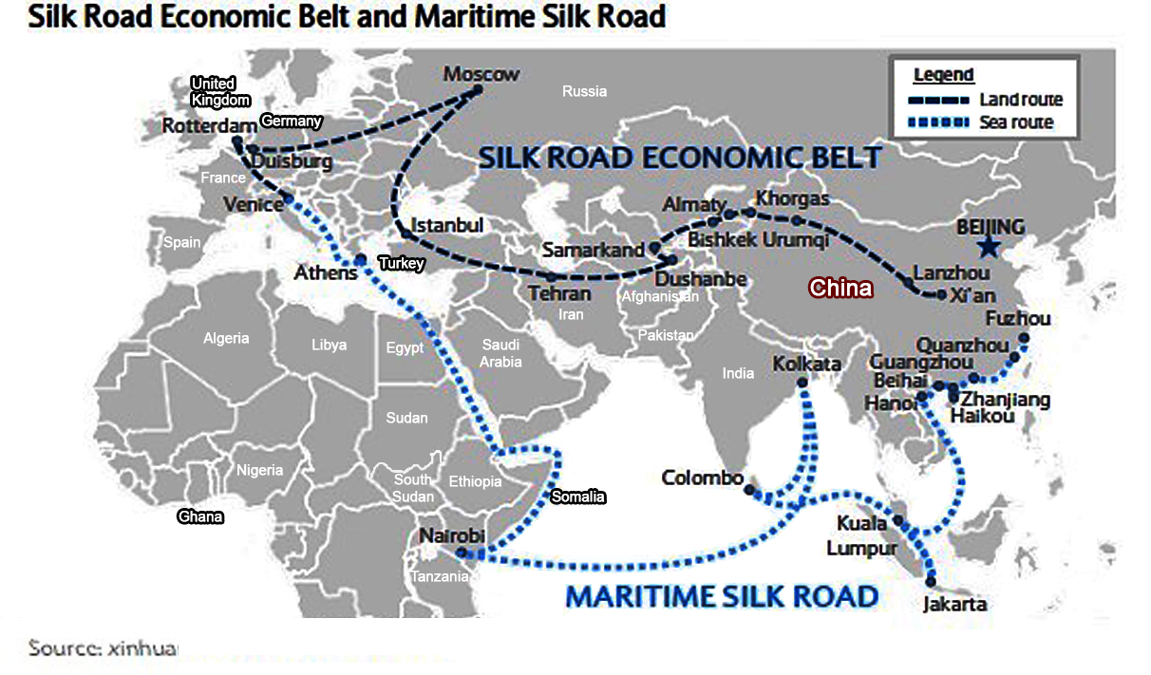
Nieuwe Zijderoute, The new Silk road, of het One Belt, One Road, of het Belt & Road Initiative (BRI)
5 January
Meine Pieter van Dijk, Heemsteedse Roei en zeilvereniging, 15-11-2018

Slide 21
China ran into problems in different African countries
Some cases of exploitation (Chinese mining in Congo)
Some countries are not able to repay their debts (for example Zimbabwe),
Some do not want the Chinese traders (Zambia, Malawi and Algeria)
Some called China's new presence ‘neo-colonial ‘ (the former South African president Mbeki)
Labour unrest in Ethiopian Chinese ‘friendship’ zones

Slide 22
conclusions
China versus the US: no trade war, but a fight for supremacy!
Big changes expected in China
Africa should try to take advantage of the opportunity
This require a common point of developed by the African Union (AU)
Cartoon NRC 16-06-2019

Slide 23
Questions or comments

Slide 24
Beijing

Slide 25
Beijing

Slide 26
Beijing

Slide 27
Beijing summer palace

Slide 28
Beijing

Slide 29
Beijing summer palace

Slide 30
Beijing summer palace 25.000 bezoekers per dag

