Slide 1
Global Navigation Satellite System
G N S S
WEB-simulation

Slide 2
Global Navigation Satellite System
Schedule Philip Wenting
Short explanation
Equipment, old and new
Demonstration outside ?
Questions? Please interrupt and ask!

Slide 3
Global Navigation Satellite System
Terminology
is
changing ! No longer GPS but GNSS

Slide 4
Global Navigation Satellite System
Now active
GPS USA Global Positioning System
GLONASS Russia GLObal'naya NAvigatsionnaya Sputnikovaya Sistema

Slide 5
Global Navigation Satellite System
Future
Compass ( Beidou-2 ) China (Ursa Maior)
Galileo Europe

Slide 6
Global Navigation Satellite System
Regional
IRNSS India Indian Regional Navigational Satellite System
Beidou-1 China
Doris France Doppler Orbitography and Radiopositioning Integrated by Satellite
QZSS Japan Quasi-Zenith Satellite System

Slide 7
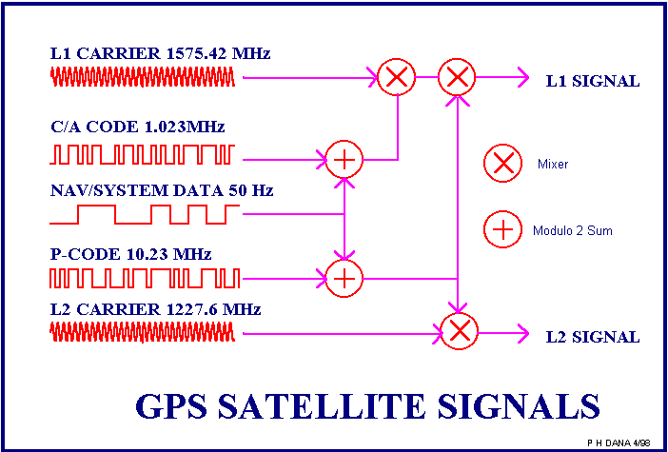
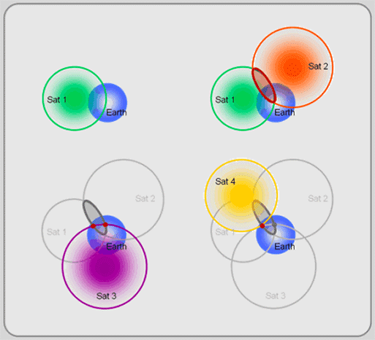
Global Navigation Satellite System
Technical information
A satellite is a radio transmitter
Distance to earth: 20200 km.
Frequency and Wave length ( ± 20 cm.)
With 28 satellites always 4 “visible”,
and why 4?

Slide 8
Global Navigation Satellite System
Positions directly calculated from Satellite data are always wrong !
Why ?

Slide 9
Global Navigation Satellite System
Accuracy
Standard up to 10 metres
Differential up to 1 metre
RTK few cm
And almost everything in between, depending on the budget !
More money >> higher accuracy.

Slide 10
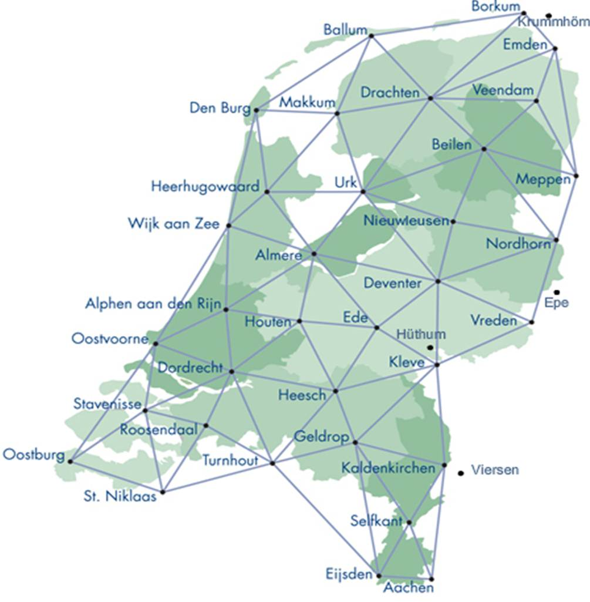
Global Navigation Satellite System
Better results
Averaging
Correction from a geostationary satellite WAAS (Wide Area Augmentation System) EGNOS (European Geostationary Navigation Overlay Service)
Radio beacon (Long distance)
Base station (Short distance) Real position on a known point Virtual ( 06-GPS-Netwerk )

Slide 11
Global Navigation Satellite System
Where to find more information?
Everywhere on the WWW, search for GNSS on
Google or
Wikipedia

Slide 12
Global Navigation Satellite System
When GNSS is not possible: use other landsurveying techniques and/or equipment !

Slide 13
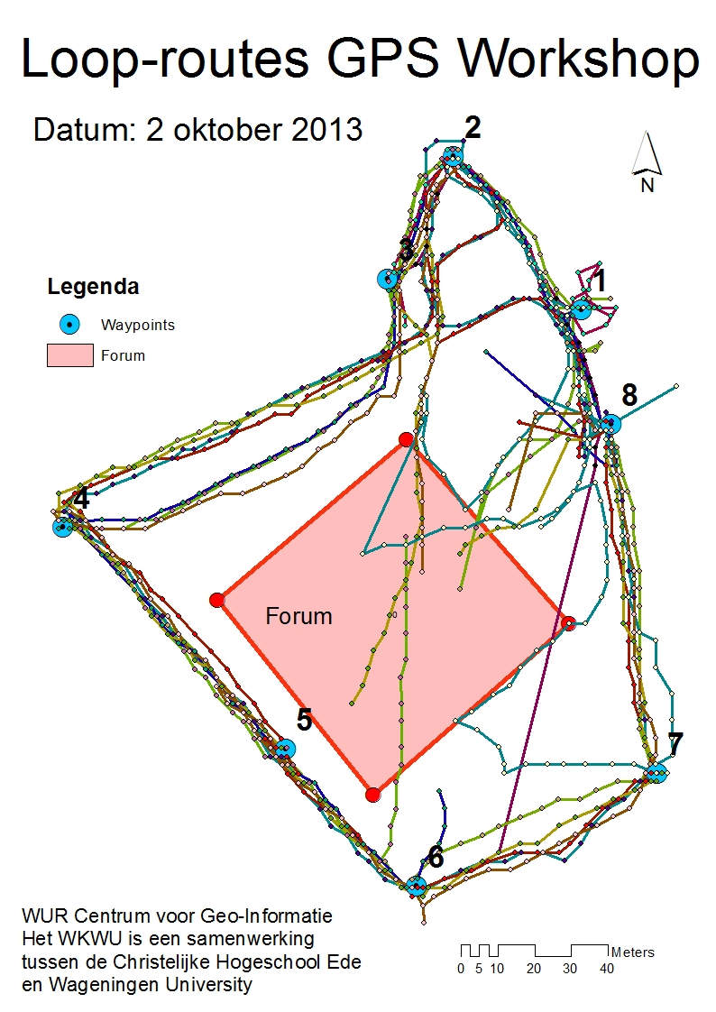
Global Navigation Satellite System
Routes outside Forum
Made with Garmin’s
On 2 october 2013
Click

Slide 14
Global Navigation Satellite System
Thank you for your attention. Please remind : No longer GPS but GNSS !

