Slide 1
Trusting at a distance; Consumer trust, food safety and global food supply
Peter Oosterveer
Environmental Policy Group
Wageningen University
29 August, 2013

Slide 2
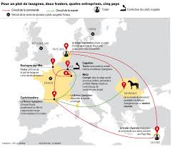
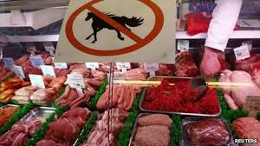
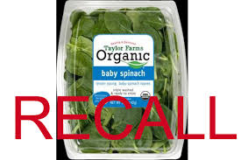
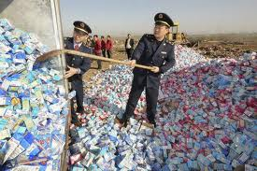
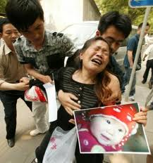
Food scandals a continuing story

Slide 3
Outline
food safety and consumer trust
based on a research proposal for food safety research in China
elaborate the notion of multiple ‘trust-in-food’ regimes linking different social practices
discuss different trust regimes and arrangements
conclusions

Slide 4
Food, trust and crisis
many consider food safety problems the consequence of contemporary food supply system which is globalised and industrialised => ‘people don’t know anymore where their food is coming from’
response: closing the gap between food producer and consumer to restore their trust in food

Slide 5
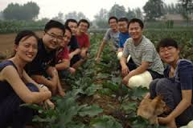
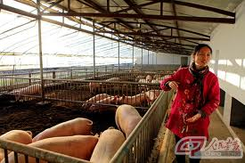
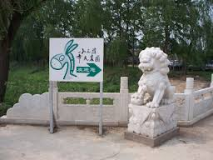
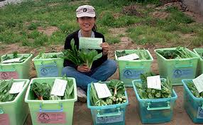
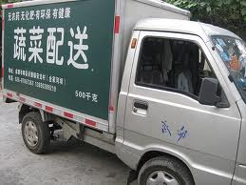
Little donkey farm, Beijing

Slide 6
Trust
trust is an input and output of everyday social interactions when dealing with uncertainty and risk
people generally act ‘as if trust were in place’ (Misztal)
forms of trust (Giddens):
personalised: face-to-face interactions
institutionalised: abstract institutions

Slide 7
Trust in food
essential because of uncertainty
means trusting suppliers of food => a social and not individual definition
personalised trust through face-to-face interactions between producer and consumer
institutionalised trust based on formal arrangements, enacted through interactions

Slide 8
Trust in food in global modernity
globalisation, technological and scientific development means that relying on institutionalised trust is inevitable for most consumers and most food items
multiple arrangements of institutionalised trust are possible
=> different trust regimes

Slide 9
Trust-in-food regimes
Sassatelli & Scott: relatively stable sets of definitions and institutional approaches to food safety
a particular set of connected institutionalised social practices:
government-based
market-based
civil society-based
all combine governments, markets and civil society (in different ways)

Slide 10
Government-based trust in food regime
classical food safety inspections introduced in 19th century
trust is built through legitimacy of governments protecting public interests, legal system, science
key social practices:
preparing and implementing policies
inspections of food processors and retailers
testing in laboratories

Slide 11
Market-based trust regime
introduced in context of globalisation and neo-liberalism
trust is built through CSR and reputational capital, threat of legal prosecution
key social practices:
developing and introducing (chain) food safety management systems by (collaborating) private companies
auditing of farmers and processors
Notes:
Cf. GlobalG.A.P.

Slide 12
Civil society-based trust regimes
introduced by NGOs to address emerging consumer concerns
trust is built on existing trust in civil society organisations, high levels of transparency, past performance
key social practices:
determining standards by leading NGO
certifying producers by auditors
communicating objectives and results via public media and Internet

Slide 13
Conclusions
contemporary food provision requires institutionalised trust in food
multiple arrangements are possible => three food regimes
all food regimes combine state, market and civil society
all are embedded in specific connected social practices
shift to broader issues and increased consumer involvement => future?

Slide 14
And discussion
future probably allows for further active involvement of consumers through ICT facilitating more transparency => more diversity in consumer concerns/demands
increased transparency means more public debate of safety and sustainability of particular food items incl. production => challenging role scientists
how to involve unconnected citizens? who risk to be ignored?

Slide 15
Thank you for your attention

