Slide 1
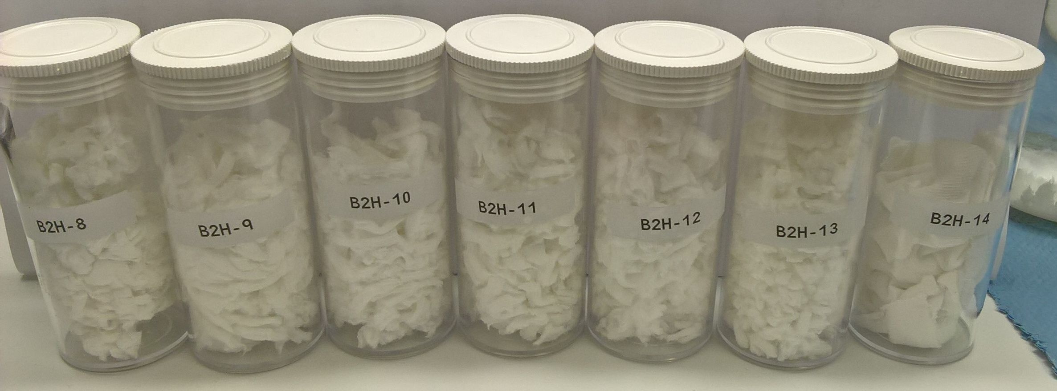
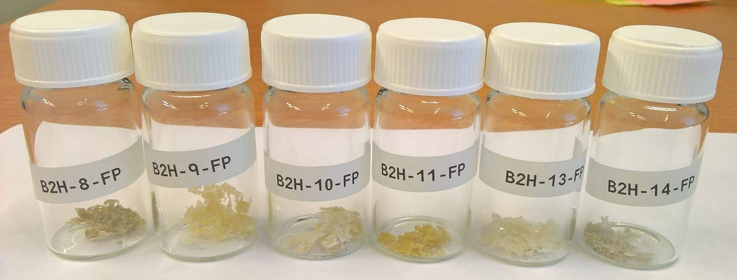
Wastexcel / Bio2HighTex Recycling of cellulose from mixed textiles Project KB34-3A-2
Martien van den Oever, Jan van Dam, Paulien Harmsen, Christiaan Bolck (WFBR)
Background
Results
Textile consumption is huge and growing. Since the year 2000, the amount of textile items sold worldwide have more than doubled. After use, the far major part is incinerated and landfilled, only a small fraction is recycled. To a certain extent, the low recycling rate relates to the composition of many textiles, which often contain different types of fibres: cotton, polyester (PET), elastane, etc. Recycling of so called mono materials like pure cotton is possible today, however, separation and recycling of mixed textiles is a challenge. A Scandinavian patent addresses separation of cotton and PET. Since a large fraction of textiles contain elastane, a technology for extraction of elastane would mean an important step for recycling of textiles.
Traditionally, the Netherlands has had a strong textile sector. This has largely disappeared to low-wage countries. Development of new recycling technologies can boost textile industry in the Netherlands again.
Over 99% of elastane present in the mixed textiles could be extracted. Following element analysis, the recovered cotton contained less than 0.05% of residual elastane.
Depending on the residual length of the cotton fibre, it could be used to blend in recycled cotton yarn. Or it could be used as feedstock for the production of regenerated cellulose (viscose, lyocell).
Objective
The development of a technology to extract elastane from mixed textiles containing cotton as the main constituent.
Patent application has been filed.
Search for collaboration with potential customers for the technology.
Figure 2. SEM images of mixed cotton/elastane textile fabric. Left: Yarns of cotton fibre at
outside. Right: Cross section showing elastane roving (thick fibre) knitted with
cotton yarn.
Activities
Value creation
A consumer textile product containing 95% of cotton and 5% of elastane, intimately blended, was subjected to several series of lab scale extraction trials using different solvents and process conditions. Both recovered cotton and extracted elastane have been analysed for quality and purity.
The Netherlands, as well as Europe, wish to shift to a more circular and climate neutral economy. Separation and recycling of materials and products play an important role in this, especially in the textile sector with many product consisting of mixed materials. Elastane is regarded as a contaminant, making recycling difficult. The technology developed in this project could contribute to recycling options for elastane containing post-consumer textiles. A patent application has been submitted to protect the knowledge.
Based on the knowledge developed, meetings with several parties in the textile sector have been organised to discuss and review possibilities for establishing joint R&D projects to further develop the technology.
New project(s) on recycling of post-consumer textiles are being set up at the moment.
Acknowledgements
This work has been partly funded by the European Fund for Regional Development (EFRO) Oost-Nederland, Overijssel & Gelderland.
Figure 1. Recovered cotton (top) and extracted elastane (bottom) after extraction trials using
different solvents and/or conditions.
Wageningen University & Research
P.O. Box 123, 6700 AB Wageningen
Contact: martien.vandenoever@wur.nl
T + 31 (0)317 48 01 05
https://www.wur.nl/nl/project/Bio2HighTexWastexcel-nieuwe-oplossingen-voor-de-textielketen.htm

